Slide 1

The Trust Lens:
A Practical Framework for Better Work and Better Customer Experiences
Dr. Wendy Fraser
Notes:
Learning Objectives:
1. Recognize the five interconnected areas of the Trust Behaviors Framework and how behaviors within them can strengthen or erode trust, working relationships, and customer experiences.
2. Diagnose workplace challenges using the Trust Behaviors Framework to look beyond visible symptoms and identify potential underlying issues related to purpose, roles, core processes, communication, and interpersonal dynamics.
3. Apply the Trust Lens to their own work by identifying a trust-related strength or opportunity and selecting specific actions they can take to strengthen collaboration, effectiveness, and the customer experience.
Trust shapes how we work together—and ultimately how we serve others. When trust is strong, people are better able to collaborate, communicate, solve problems, navigate differences, and create positive experiences for others. But when something isn't working, how do we know what is really getting in the way?
In this interactive session, Dr. Wendy Fraser introduces her research-based Trust Behaviors Framework, a practical lens for understanding the behaviors and organizational conditions that strengthen—or erode—trust. Grounded in research and refined through years of work with teams and organizations, the framework explores five interconnected areas: purpose, roles, core processes, communication, and interpersonal dynamics.
Participants won't just learn about the framework—they'll use it. Through reflection and hands-on diagnostic activities, participants will apply the Trust Lens to a workplace situation and explore their own work environment, identifying where trust is strong, where challenges may originate, and what actions could make a difference. They'll leave with a practical tool they can use to strengthen working relationships, improve how work gets done, and contribute to better customer experiences.
Wendy Fraser, Ph.D. has spent her career asking a deceptively simple question: what does it take to rebuild trust once it’s been broken? In Trust Repair: It IS Possible!, she brings that question to life through research, experience, and deeply human insight.
With more than 30 years in leadership and organizational development, Fraser has worked with organizations across sectors, helping people navigate conflict, repair relationships, and rediscover what makes collaboration possible. Her work—grounded in doctoral research and shaped by real-world practice—offers both hope and practical tools in a time when trust can feel increasingly fragile.
A speaker, consultant, and educator, Fraser is known for her engaging style and her belief in the collective wisdom of people. She lives in Olympia, Washington, where she continues to explore the transformative power of trust.

Slide 2
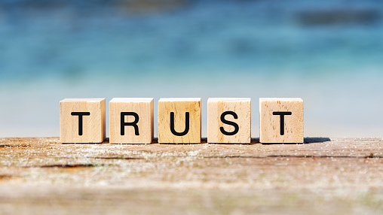
Discussion: what does trust mean to you
Notes:
What does trust mean to you?

Slide 3
Working Definition of Trust
Trust is a belief in the character, ability, reliability, and intentions of others and the willingness to risk vulnerability with them.
© Wendy Fraser, PhD
Notes:
Oxford Dictionary description – variation: I added concepts of vulnerability and willingness to risk

Slide 4


Your Turn: think about a negative cx
Your Turn
Notes:
Think about an experience that didn’t go so well…
Interacting with customers through your job
As a customer yourself
As a team member at work
Leading a project or a team
We’re going to explore how to diagnose it and open up options on what to do about it

Slide 5
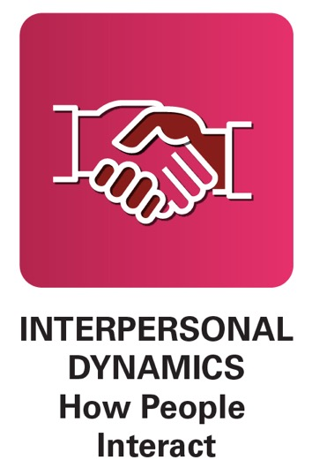
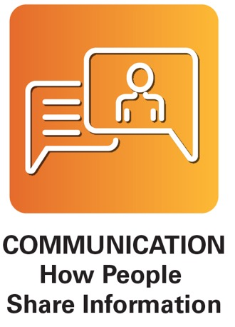
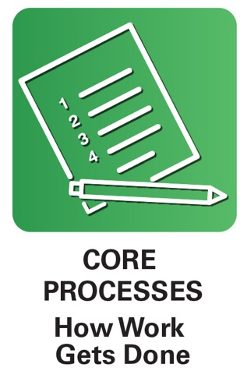
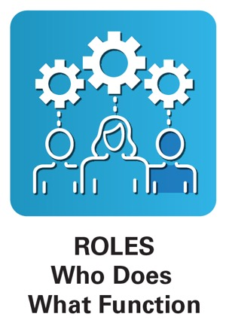

Trust Behaviors
Trust Behaviors
Behaviors that affect relationships in groups
© Wendy Fraser, PhD

Slide 6
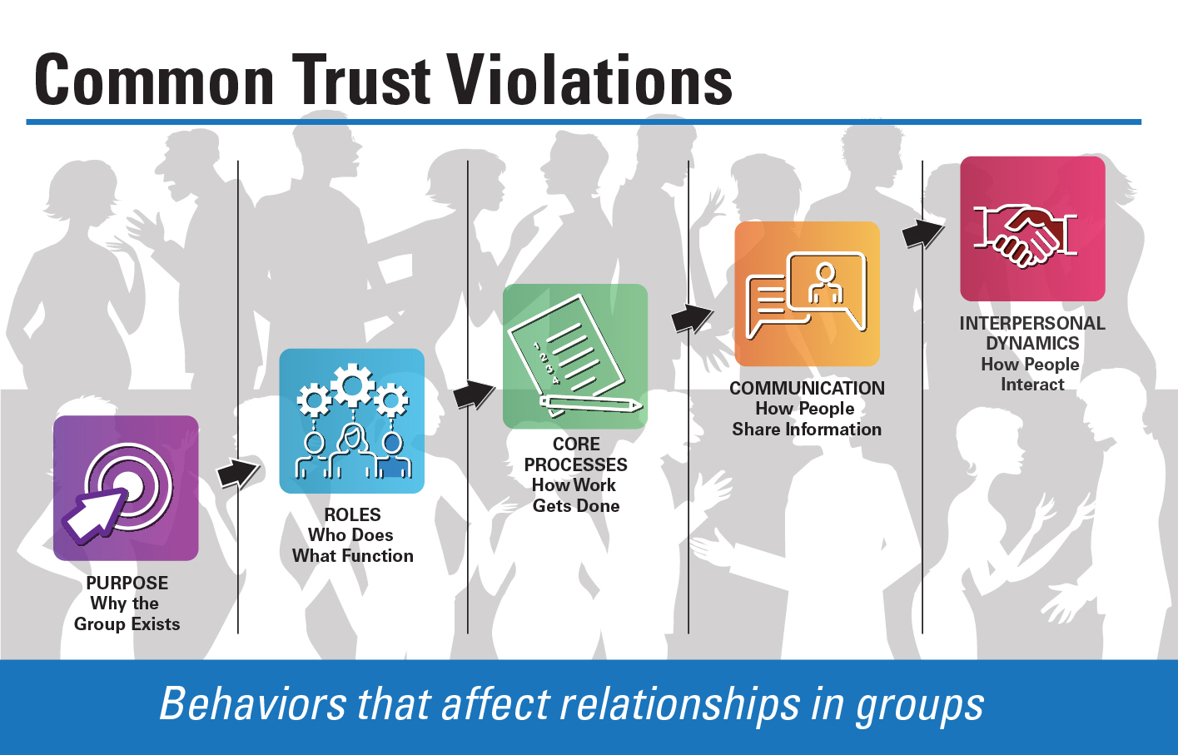
Common Trust Violations
89%
18%
36%
61%
75%
© Wendy Fraser, PhD

Slide 7


Trust Behaviors: Purpose
Trust Behaviors: Purpose
Align people,
systems, and resources for success
Determine purpose, direction, scope, priorities, and boundaries

Slide 8

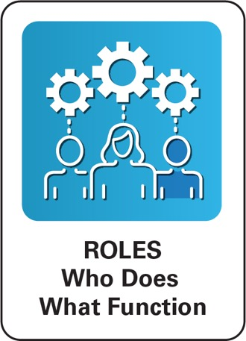
Trust Behaviors: Roles
Trust Behaviors: Roles
Establish clear roles and
responsibilities; mutual expectations; and accountability
Set-Up people for success; delegate well; and create support systems
Honor agreements, commitments, and confidentiality

Slide 9

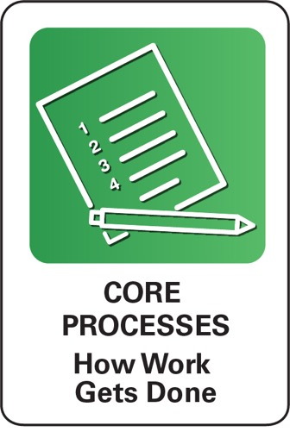
Trust Behaviors: Core Processes
Trust Behaviors: Core Processes
Improve operations, relationships, and results; be open to new ways of doing things
Ensure consistency, reliability, and responsiveness
Engage people; broaden decision-making; ask for input

Slide 10
Your turn: apply structural phases to cx example
Your Turn
Notes:
Think again about your scenario. What parts of these “structural” phases contributed to your situation?

Slide 11
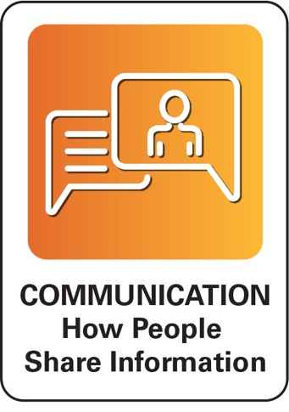

Trust Behaviors: Communication
Trust Behaviors: Communication
Listen openly without judgment or interruption; and tune into the quiet voices
Check-in on assumptions, intentions, and mutual understanding

Slide 12
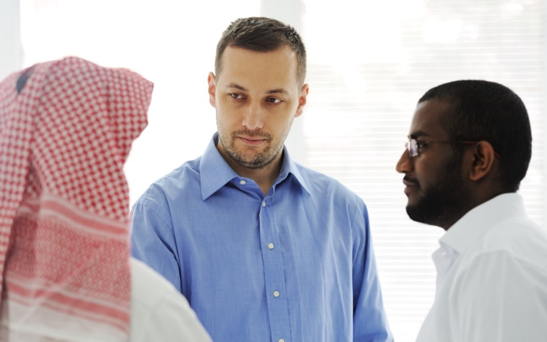
Communication: How people share info
Trust Behaviors: Communication
Trust Behaviors: Communication
Seek feedback, sound and current information, and new perspectives
Share timely, relevant information, avoid surprises, be transparent and truthful
Foster curiosity, open-mindedness, and engage in healthy challenges to conventional thinking

Slide 13
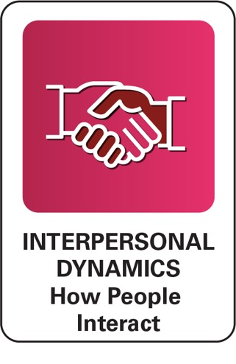

Trust Behaviors: Interpersonal Dynamics
Trust Behaviors: Interpersonal Dynamics
Strengthen Relationships and Connectivity by investing time, resources, and energy into building others up; avoid gossip
Respect people’s unique contributions; honor differing perspectives and styles; be inclusive and welcoming
Notes:
Think again about your scenario. Apply these last two – communication and interpersonal dynamics.
- What is contributing?
- What are symptoms?

Slide 14

Interpersonal Dynamics: how people interact
Trust Behaviors: Interpersonal Dynamics
Invest in the growth and development of others
Model high standards, integrity, and vulnerability.
Acknowledge mistakes, impact on others, and sincerely apologize in a timely manner

Slide 15
Your Turn: apply previous principles to cx example
Your Turn

Slide 16
Trust Behaviors Framework
Trust Behaviors Framework
Behaviors that affect relationships in groups
© Wendy Fraser, PhD

Slide 17
Apply at Multiple Levels of Human Systems
Community
Organization
Group
Interpersonal
Self

Slide 18

The Trust Lens…many possible next steps

Slide 19
Questions?
Contact Information:
Dr. Wendy Fraser
Wendy@WendyFraserConsulting.com
360-556-6056
www.WendyFraserConsulting.com

