Slide 1

From Feedback to Function
CX 2026
Why CX is the new standard for public service
Kellyanne Beck | Chief Experience Officer and Product Manager AtoZ Arizona, AZ DES
Powered by Qualtrics

Slide 2

Today's Agenda
01
CX Not A Buzzword, a Driver of Efficiency & Success
Defining CX as an operational lever for legislative compliance and improved service delivery
02
Measuring the “Double Win”
CX-first approach creates dual ROI– lower workforce burnout and increase public trust
03
A Statewide Vision
Arizona's bold plan to expand digital CX across all agencies
04
From Pilot to Every Agency
How Arizona will roll out Qualtrics statewide and measure impact at scale

Slide 3
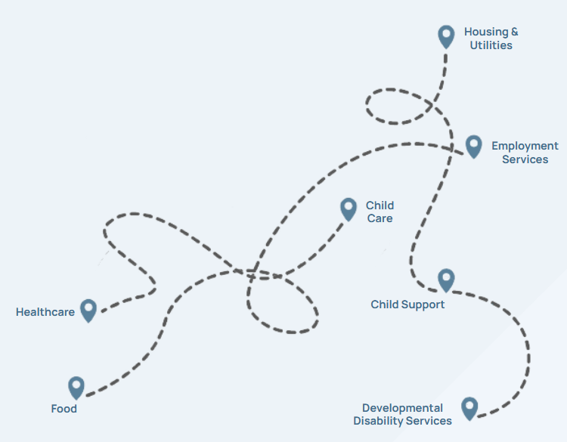
The Beginning
19 Front Facing Portals
Notes:
DES is a one of the largest agencies in the nation -administering more than 50 programs including Unemployment insurance, nutrition assistance, child care, utility assistance.. paint a picture of what that is like for someone applying… someone applying for child care…waiting while also trying to a get job..

Slide 4
The Goal
Provide an online option to apply
Increase Program Integrity
Reduce manual data entry for employees
Provide clear, real time communication on status, information needed and “pre-notices”
Next steps and what to expect
1 Front Facing Portal

Slide 5
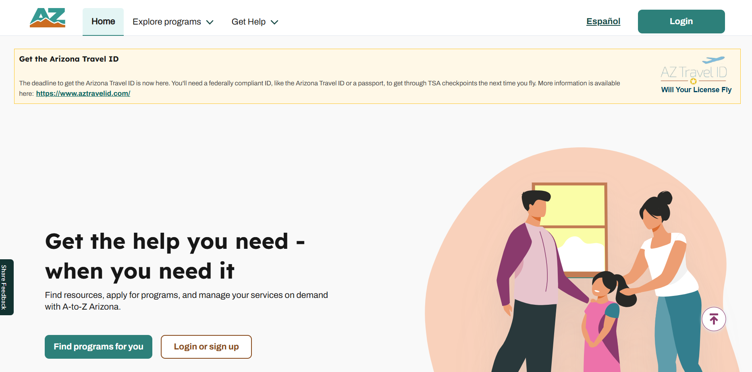
How It’s Going
Notes:
We launched AtoZ Arizona in October 2024 and we have fully integrated our child care program and utility assistance programs….

Slide 6
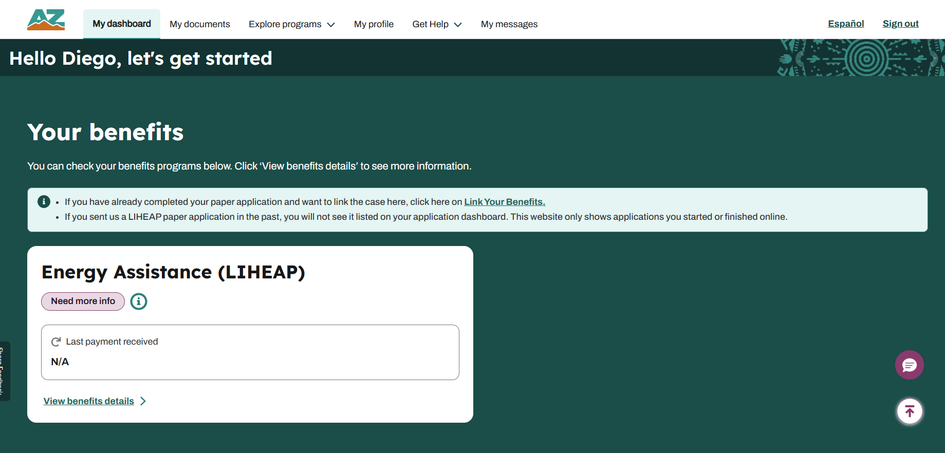
How It’s Going: Example program dashboard
How It’s Going
Notes:
Now able to see process along the way .. would you expect our calls would increase or decrease… ? discuss the change management of government working well..

Slide 7
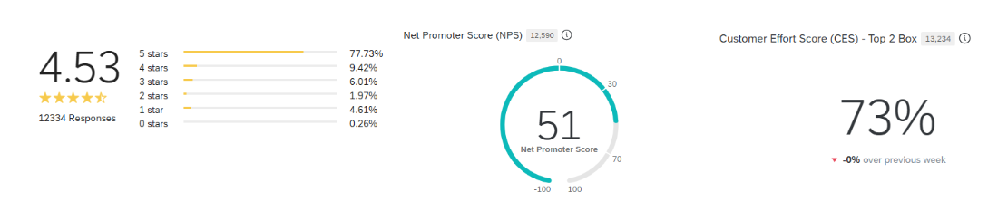
How It’s Going: Qualtrics Dashboard
How It’s Going
Notes:
We launched AtoZ Arizona in October 2024 and we have fully integrated our child care program and utility assistance programs….

Slide 8
Dual ROI - Not JUST a pretty Interface…
↓ 20% Manual Entry
Improved Reporting
Employees moved from scanning documents to determining eligibility
Real-time statewide information - takes minutes to put together, not hours
Statewide Model
Reduced Needs Info Applications by 30%
Employees were only doing intake and eligibility within their local office.
More energy assistance applications are coming through completed.
The process to apply for childcare was completely manual — applicants had to come in person. Now everything is online, completed in 32 minutes on average.

Slide 9
From Feedback to Function: The Online Portal Update
From Feedback to Function
1
UI & UX Enhancements
Verbiage and instructions updates, navigation and interaction, feedback collection during successful events.
2
Form Validation & Data Entry Updates
Error messaging more clear and concise, highlight what is missing on the page to move forward.
44
3
Document Upload & Management
Multi-document upload logic, upload and download reliability
4
System Stability & Bug Fixes
Session management and application interruptions

Slide 10
Testimonials
What residents and staff are saying about the new digital experience at Arizona DES
“
“
“
I’m very grateful, this was such a quick and easy process. I couldn’t believe how quickly I was able to finish. Thank you!”
The promptness in problem solving together before and after launch. We always felt very included every step of the way and meeting our feedback or ideas with openness and then seeing them happen. We’ve transformed how we serve Arizonans.”
This experience was amazing, can I apply to all the programs through this website?”
Arizona DES Resident
Child Care Assistance Applicant
DES Program Manager
Child Care Program
Arizona DES Resident
Applicant
Real voices. Real impact. Resident feedback is at the heart of how Arizona DES improves every day.

Slide 11
How to Start
1
Current state (METRICS), Goals & What Actually Happened?
You have to start somewhere and if you don’t have your numbers from the current state, how will you know if it worked and… how can you tell your data-driven success story?
2
Communication is Key
Continue to communication with managers and frontline staff after launch - listen to employee feedback as much as customer feedback.
3
Change Management is a MUST
Explain the ‘why’ from the very beginning and one training is NOT enough. Keep your teams aware, prepared and excited.
4
Patience & Resilience
A no today, can be a yes tomorrow - know your audience with every conversation.

