Slide 1
Evidence Based Treatment to Improve Client, Staff, and Community Recovery
Rain Carei, Ph.D.
Psychologist 4
Washington corrections center for women
Notes:
Hi! I’m glad to be here. My name is Rain Carei, I’m a clinical psychologist at Washington Corrections Center for Women, which is the only women’s prison in the state of WA and I’m really excited to share some of our work with you today so thank you for being here. This is my 18th year at WCCW, and I remain passionate about what I do.
A little bit about me, I go by Carei, I use she/her pronouns. I am a white woman with blond hair and blue eyes and I’m wearing a black shirt. I’ll be using slides and some polls during this presentation. CART captions and ASL interpretation will be provided. There is a Q and A section for interaction.

Slide 2
What best describes the work you do?
Do not edit
How to change the design
The Slido app must be installed on every computer you’re presenting from
Notes:
Welcome. Before we get started I would love to know more about who is in the room.

Slide 3
Presentation Objectives
Discuss the bridge between quality indicators, service provision, client recovery, and reduction of staff burnout
Identify key steps in creating correctional health care quality indicators, including client voice and choice
Analyze positive outcomes when tailored services are provided

Slide 4
Overview
Who
What
Why
How
Results
Next steps
Notes:
This is a brief overview of what we will cover today.
Who We will start with taking a closer look at who we are we talking about - incarcerated women and staff – all of whom are part of our community. Only 1% of incarcerated women stay behind bars forever, which means that most of the individuals in our care release to the community and re-engage in our daily living activities.
What We will talk about what we are focusing on today: evidence based practices and measuring their efficacy. There is only so many hours in a day, so many dollars available. Implementing and measuring these practices threads the needle of fiscal responsibility, continuous improvement, performance management, and human centered design and intervention.
Why We will talk about why we are doing this – including how this intersects with WA DOC’s mission is to transform lives and improve public safety, as well as links to things like global policy, research, and client voice and choice.
How We will talk about how we created and utilize quality indicators through integrating research, customer feedback, and evidence-based solutions.
Results We will look at the results of this work.
Next steps and lastly we will talk about next steps, as well as invite your feedback on ideas you see or might think might be useful.

Slide 5
The Who
Starting With a Story….
Notes:
Before I talk about my work and the work I do with clients, I think it’s important to recognize the privilege I have to share my story and other stories. I have a lot of privilege speaking here today. I come to this space as white, free, highly educated, financially stable. I also hold overlap with some of my clients: I’m part of the LGBTQ community, I’m female, I’m a survivor of trauma and in active trauma recovery. And because of both these intersections and gaps, I get to use my voice to lift up other voices. That’s such an opportunity.
Stories are powerful for lots of reasons. In presentations with data, I find them orienting. While we are talking about strategy and continuous improvement, we are also talking about human lives. it’s easy to get lost in data and metrics. Stories help to ground us and remind us that we are talking about real people – sisters, mothers, daughter, grandmothers – the women who are being served and the people who are working day in and day out in a system that is very difficult.
The story I’m thinking about highlights this pathway. It involves my experience providing the first course of evidence-based trauma treatment at WCCW in 2014. The woman I provided the care to was a client I had worked with for years. I want to talk about that experience at a high level as we go along today to show women’s pathway to prison and to show how powerful it can be when human centered intervention and continuous improvement practices intersect.
At the start of this story, was a woman who arrived in prison without any treatment. In her life, she had experienced what almost all our clients here have experienced - childhood sexual abuse and sexual assault as an adult, in addition to drug addiction, and compromised relationships, which led this person to criminal activity to sustain connection and maintain addiction. This led her to us. This is often called women’s pathway to prison.
Before we look at that pathway from a research perspective, let’s take a look at what kinds of experiences people think might contribute to women coming to prison.

Slide 6
What types of experiences do you think might contribute to women coming to prison?
Do not edit
How to change the design
The Slido app must be installed on every computer you’re presenting from

Slide 7
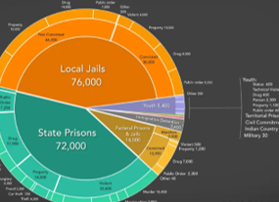


Women’s Pathway to Prison
Substance Use Disorder (SUD)
Incarceration
50.8% of women meet criteria (compared to 38.5% men)**
Trauma
56-82% Lifetime sexual assault*
*Karlsson & Zielinski, 2018
**Staton et al, 2023
Notes:
Based on response – …okay, so a lot of people are familiar with this pathway, or okay, so this is a new pathway for people and an important one to highlight.
Research based assessment of incarcerated women shows that women’s pathway to prison starts with trauma, which diverts developmental processes into survival processes. Women miss critical opportunities to learn things like how to manage emotions, set boundaries, and navigate relationships. Often then women use substances to cope with trauma. Which occurred in this woman’s case. When substances are introduced, this amplifies dangerous situations and further compromises decision making abilities, also what happened to this person. And that eventually leads to incarceration. The pie of women’s incarceration about the word incarceration shows that 72,000 women nationally are held in state prisons and 14,000 in federal jails and prison, which is about half of incarcerated women nationally.

Slide 8
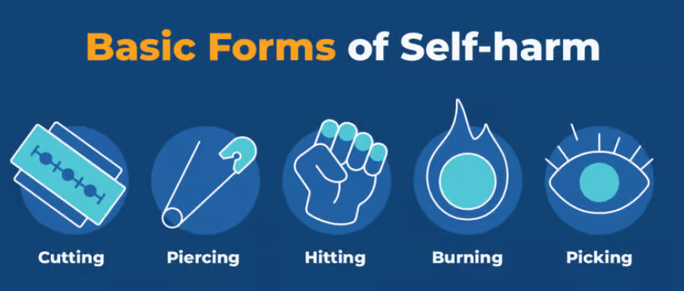
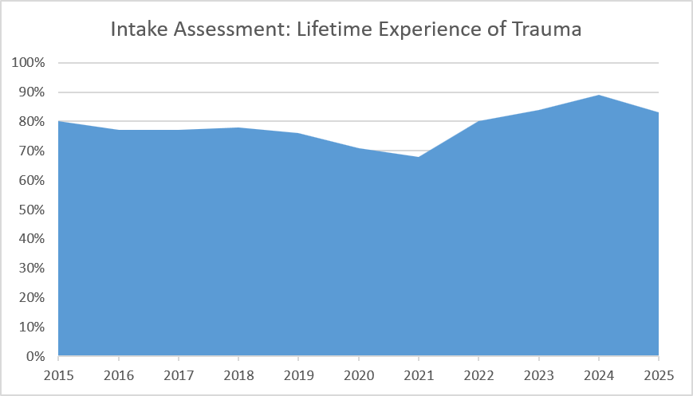
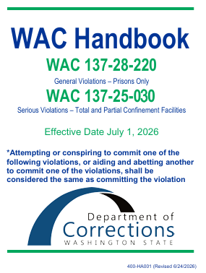
Women’s Pathway Through Prison
80% of women at intake have experienced lifetime trauma
Maladaptive strategies to manage symptoms
Sanctions
Aggression/fighting
Trauma
Infractions
Self Harm
Segregation placement
Notes:
Another pathway that you might be less familiar with, but makes sense If you think about women’s pathway to prison, is women’s pathway through prison.
At intake, 80-90% of women (including this woman I’m thinking of) report lifetime trauma exposure, 61% being diagnosed with a trauma disorder, and 62% of women being diagnosed with a SUD. That means women arrive with trauma and are suddenly sober. To cope with those symptoms, individuals use other maladaptive strategies, which includes aggression/fighting, self harm, and crisis. This then can lead to sanctions.

Slide 9
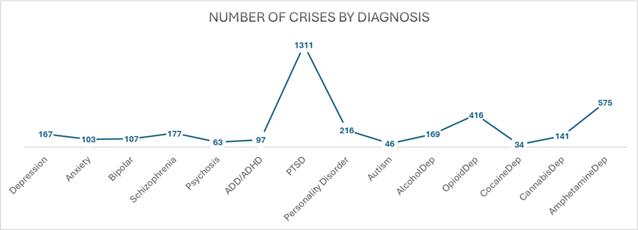
Impact of untreated trauma and substance use on women and staff
WCCW, 2022-2026, Operational Data
Notes:
This is what that pathway looks like in prison setting.
On the screen you can see graph of numbers of crises (staff or client reported) between 2022-206. You can see that most crises in the prison are driven by untreated PTSD and SUD, which reflects the pathways we have been talking about.
This means individuals are in repeated crisis and it also means staff’s workload is high, driven by intense experiences, and that the space for proactive treatment is typically low.
This is very much the experience this woman was living before we implemented evidence based care. She was experiencing a high level of trauma symptoms, engaging in cutting, having suicidal thoughts, and getting in trouble for not attending programming because of her severe trauma symptoms.

Slide 10
The Why
Evidence Based Care and Measurement
Notes:
So now that we have talked about these pathways, hopefully the need for intervention is standing out. The need for trauma treatment and substance use treatment are pretty clear through an operational and research lens, but let’s also take a look at other factors.

Slide 11
...because of global public health policy
Reducing health inequalities is a fundamental principle of global public health policies (Stürup-Toft et al., 2018).
Statutory responsibilities towards the human rights of prisoners are outlined in the United Nations’ Standard Minimum Rules for Treatment of Prisoners (known as the Nelson Mandela Rules).People living in prison ‘should enjoy the same standards of health care that are available in the community’ (Rule 24.1)
Prison healthcare services are responsible for ‘evaluating, promoting, protecting and improving’ the health of incarcerated people (Rule 25.1) (United Nations General Assembly, 2015).
Notes:
So why provide trauma and SUD care in prison?
Specifically, let’s start big – the first big picture consideration is global public health policy.
Reducing health inequalities is a fundamental principle of global public health policies (Stürup-Toft et al., 2018).
Statutory responsibilities towards the human rights of prisoners are outlined in the United Nations’ Standard Minimum Rules for Treatment of Prisoners (known as the Nelson Mandela Rules). People living in prison ‘should enjoy the same standards of health care that are available in the community’ (Rule 24.1, a stance known as the equivalence principle)
Prison healthcare services are responsible for ‘evaluating, promoting, protecting and improving’ the health of incarcerated people (Rule 25.1) (United Nations General Assembly, 2015).
This is critical because people are coming back out to the community.

Slide 12
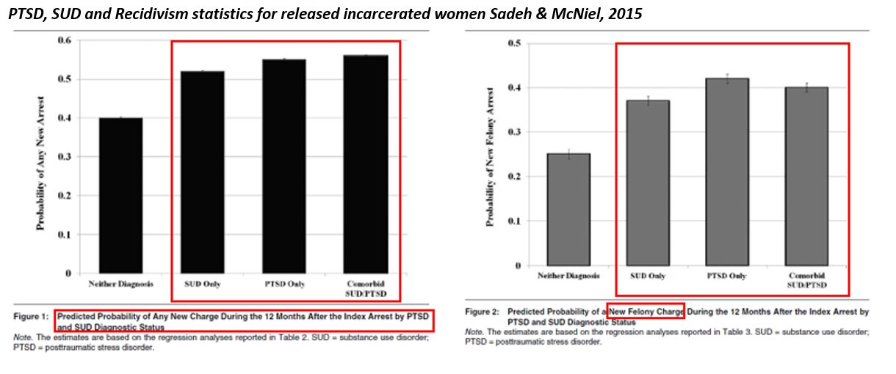
...because untreated trauma and untreated SUD links to recidivism
Notes:
Additionally, we know that PTSD does not go away on it’s own. In fact only 9 out of 100 people with PTSD with no treatment will recover without intervention.
In fact, research shows that untreated PTSD and SUD are predictive for the probability of a new charge and a new felony charge in the next 12 months. This is critical for us as Washingtonians.

Slide 13
…because of client voice and choice
97% of incarcerated women want access to trauma treatment (Fradley et al, 2023)
Women who had the opportunity to participate in trauma focused programs requested they be more readily available (Gajewski-Nemes and Messina, 2021)
Fradley et al (2023) study said they felt prison was an acceptable place to get treatment (63%).
Notes:
Our data is in line with national data – lots of people in prison have mental health concerns, and most have experienced trauma.
Women who had the opportunity to have treatment wanted more of it and for it to be available to others and recommended it to others
Women’s experiences of prison-based healthcare (Bright et al, 2023):
Women more likely to engages in mental health treatment than male counterparts
Barriers are significant and include delays in care, shame, disempowerment, reduction of privacy, strained relationships

Slide 14
...because empathy and attunement nourishes and sustains clinicians.
Research on mental health staff burnout showed that positive experiences with incarcerated individuals improved work life (Gallavan and Newman, 2013).
"When clinicians maintain clarity about interpersonal boundaries, when they are able to get very close without fusing or confusing the client's story, experiences, and perspective with their own, this exquisite kind of empathic attunement is nourishing for the therapist“ (Harrison & Westwood, 2009).
Empathy reduces burnout (Yue, Z. et al., 2022).

Slide 15
The What
Evidence Based Treatment and quality indicators
Notes:
So now that we have talked about the who and the why, let’s talk about the what.

Slide 16
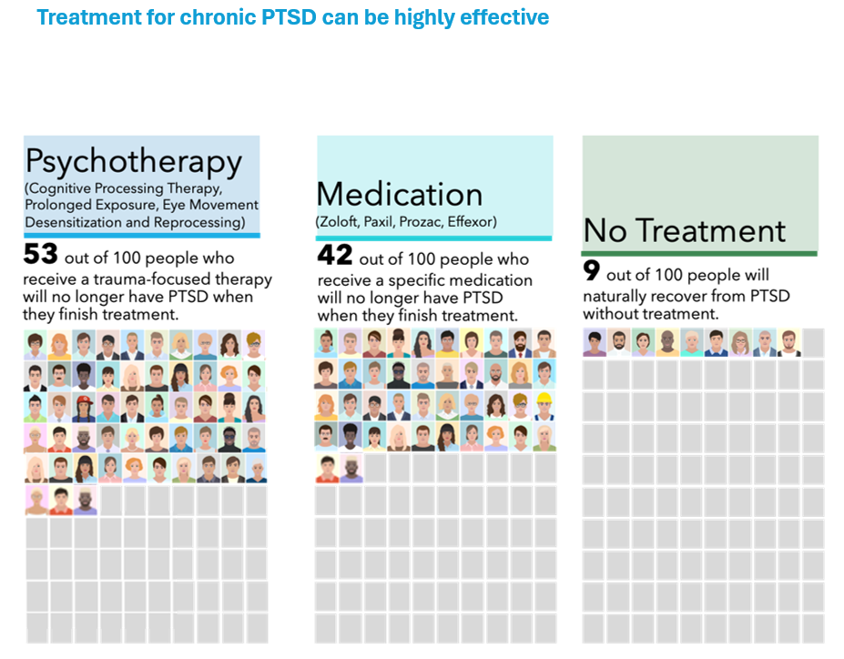
Therapy is the most effective treatment for PTSD
Graphic Reference: Debra Kaysen, Ph.D., ABPP
Stanford University School of Medicine
Notes:
We’re specifically talking about is two things: implementing evidence based therapy for trauma. And measuring it’s efficacy.
Implementation is critical, as implementation science tells us that it takes 17 years for evidence-based practices to make it into routine healthcare. The barriers to implementing this in the community are huge, let alone in prison.
What’s amazing about evidence based therapy for trauma is that it works. Many people do not know that - you can see that after just a few months, recovery is possible.
And with implementing evidence based care, we needed evidence based measurement to ensure that we are actually effectively treating trauma.

Slide 17
Shifting from metrics to quality indicators
METRICS
QUALITY INDICATORS
Process and performance based
Rely on existing infrastructure
Useful for policy evaluation and task measurement
Quality based
Rely on patient feedback and clinician evaluation
Require different tools
Give real time feedback so interventions can be adjusted
Notes:
Needing to measure efficacy meant we need to shift what we measured. So let’s talk about that.
So on the left, you can see that where we started, which was with system wide metrics. There are performance based, rely on existing infrastructure, and are primarily useful for policy evaluation and task measurement. These were helpful when we started to make sure we were meeting foundational markers.
So with this client that I’ve been talking about, when we only used performance metrics, we asked things like: Mainly - did her intake assessment done (yes)? Did she get a mental health diagnosis and need treatment (yes)? Did she get a treatment plan? (yes). But that was that was the end of it. And those were important starting steps, but they didn’t include measuring the impact of our care and intervention.
So when we shifted to measuring quality, we went from metrics to quality indicators. These are based on patient feedback, clinician evaluation, require different tools, and give real time feedback so clinical staff can adjust interventions, respond to data, and generate curiosity about trends.
With the woman I am thinking of, this shift moved us then to start asking different questions, like did she get a EBP? How were her symptoms? Was she getting better (yes)? Did the intervention work as measured by symptoms and behaviors (yes)?
And that really brings us back to the power of measurement; you measure what’s important to you. Measurement = value. We value healing for our clients and for our community. So, this change in practice helped us match our values to our metrics.

Slide 18
Our Story...
The How
Notes:
So now that we have shared about the people involved and the reasons to intervene, recognized the shift we wanted to make, let’s talk about the how.
But before we do that, this shift meant overcoming a lot of barriers.
I’m curious to know which barriers have you experienced or overcome in your work, or what can you relate to? So I just want to take a minute to hear back from you on that and for that connection.

Slide 19
What are the biggest barriers you face at your job?
Do not edit
How to change the design
The Slido app must be installed on every computer you’re presenting from
Notes:
This is so important to recognize. There are so many barriers that we all face.
Thank you for sharing that. I feel less alone, hopefully you feel less alone. So some of what I’m sharing about our story is not prescriptive in any way, this is just how we took steps through such a hard environment.

Slide 20
TIMELINE SLIDE
Tools for a Functioning Team
Quality indicators approved by Clinical Service Board.
504 completed EB cases
Presented to HQ
Access to RDA
2014
2017
2020
2025
2019
2022
2026
2015
1 evidence based (EB) case
Making operational data visible
Designed quality indicators
Started tracking staff health
Notes:
This slide gives you the broad brushstrokes because every project exists inside a timeline. Nothing happens in a vacuum or without partnerships.
It shows a long journey, highlighting some key points, but these are in no way exhaustive. You can see steps along the way that helped us get to where we are now. This included things such as team building, entering data by hand into excel, to make data visible, presenting that data to HQ’s and gaining access to our research and data analytics team, designed indicators, getting them approved, starting to focus on staff health, and then lastly you can see the starting point of 1 case, and the current point now of 504 completed cases today. Each of these steps has in some iteration been a presentation. Don’t worry, I’m not going to highlight them all today, although please feel free to reach out if you want to talk more about any piece.
Today I’m mainly going to focus on designing metrics and the outcomes. Part of the reason for this slide is to show that this is a labor of love over time and took a full team to complete.

Slide 21
The first step: Radical Acceptance
In an environment such as corrections there will always be some sort of challenge.
We decided the goal was not to wait until change came to us.
Seeing ourselves as part of a change process is a critical piece of our job as therapists – we brought that into our operations.
We accepted we would not get more resources, more staffing, or more money.
We decided to move forward anyways
Notes:
The first step was radical acceptance. I wish I could tell you this came from some sort of noble place, but really this came from a place of oh my god, we have to survive this. I think a lot of you can relate based on your answers to the poll.
In an environment such as corrections there will always be some sort of challenge.
We decided the goal was not to wait until change came to us.
Seeing ourselves as part of a change process is a critical piece of our job as therapists – we brought that into our operations.
We accepted we would not get more resources, more staffing, or more money.
We decided to move forward anyways
We decided to see what we could do with nothing.

Slide 22

Next steps: Operational Data
Team members interested in entering paper and pencil data into Excel did so with no extra resources.
  Operational data clarified women's needs: trauma care and women's pathway through prison (intervention points).
  Presented operational data to HQ's leading to provision of resources.
  Built relationships with Research, Data, and Analytics (RDA) staff. Began to find ways to use Microsoft forms, SharePoint, & Power BI to track outcomes.
Notes:
First step was looking at the data we had in front of us. What were women saying? What did they need? We hand entered 5400 women's data by hand into excel and then looking at basic statistics. We found out what we talked about earlier – our women had been through trauma, their symptoms were high, they wanted and needed treatment.

Slide 23

Next steps:
Client (Customer) Feedback
We focused on feedback from clients.
Clients choose to write letters to staff and clients after treatment to tell them what they think and what they recommend
Each quarter we invite clients to give feedback on our services and our work
We ensure we invite clients that both support and criticize our work
We listen, take notes, and integrate feedback into our care
Notes:
What we found was that clients resoundingly told each other to “Listen up” and shared things like “I hope to can inspire you to challenge and overcome the negative trauma that has brought you here.” To just do it.

Slide 24


Ongoing steps: Partnerships
Facility Connections
Administrative
Scheduling Teams
Health Care Managers
Research and Analytics
Data Teams
Clinical
Mental Health Service Delivery Teams
Mental Health Clinical Managers
Our Patients.
Research Teams
Custody Partners
Administrative Services Board
Clinical Services Board
Notes:
This work involved partnership and steps. You can see some of these steps in a more formal way on the screen, ranging from ideas, to facility connections, to local administrative connections, RDA, and other critical links and sets of expertise. While this is a fancy slide showing as step wise progression. Like I said before, this project is about people, and in real life, partnerships look like:

Slide 25
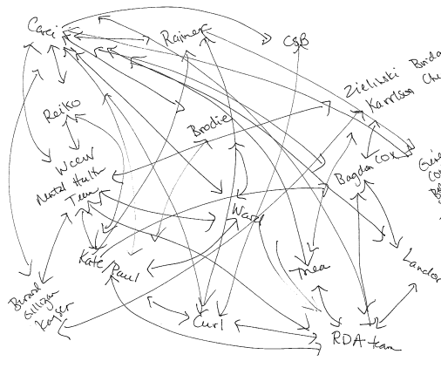
Partnership in real time
Connections, conversations, refinement, growth, learning, revisions, wrong turns, uphill (both ways)
Notes:
This.
Partnership in real time is messy. It involves connections, conversations, refinement, growth, learning, revisions, wrong turns, and going uphill (both ways). So it’s critical to communicate that this process was not linear; it was authentic, ongoing, and multidirectional.

Slide 26
Putting it All Together:
Integration and Connection
Partnerships
Operational Data
Research
Client Voice and Choice
Evidence Based Practices
Notes:
So as this process unfolded, we took all these things, integrated them, connected them, and created our quality indicators. So let’s take a look.

Slide 27
How is the pace of this presentation so far?
Do not edit
How to change the design
The Slido app must be installed on every computer you’re presenting from

Slide 28
Quality Indicators
  Trauma treatment client improvement
  Facility safety
Notes:
These steps and partnerships and integrated data points helps us create quality indicators, two of which are part of the evidence based therapy indicator work, which I’ll share today. Those were:
Trauma treatment client improvement and facility safety

Slide 29
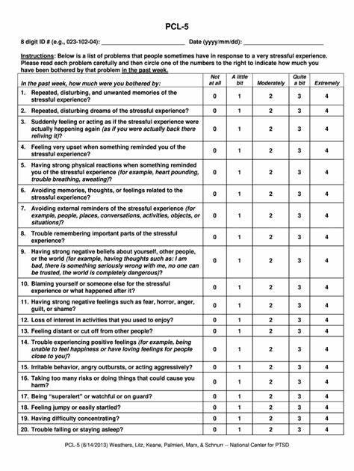
Trauma Treatment Client Improvement
Purpose: Ensure EBP’s are provided (evidence based, women’s voice and choice) by tracking provision. Ensure interventions work.
Meeting/Not Meeting: A 10 point or greater score change represents clinically significant change (National Center for PTSD) and is defined as “meeting target.” Anything less is “not meeting target.”
How it works: Clients completed a PTSD Checklist-5 (PCL-5) before every EBP Trauma session. Clinicians enter it into a SharePoint site. The SharePoint site calculates the score change between first and last session.
Notes:
Each indicator we made had a backstory that we presented to our clinical service board, using operational data, women’s voices, and research, to propose meaningful metrics for change. This involved translating clinical language (did treatment work?) into data language (did the PTSD Checklist score drop 10 or more points?) which moved it from theory, to language, to production.
You can see on this one that the purpose has the combination of data, women’s voices, and research. The tool for tracking, the PTSD Checklist 5 is a national tool used in both PTSD research and treatment and clients completed it before each session.
Lastly, it can be used we defined clinically significant change based on the National Center for PSTD’s guidelines. We defined helped us set a “meeting target” – scores dropped 10 points or more, and a “not meeting target,” scores dropped less than 10 points or more.

Slide 30
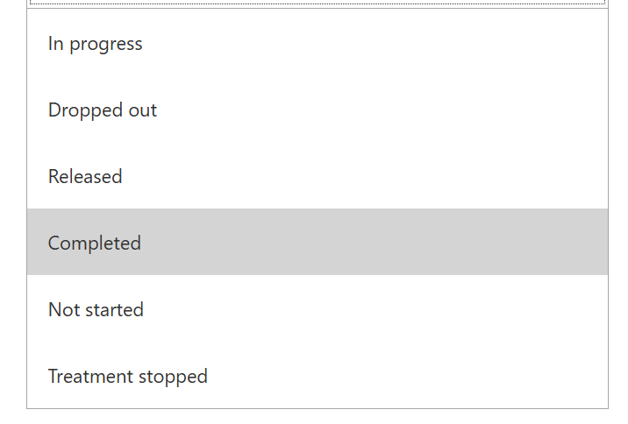
Facility Safety
Purpose: Ensure when EBP’s are provided (evidence based, women’s voice and choice) that they work not only emotionally for women, but behaviorally.
How it works: Data from the trauma treatment client improvement SharePoint site includes a selection of the treatment status (completed, dropped out). WA DOC has an electronic database that stores infractions. Infraction rates are examined for clients by treatment status.
Meeting target/Not Meeting Target: Individuals having a 50% decrease in substance use and aggression infractions between the 6 months before treatment, and the 6 months after treatment, are “meeting target.”
Notes:
Each indicator we made had a backstory that we presented to our clinical service board, using operational data, women’s voices, and research, to propose meaningful metrics for change. This involved translating clinical language (did treatment work?) into data language (did the PTSD Checklist score drop 10 or more points?) which moved it from theory, to language, to production.
You can see on this one that the purpose has the combination of data, women’s voices, and research. The tool for tracking, the PTSD Checklist 5 is a national tool used in both PTSD research and treatment and clients completed it before each session.
Lastly, it can be used we defined clinically significant change based on the National Center for PSTD’s guidelines. We defined helped us set a “meeting target” – scores dropped 10 points or more, and a “not meeting target,” scores dropped less than 10 points or more.

Slide 31
Results
Trauma Treatment Client Improvement
Facility Safety
Notes:
So let’s take a look at what we found.

Slide 32
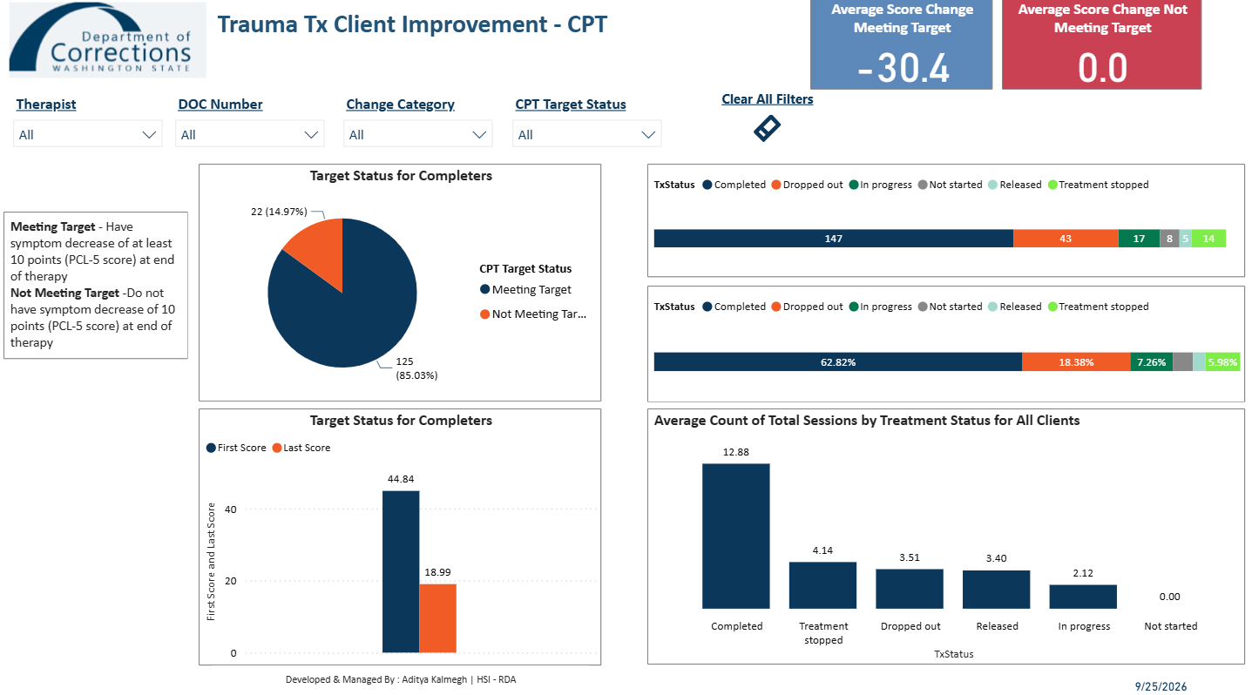
Quality Indicator: Trauma Treatment Client Improvement
80% of women who complete treatment recover!
Notes:
This is an example of one of the power bi dashboards that tracks trauma treatment client improvement data.
You can see that for this type of therapy, CPT, about 85% of women have met the target (had at least a 10 point drop). And you can also see how many women have dropped out, released, are in progress, etc. This is one of 5 types of evidence based care we provide. You can also see the average score drop an the number of sessions it requires. This helps us see how treatment is working. And we also look overall at scores as related to diagnostic cutoff’s. So 80% of women score on the PCL-5 in a range that indicates they likely no longer have PTSD after receiving treatment. So it is working; women are recovering.

Slide 33
RESULTS: Drop out Rates
Cognitive processing therapy (CPT)
Written exposure therapy (WET)
WCCW drop out rates 23% (151 completed/ongoing, 34 dropped out/treatment stopped)
Community drop out rates are higher (Alpert et al, 2020), 39.7% CPT, 6.4% WET.
WCCW drop out rates 15% (240 completed/in progress, 37 dropped out/treatment stopped)
Community drop out rates are lower (Alpert et al, 2020), 6.4% WET.
Notes:
This indicator also helps us track drop out rates. This is critical to know if we are reaching the amount of people we need to reach.
It also shows things that we are not expecting or aware of; for example our drop out for WET is higher than the community. Why is that? This goes back to the value of quality indicators, helping generate curiosity, looking for trends, digging deeper. This is something we can explore on the details page of power bi. This is really important example of showing the difference between a process metric and a quality indicator. The point is not to get a certain result, it’s to more deeply understand something and make adjustments in real time. Surprising results are just as critical as the results that show we are on track.

Slide 34
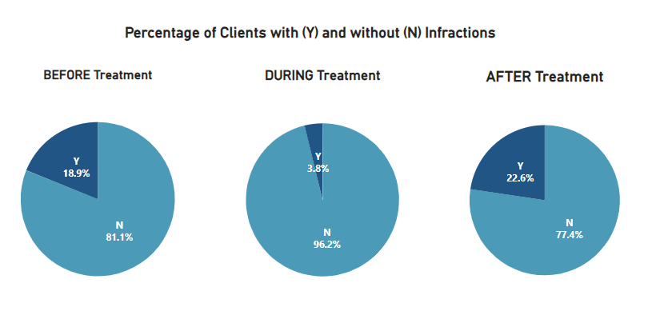
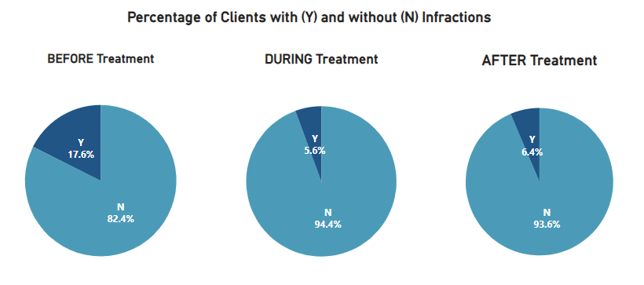
Quality Indicator: Facility Safety
DROPPED OUT/CARE STOPPED
Data shows a significant Reduction in Infractions* after Completing Trauma Treatment.
*Infractions directly related to substance abuse and aggression.
COMPLETED CARE
Notes:
For the facility safety indicator we can track improvements related to completion status. What you can see her is that clients that complete treatment have a reduction in SUD and aggression infractions that holds after treatment, but clients who drop out have an increase in infractions that is worse than before treatment.
This is critical to both women’s access to care – if they are in trouble, they can’t get treatment, and staff safety – if they are healing, they are less dangerous. As a staff of community members who want to go home safely and be there for our community, this is a critical measure that reaches into the community.

Slide 35
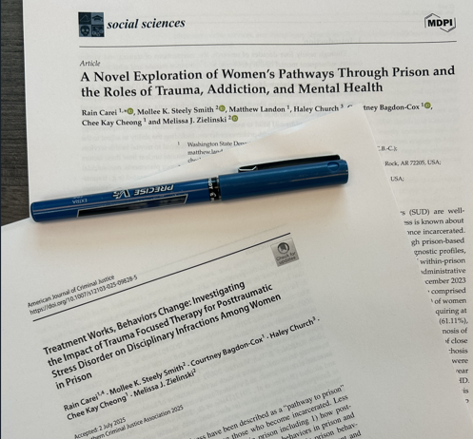
Published work – the win’s
Trauma treatment works, clients leave in a better state that when they arrive
Facility safety is real
Dosage matters
Notes:
The quality indicators we created as a whole team helped us know where to head in terms of research evaluation. This also strengthened our connections with external collaborators and brought in more research, training, supervision, and consultation. The references are at the end of this presentation. I’m also happy to send them out if requested.
There were some key take aways from our work, one of which was an 8 year retrospective analysis of 5775 women to more deeply understand these pathways through prison, both validating what we observed, and bringing up new considerations. The other was a paper comparing individuals who received treatment to a matched sample to individuals who did not receive treatment. Both papers highlighted that treatment works, as evidenced by consistent symptom drops to subthreshold diagnostic levels.
The paper comparing samples showed initial findings that both symptoms and infractions for substance use, fighting/assault, and overall infractions, decreased with intervention. As far as we know, it’s one of the first of its kind, which leads the way for evaluating how treatment improves living conditions for clients and staff.
Lastly, we also found that dosage matters. More treatment improves outcomes; women come in with high needs and leave with high needs, the more treatment we can provide, the better change we have of disrupting recidivism.

Slide 36
Published Work – the challenges
We’re not reaching enough people – in the retrospective sample, our reach for evidence-based trauma care was under 5% of our population in those eight years.
  High caseloads
  Challenges in perspectives
  Slow build of capacity for services
Recidivism appears potentially disrupted but appears too complicated a concept to directly tie to treatment.
Notes:
With the win’s comes what I call the “aye’s “ – they deep sigh that comes with relentless work when you know there is more to do. We aren’t reaching enough people; which both reflects a slow build of services over time and the gigantic task ahead of us.
And recidivism appears potentially disrupted by improving health outcomes, but it’s too complicated a concept to be directly tied to treatment. Other factors such as sentencing guidelines, education, housing, and community support, have equal ties in the burden.

Slide 37
Reflections and future directions
A collaborative story
Notes:
In ending, it’s important for us to note that the work we did was connected deeply to our community, clients, and ourselves. Nothing we did was one person sailing the ship. It was all hands on deck.

Slide 38
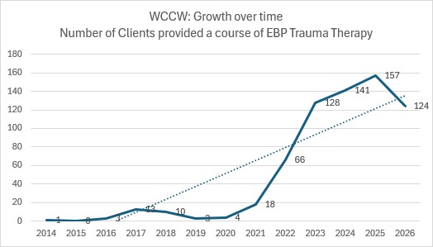
The journey of a thousand miles starts with a single step
-Lao Tzu
Notes:
Small steps result in big outcomes. One case led to hundreds.
What you are seeing on the screen is our growth graph. You might notice 2019-2021 was really low – you might recall the pandemic…. Some of us have blocked it out.
And lastly, let’s end with the same story we started with; the first woman to receive that care. That first woman who received evidence based care in 2014 she never came back to prison. She broke the cycle in her life and she’s stayed free for the last 16 years.

Slide 39

Healing is possible
Notes:
That brings us back to measuring what we value – healing – because Healing. Is. Possible.
The wins are big. Clients answer the questions “why heal now” in treatment before they start. The board shows that healing is possible and that the reasons clients embark on this journey are big.
So I can help my girls heal from past trauma, so I can change my life, so I can be the best version of myself for my friends and family, which is all of us.

Slide 40
Staff experience: Providing Treatment
“When I offer evidence-based written exposure therapy to patients, I’m confident in it because I know it works.
It feels wonderful to provide treatment that works to people who have suffered so long and haven’t had access to proven methods.”
– S. Hoag, Psychologist 3, WA DOC
Notes:
This also is reflected in our staff narratives. Staff are feeling better, more purposeful, better engaged. This has increased feelings of accomplishment at work.

Slide 41
Staff Experience: Reducing Burnout
“Providing evidence-based trauma therapy helps reduce burnout and get to the root cause of the issues.
Case management work often feels like we put out fires that inevitably pop up elsewhere. By treating trauma, we see the global change that prevents fires in the first place!
Helping my clients recognize their ability to grow and heal through trauma treatment feels incredibly fulfilling and worthwhile. They take back the reins in their healing journey, and I get to use my energy more effectively.”
– R. Gardner, Psychology Associate, WA DOC
Notes:
You can see this has also helped reduce burnout.
One of the pilot projects we currently are working on is collecting monthly data on burnout and secondary traumatic stress for our team members. Our pilot data over the last 2 years is starting to tell us that we may need a staff quality indicator. How do we keep track of this for staff?

Slide 42
…Next Steps of our journey.
Continuing to expand capacity for evidence based co occurring care to support incarcerated women and Washingtonians.
Continue to build a healthy work environment through increasing efficient and compassionate work. Consider staff metrics.
Continue building our clinical dashboards so we can track outcomes in real time
Continue research, grants, and connections, to make a healthier Washington and be good neighbors

Slide 43
What feedback or ideas do you have to help guide our future work?
Do not edit
How to change the design
The Slido app must be installed on every computer you’re presenting from

Slide 44
Thank you
WCCW Mental Health is recognized by the Council of State Governments (CSG) as a Criminal Justice-Mental Health Learning Sites - CSG Justice Center .
→ Peer support and consultation is part of work. Please reach out if we can be of support.
Notes:
So how do we build capacity to intervene and ensure efficacy of care?

Slide 45
References
Alpert, E., Hayes, A. M., Barnes, J. B., & Sloan, D. M. (2020). Predictors of dropout in cognitive processing therapy for PTSD: An examination of trauma narrative content. Behavior Therapy, 51(5), 774–788. doi:10.1016/j.beth.2019.11.003
Carei, R., Smith, M.K.S., Bagdon-Cox, C., Church, H., Cheong, C.K., & Zielinski, M (2025). Treatment Works, Behaviors Change: Investigating the Impact of Trauma Focused Therapy for Posttraumatic Stress Disorder on Disciplinary Infractions Among Women in Prison. Am J Crim Just 50, 940–965 (2025). https://doi.org/10.1007/s12103-025-09828-5
Carei, R., Smith, M.K.S., Bagdon-Cox, C., Church, H., Cheong, C.K., & Zielinski, M (2025). Treatment Works, Behaviors Change: Investigating the Impact of Trauma Focused Therapy for Posttraumatic Stress Disorder on Disciplinary Infractions Among Women in Prison. Am J Crim Just 50, 940–965 (2025). https://doi.org/10.1007/s12103-025-09828-5
Fradley, M. F., Kathryn Allison, M., Steely Smith, M. K., Bossard, M., & Zielinski, M. J. (2023). Justice-Involved, Sexually Victimized Women’s Perspectives on the Acceptability of Receiving Trauma-Focused Therapy in Prison. Violence Against Women, 29(14), 2964-2985. https://doi.org/10.1177/10778012231200480

Slide 46
References part 2
Gajewski-Nemes, Julia, and Nena Messina. 2021. Exploring and Healing Invisible Wounds: Perceptions of Trauma-Specific Treatment from Incarcerated Men and Women. Journal of Trauma & Treatment 10: 1–8.
Gallavan, D. B., & Newman, J. L. (2013). Predictors of Burnout Among Correctional Mental Health Professionals. Psychological Services, 10 (1), 115-122.
https://www.prisonpolicy.org/
Harrison RL, Westwood MJ. Preventing vicarious traumatization of mental health therapists: Identifying protective practices. Psychotherapy (Chic). 2009 Jun;46(2):203-19. doi: 10.1037/a0016081. PMID: 22122619.
National Center for PTSD: PTSD: National Center for PTSD Home (va.gov)
Sadeh, N., & McNiel, D. E. (2015). Posttraumatic Stress Disorder Increases Risk of Criminal Recidivism Among Justice-Involved Persons With Mental Disorders. Criminal Justice and Behavior, 42(6), 573–586. https://doi.org/10.1177/0093854814556880

Slide 47
References part 3
Staton M, Tillson M, Levi MM, Dickson M, Webster M, Leukefeld C. Identifying and Treating Incarcerated Women Experiencing Substance Use Disorders: A Review. Subst Abuse Rehabil. 2023 Nov 13;14:131-145. doi: 10.2147/SAR.S409944. PMID: 38026785; PMCID: PMC10655602.
Stürup-Toft S, O'Moore EJ, Plugge EH. Looking behind the bars: emerging health issues for people in prison. Br Med Bull. 2018 Mar 1;125(1):15-23. doi: 10.1093/bmb/ldx052. PMID: 29394343.
United Nations General Assembly (2015).
Yue, Z., Qin, Y., Li, Y. et al. Empathy and burnout in medical staff: mediating role of job satisfaction and job commitment. BMC Public Health 22, 1033 (2022). https://doi.org/10.1186/s12889-022-13405-4

