Slide 1

Targeted Universalism
Washington State Office of Equity:
Using Targeted Universalism to Improve Customer Experience
Presented by Amber Ortiz Diaz (EQUITY)
Prepared for Your Washington CX Community of Practice

Slide 2

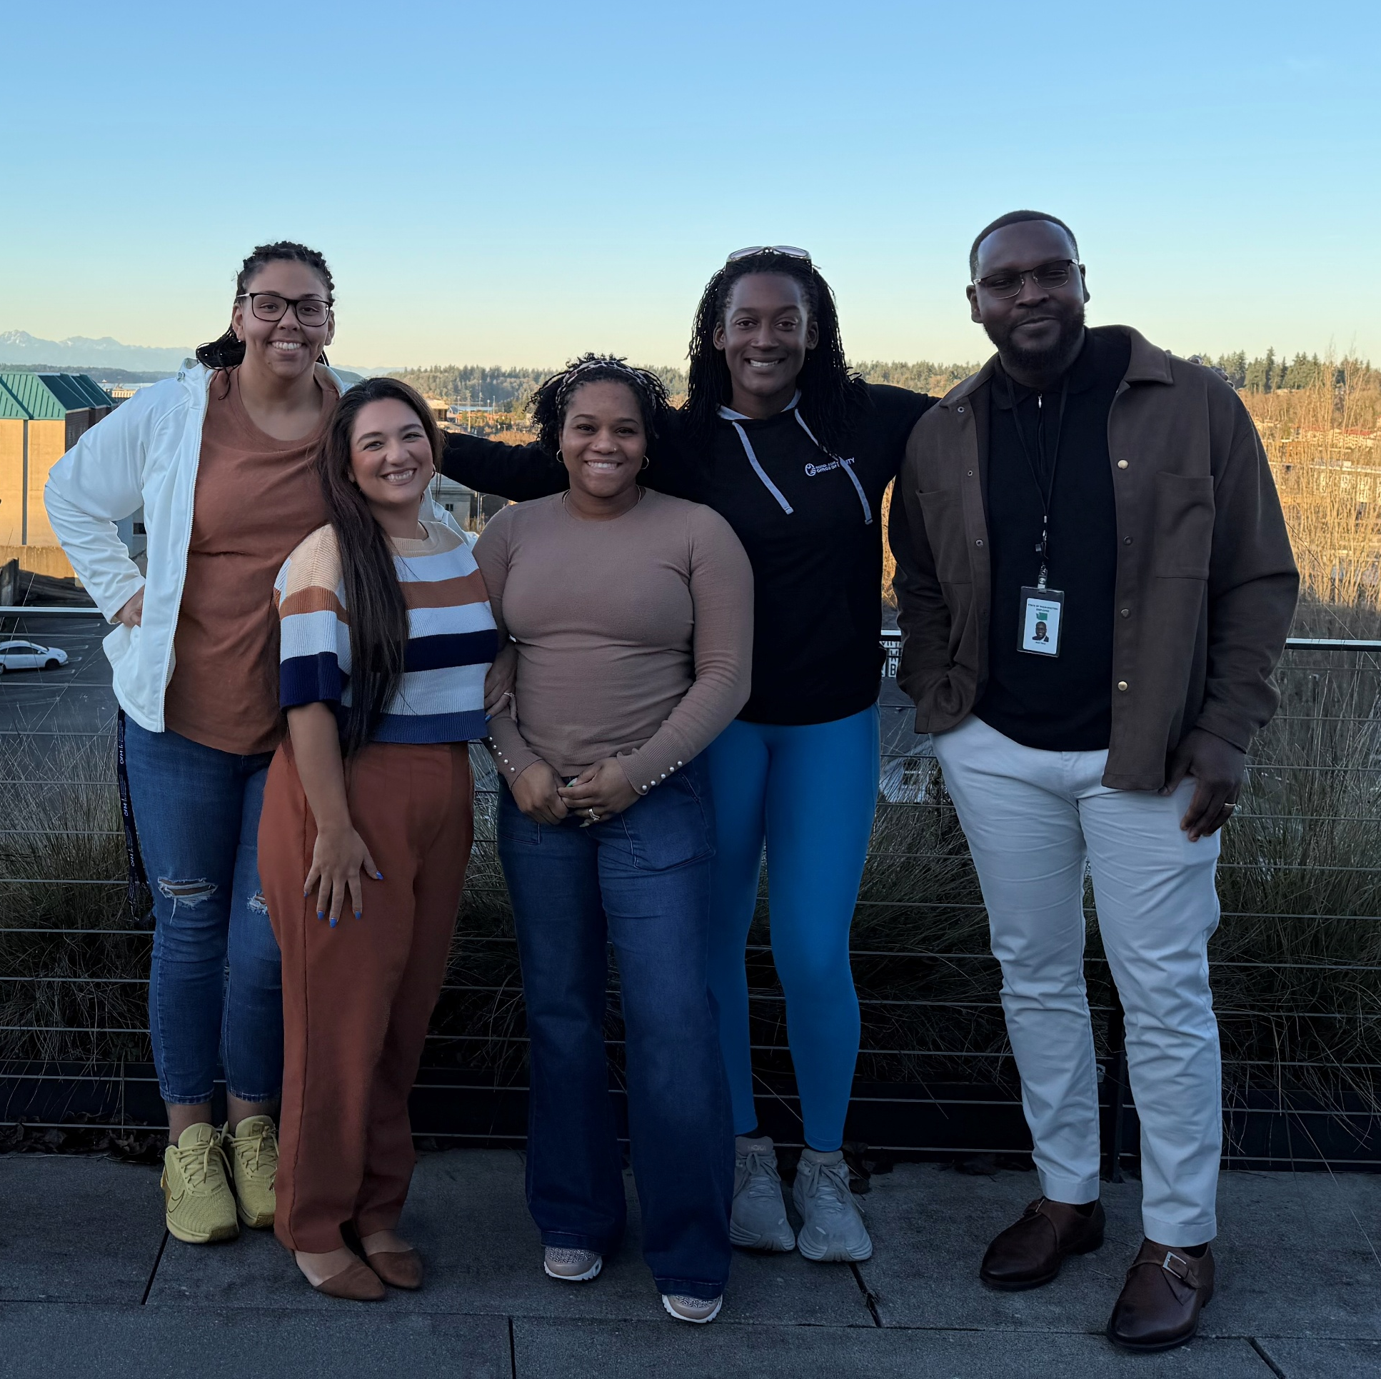
Amber Ortiz-Diaz
Program Manager,
Shared Power Design
Shared Power Team | Olympia, WA
Sabrina, Amber, Rauneisha, Megan, Jean

Slide 3

Introductions: Use the Chat
Name + pronouns
Agency/organization
Shout out the county you live in!

Slide 4
Learning Objectives
Learners will develop an understanding of the concept of Targeted Universalism.
Learners will develop an understanding how it differs from both targeted and universal approaches.
Learners will understand why the Targeted Universalism approach is particularly useful for designing for equity.

Slide 5
Targeted Universalism
How familiar are you with the Targeted Universalism Framework?
1 -- New to me: I’ve never heard of it
2 -- Heard of it: I recognize the term, but don’t know much about it
3 -- Understand the basics: I have a general understanding
4 -- Applied it: I’ve used it in my work

Slide 6
Targeted vs. Universal
Extend benefits or protections to a specific group, and not to individuals outside of that group. | Treat everyone the same.
e.g., veteran benefits, Medicare/Medicaid, specific to area, need, group | e.g., minimum wage, universal healthcare, viewed as a benefit, protection, a right
Targeted approaches (e.g., racial equity) can be viewed as unfairly helping one group over another, seeding hostility and resentment. | Universal strategies can neglect the suffering uniquely experienced by some people
Notes:
Ask if they have any other examples

Slide 7
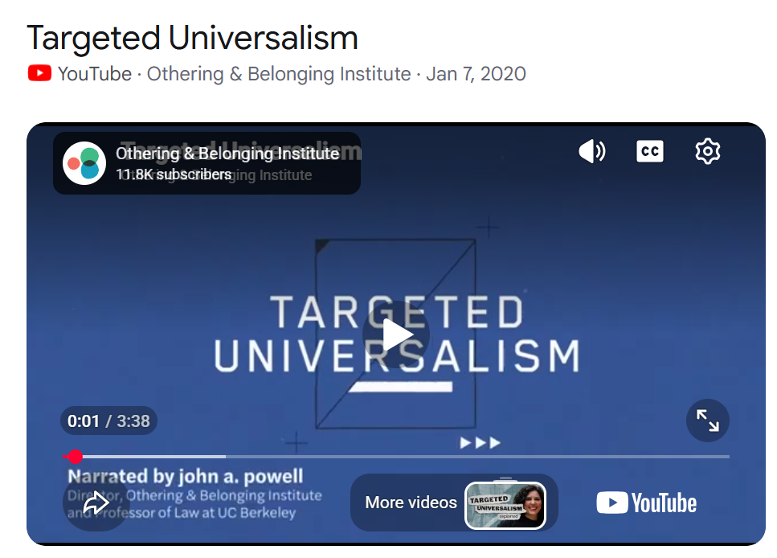
https://youtu.be/a0At2xbQB7w

Slide 8
Targeted Universalism
Focuses on a universal goal that is co-created with those who are impacted by the goal then create targeted solutions. ​
Measures both the general population and population segments proximity to the universal goal rather than pitting groups against one another​​
Empowers communities and population segments to co create with their own solutions instead of prescribing and controlling exactly how they will achieve the universal goals. ​

Slide 9
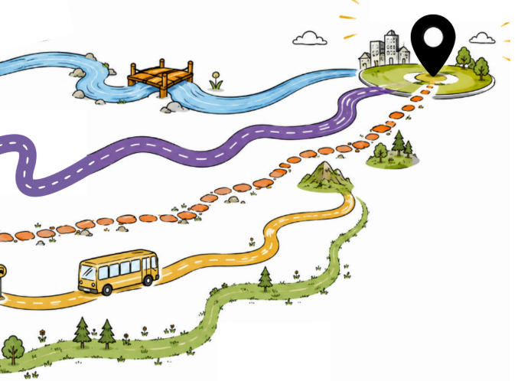

Notes:
Explain how TU is an Equity Framework – what it is.. And how people can use this for their equity goals.
Targeted Universalism starts by identifying a shared goal that everyone would like to achieve. It recognizes that communities may face different barriers, so it uses different strategies and supports to help everyone reach that goal.
This framework understands that people have different experiences and circumstances. Because of this, the same strategy may not work for everyone, and different groups may need different approaches to achieve the same outcome.

Slide 10
7 Steps of Targeted Universalism
A universal goal that is informed and co-created with those impacted by the goal.
Measures both overall population performance and population segments in relation to the universal goal rather than pitting groups against one another.
Disaggregate Data: Identifies the conditions and structures that create different outcomes for different groups.
The “why”: Identify the structures and systems that intersect with the problem and determine the outcomes for each group.
Design and implement targeted strategies for each group to reach the universal goal
Develop messaging and stories that support TU strategies and belonging
Continuous learning and evaluation: Co-create and agree on the design of how impact will be measured and evaluated. Include those with lived experience in co-creation process.
Notes:
Establish a universal goal based upon a broadly shared recognition of a societal problem and collective aspirations.
Assess the general population performance relative to the universal goal.
Identify groups & places that are performing differently with respect to the goal and the overall population. Groups should be disaggregated.
Assess and understand the structures and conditions that support or impede each group or community from achieving the universal goal.
Develop and implement targeted strategies for each group to reach the universal goal.

Slide 11

Step 1:
Co-create
Universal Goal

Slide 12
Universal Goal
Universal goals are outcomes based
Universal goals focus on structures and institutions
in understanding what problem you are addressing,
Do focus on the construction and situatedness of groups and individuals
Do focus on data and disaggregated information and what story it tells
Do build more cohesion with all groups through the co-creation of a universal goal
Notes:
Identify universal goals you hope to achieve.
Separately, specify what disparities or inequities you hope that achieving the universal goal will help solve.
Most policies have a statement of goals or purposes.
The goal should be framed in relation to the problem you wish to address. (This seems simple but is possibly the most difficult step in the process)
It is time-intensive and requires tremendous collective effort.
–
The universal goal should not reference specific groups or aim to reduce disparities, and should be set independent of all groups.
The articulation of the universal goal is the first step in a targeted universalism platform because it then serves as the basis for subsequent policy development.
Without reference to the universal goal, it becomes difficult, if not impossible, to assess progress and evaluate success.
Defining the goal in terms of collective aspirations will require the input of many stakeholders, and can be a time-intensive process if done well.
It is partly a visioning process as well as an effort to get members of the institution or community to articulate a shared vision, much like vision and mission statements do for institutions.
This step requires bringing everyone affected or touching the policy to be at the table: experts, community members, affected people, and everyone involved in implementation. It requires meaningful community engagement and involvement.
TU is not just about removing barriers; it is about being affirmative and how we organize to realize the universal.

Slide 13
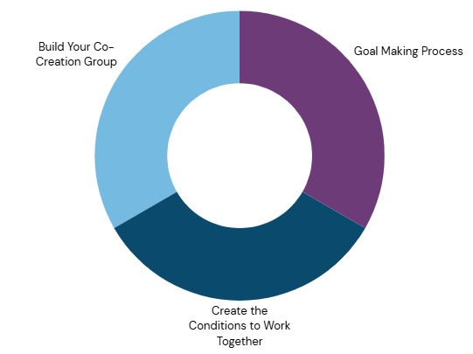
Universal Goal
Notes:
Identify universal goals you hope to achieve.
Separately, specify what disparities or inequities you hope that achieving the universal goal will help solve.
Most policies have a statement of goals or purposes.
The goal should be framed in relation to the problem you wish to address. (This seems simple but is possibly the most difficult step in the process)
It is time-intensive and requires tremendous collective effort.
–
The universal goal should not reference specific groups or aim to reduce disparities, and should be set independent of all groups.
The articulation of the universal goal is the first step in a targeted universalism platform because it then serves as the basis for subsequent policy development.
Without reference to the universal goal, it becomes difficult, if not impossible, to assess progress and evaluate success.
Defining the goal in terms of collective aspirations will require the input of many stakeholders, and can be a time-intensive process if done well.
It is partly a visioning process as well as an effort to get members of the institution or community to articulate a shared vision, much like vision and mission statements do for institutions.
This step requires bringing everyone affected or touching the policy to be at the table: experts, community members, affected people, and everyone involved in implementation. It requires meaningful community engagement and involvement.

Slide 14
POLL / SURVEY
Based on the information we went over select which are examples of universal goals.
Notes:
Reduce U.S. birthing individuals’ mortality rate to 1 death per 100,000 live births across all demographic groups.

Slide 15
Step 2:
Assess performance relative to the
Universal Goal

Slide 16
Step 2:
Assess all group’s performance relative to the Universal Goal
Identify the difference between the universal goal and overall performance.
Example: Goal is 100% high school graduate rate. Suppose a school district’s graduation rate is 92%.

Slide 17
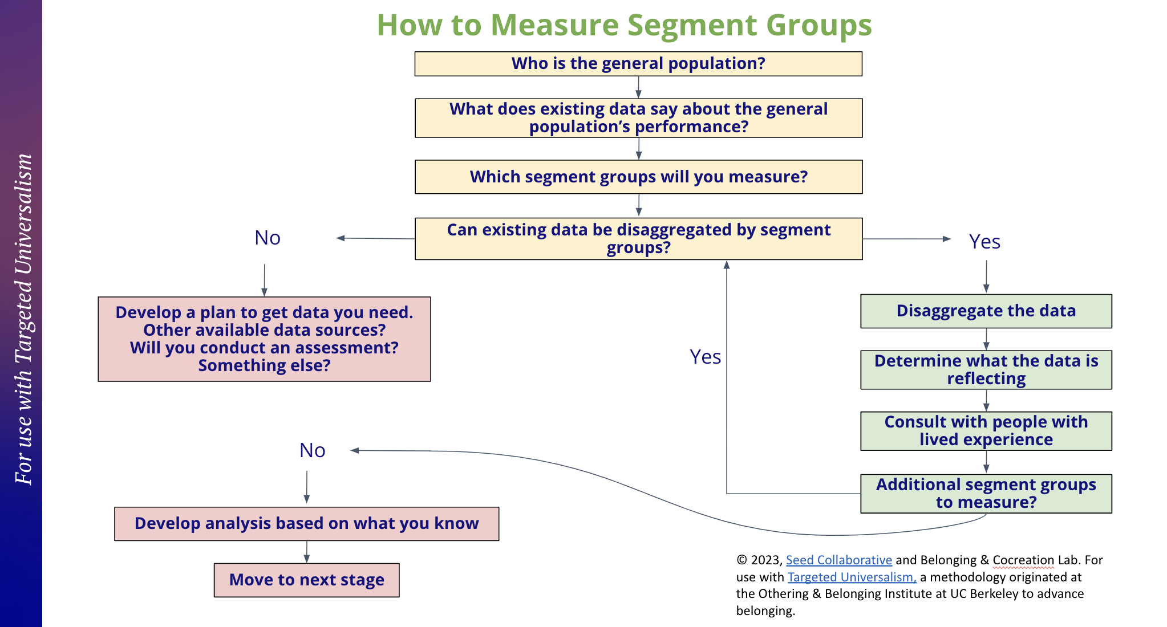
Data

Slide 18
Step 3:
Identifies the conditions & structures that create different outcomes for different groups.

Slide 19
Step 3:
Identifies the conditions and structures that create different outcomes for different groups.
Identify groups & places that are performing differently with respect to the universal goal and the general population.
Groups should be disaggregated
Notes:
Disaggregating the data creates a very different impression.
Group that needs the most attention.
If we disaggregate further, we would get an even stronger sense.

Slide 20
Disparities Analysis
There is no prescribed formula.
  In each situation, different groups may perform differently.
Isolate groupings that are performing further from the goal.
  Social identity groups
  Geographies
  Socioeconomic circumstances
  Other conditions/circumstances.

Slide 21
Step 4:
Identify Barriers
& Resource Needs

Slide 22
Step 4: Assess and understand the structures and systems the support or impede each group from achieving the Universal Goal.
This is the WHY some groups are further from the universal goal.
  SWOT Analysis
  Iceberg Model
  The 5 Why’s Analysis
  Cause & Effect Diagram

Slide 23
Whose perspective should be at the center?
Education Sector Example:
  To understand why a “x” group performs worse in a class:
  Ask students, teachers, parents, counselors, and experts/researchers.
  Maybe it has to do with nutrition, sleep, undiagnosed vision or hearing problems, English language difficulties, etc.,

Slide 24
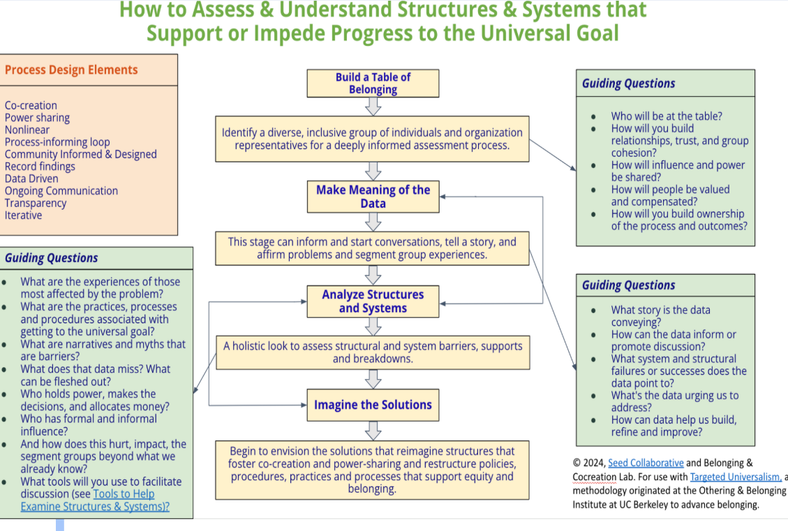

Slide 25
Step 5:
Targeted Strategies

Slide 26
Step 5:
Targeted Strategies: Brainstorm, Select, Implement
Brainstorm, select, and implement specific strategies tailored to the barriers or resource needs you identified in step 3-4 for each group analyzed.
Notes:
Different implementation strategies may be required for different groups and/or institutions or systems.
Example: Students with learning disabilities may need a different set of supports that students who are food insecure.

Slide 27
Develop goals and subgoals, strategies or recommendations:
Develop outcome-focused targeted strategies based on categories.
Group together recommendations/goals organized by agency, area, or based on groups/people of influence and authority.
Prioritize need and urgency. Prioritization aligns with allocation of resources.
Notes:
Combine local knowledge
Groups in distress and farthest from the universal goal are the recipients of greater and more urgent support.
Don’t ignore the needs of any group, including those closer to achieving the universal goal, unintentionally excluding them from the process or dismissing their needs.
Prioritization aligns with allocation of resources.
and qualitative insights for an intentional process of prioritization based on acute need and extreme circumstances.

Slide 28
Step 6:
Communication &
Messaging

Slide 29
Step 6: Communication & Messaging
Lead your messaging with an affirmative universal goal
Tell intentional stories that give context to the problem
Center humanity and transparency
Affirm solutions-oriented process grounded in fairness, care and belonging
Restate the universal goal and bold vision
Concrete asks or call-to-action (if applicable)
Notes:
Lead your messaging with an affirmative universal goal
Tell intentional stories that give context to the problem
Center humanity and transparency
Affirm solutions-oriented process grounded in fairness, care
and belonging
Restate the universal goal and bold vision
Concrete asks or call-to-action (if applicable)

Slide 30
Step 6: Communication & Messaging
Goal/Crisis: You are an organization that receives a number of federal grants. The Fed govt has informed you to discontinue DEI/equity efforts.
We are committed to our workers reflecting our community and being a place where everyone can thrive.
Notes:
Lead your messaging with an affirmative universal goal
Tell intentional stories that give context to the problem
Center humanity and transparency
Affirm solutions-oriented process grounded in fairness, care
and belonging
Restate the universal goal and bold vision
Concrete asks or call-to-action (if applicable)

Slide 31
Step 6: Communication & Messaging
Reduce U.S. birthing individuals’ mortality rate to 1 death per 100,000 live births across all demographic groups.
“Our organization is focused on ensuring that every individual giving birth is treated with dignity and a level of care and fairness that will eliminate maternal mortality.”
Notes:
Lead your messaging with an affirmative universal goal
Tell intentional stories that give context to the problem
Center humanity and transparency
Affirm solutions-oriented process grounded in fairness, care
and belonging
Restate the universal goal and bold vision
Concrete asks or call-to-action (if applicable)

Slide 32
Step 7:
Continuous
Measurement
&
Evaluation

Slide 33
Step 7: Evaluation of Process & Outcomes
To what extent were structures and/or systems changed or transformed and did more people advance towards the universal goal as a result?
Notes:
The golden evaluation question when it comes to evaluating TU application is:

Slide 34
Evaluation - Process
To what extent was co-creation practiced throughout all seven stages?
Were people with lived experience included in the co-creation process?
To what extent was bridging practiced?
To what extent was messaging effective?
Notes:
The golden evaluation question when it comes to evaluating TU application is:

Slide 35
Evaluation - Outcomes
To what extent did population and segment groups reach or advance towards a universal goal?
To what extent were strategies successful in changing/transforming structures/systems?
To what extent did the co-creation group make progress towards or achieve identification of barriers?
Notes:
The golden evaluation question when it comes to evaluating TU application is:

Slide 36
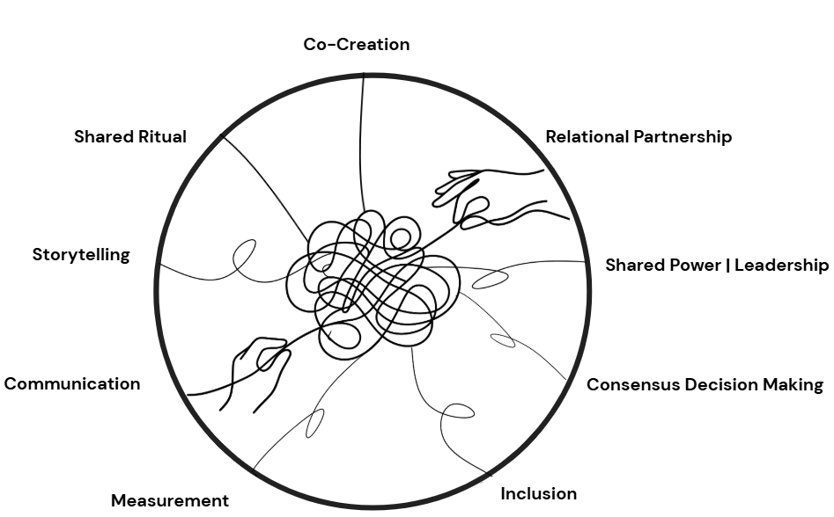
9 Processes of Targeted Universalism
Notes:
Designing for belonging, designing for equity
A Targeted Universal framework manifest the understanding that we are collectively better off when all groups advance towards a shared goal.

Slide 37

Contact Information
Amber Ortiz-Díaz, M.Ed, (She/Ella)
Program Manager, Shared Power Design
Washington State Office of Equity | Office of Governor Bob Ferguson
amber.ortiz-diaz@equity.wa.gov
sharedpower@equity.wa.gov
www.equity.wa.gov

Slide 38
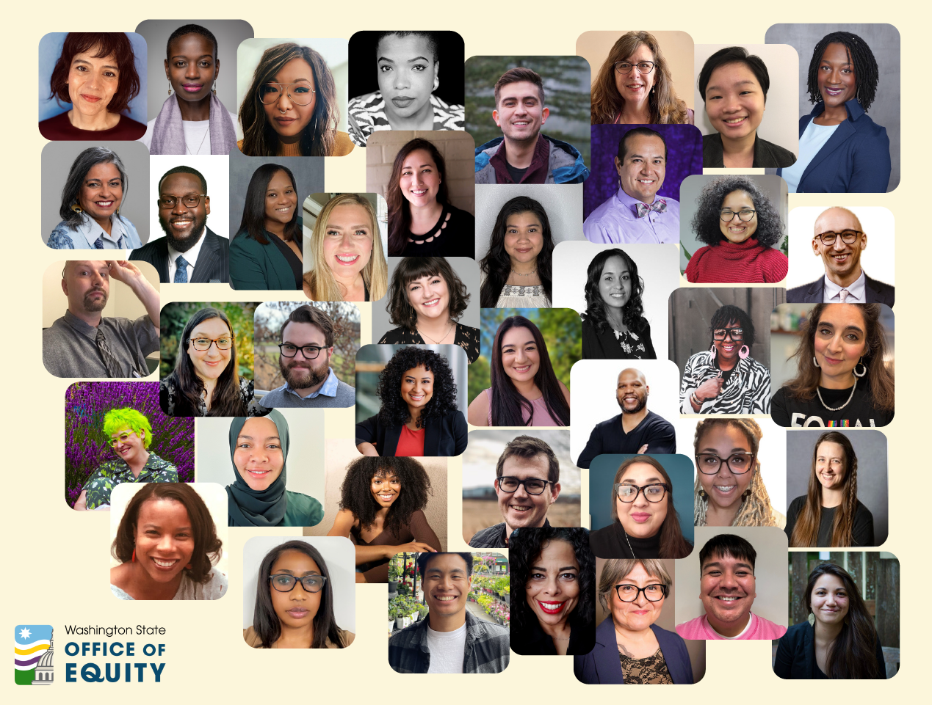

Slide 39
EQUITY Resources
Community Engagement Toolkit
Relational Partnership Workbook
Coming Soon: Washington State Office of Equity Shared Power Guide

Slide 40
Templates/Resources:
Seed Collaborative & OBI
Universal Goal Co-Creation Worksheet
Targeted Universalism Glossary
Flow Chart: Support or Impede Universal Goal
Flow Chart: How to measure segment groups
TU Communication Model template
Evaluation Metric template for process & outcomes

Slide 41
Sources
Othering & Belonging Institute. Frequently asked questions about Targeted Universalism. University of California, Berkeley. Retrieved from https://belonging.berkeley.edu/faq-targeted-universalism
Othering & Belonging Institute. Introduction. University of California, Berkeley. Retrieved from https://belonging.berkeley.edu/introduction
Othering & Belonging Institute. Targeted Universalism animated video. University of California, Berkeley. Retrieved from https://belonging.berkeley.edu/targeted-universalism-animated-video
Othering & Belonging Institute. Targeted Universalism case studies. University of California, Berkeley. Retrieved from https://belonging.berkeley.edu/tu-case-studies
Othering & Belonging Institute. Targeted Universalism primer (PDF). University of California, Berkeley. https://belonging.berkeley.edu/sites/default/files/ARCHIVE/targeted_universalism_primer.pdf?file=1&force=1
Othering & Belonging Institute. Targeted Universalism training courses. Retrieved from https://obiu.org/courses

Slide 42
Special Thanks & Credit to:
john a. powell
UC Berkeley
Othering & Belonging Institute
The Seed Collaborative
&
Washington State Office of Equity
Shared Power Design Team

