Slide 1





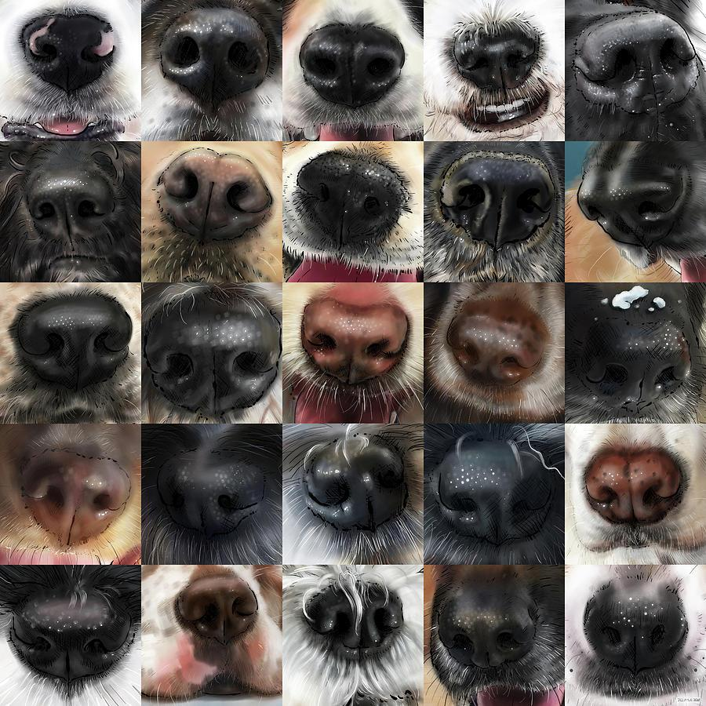
Who do we serve? Why CX makes it easier to serve everyone
And faster and cheaper!
Icebreaker: What’s your favorite smell?
October, 2025

Slide 2
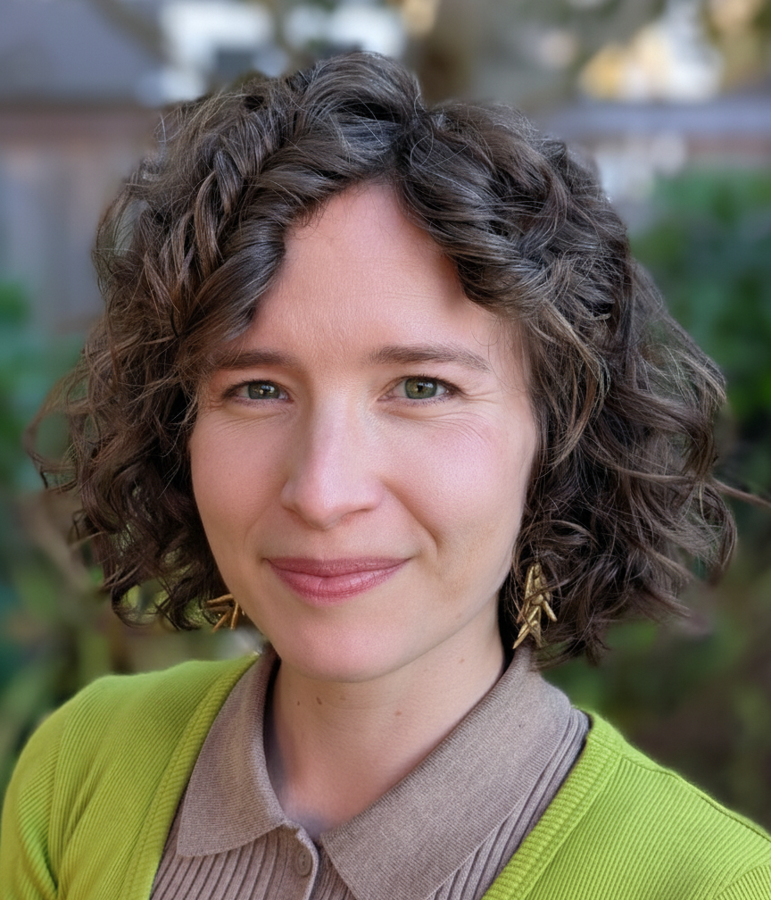
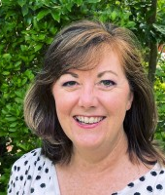
Presenters
Hannah Burn (she / her)
Customer Experience Lead
@ Washington Technology Solutions
Dr. Sydney Heimbrock
Chief Industry Advisor for Government
@ Qualtrics

Slide 3
We ask a lot of government.
Efficient but not costly
Responsive but not too risky
Personalized but built for everyone

Slide 4
Efficient but not costly
Responsive but not too risky
Personalized but built for everyone
Make government more human.

Slide 5

Agenda
Intros
Hannah & Sydney (hi!).
Customer Story
Statewide state of mind.
A Framework
Lessons from the feds.
WA Experiences
A HMW moment.
Closing
And thank you.

Slide 6

First up, a quick game of…
Connections!

Slide 7



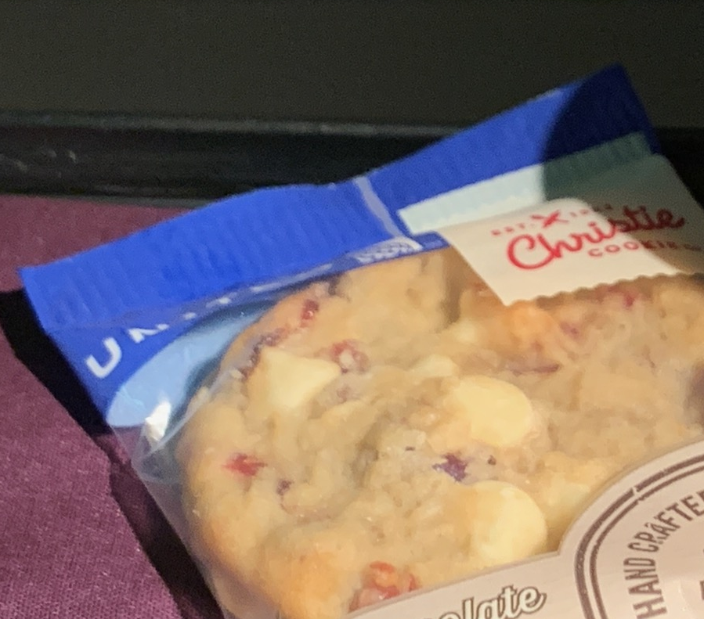
FOOD PERMIT
UBI
LLC FILING
FOOD PROCESSING LICENSE
THINGS YOU NEED TO START A COOKIE BUSINESS
FOOD PERMIT, UBI, LLC FILING, FOOD PROCESSING LICENSE
Go to chat!
What do these have in common?

Slide 8




KC PH
DOR
SOS
WSDA
AGENCIES YOU NEED TO INTERACT WITH TO START A COOKIE BUSINESS
KC PH, DOR, SOS, WSDA
Go to chat!
What do these have in common?

Slide 9
CONFUSION
FRUSTRATION
FEAR
EXASPERATION
What the heck is a UBI?
It’s a whole rabbit hole
What have I got myself into?
I might just give up
FEELINGS HAD STARTING A COOKIE BUSINESS
CONFUSION, FRUSTRATION, FEAR, EXASPERATION
Go to chat!
What do these have in common?

Slide 10

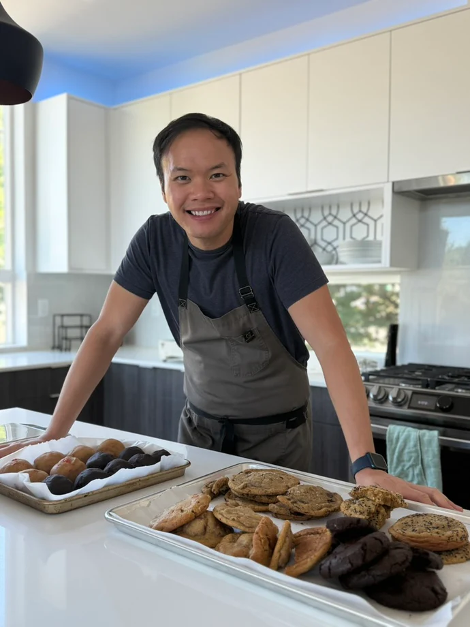

Vince, a customer of WA.
VINCE VU
Anh Ơi Bake Shop Owner
@ohanoi

Slide 11

Vince, a customer of WA.
I need the agencies to talk to each other. I understand – as a business owner – I’m going to have to file for different things. But it’s really frustrating that I have to piece it together myself.
VINCE VU
Anh Ơi Bake Shop Owner
@ohanoi

Slide 12
Inside out vs outside in.
I live with these acronyms everyday.
I need to do a thing and I think it requires government.
Governor
DOL
DOR
SOS
WSDA
DOH
DOC
DOT
SAO
ESD
DCYF
DSHS
CDHY
OFM
DNR
DFW
DES

Slide 13
What happens when we get trapped in “inside out” thinking?
Go to chat!

Slide 14
Customers suffer. And so do we.
When our services forget the customer’s experience, it can make it harder, slower, and more expensive to deliver service.
Misdirection
People call us for the wrong stuff and we have to deal with re-routing upset customers
Ambiguity
We have to negotiate ownership and handoffs – it can get grey and hard to navigate
Competition
We fight with each other for limited resources – often to solve the same problem at the same time

Slide 15
Agenda
Intros
Hannah & Sydney (hi!).
Customer Story
Statewide state of mind.
A Framework
Lessons from the feds.
WA Experiences
A HMW moment.
Closing
And thank you.

Slide 16
President Biden Executive Order
The Federal Government interacts with millions of people each day and provides vital services during some of the most critical moments in people’s lives.
THE WHITE HOUSE
Putting the People First: Improving Customer Experience and Service Delivery for the American People

Slide 17
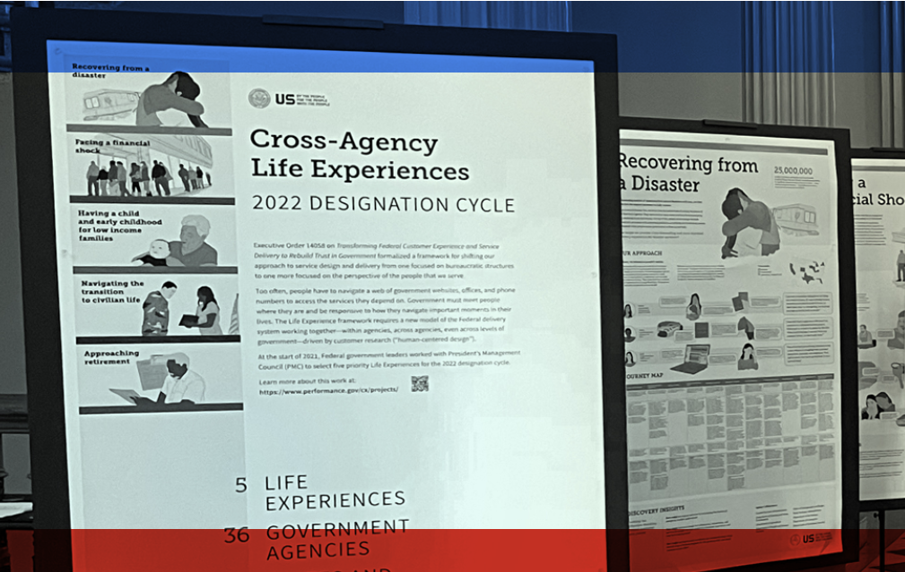
“Life Experience” Framework
Moment that matters
Requires multiple touchpoints
Crosses more than one agency
Or even level of government

Slide 18
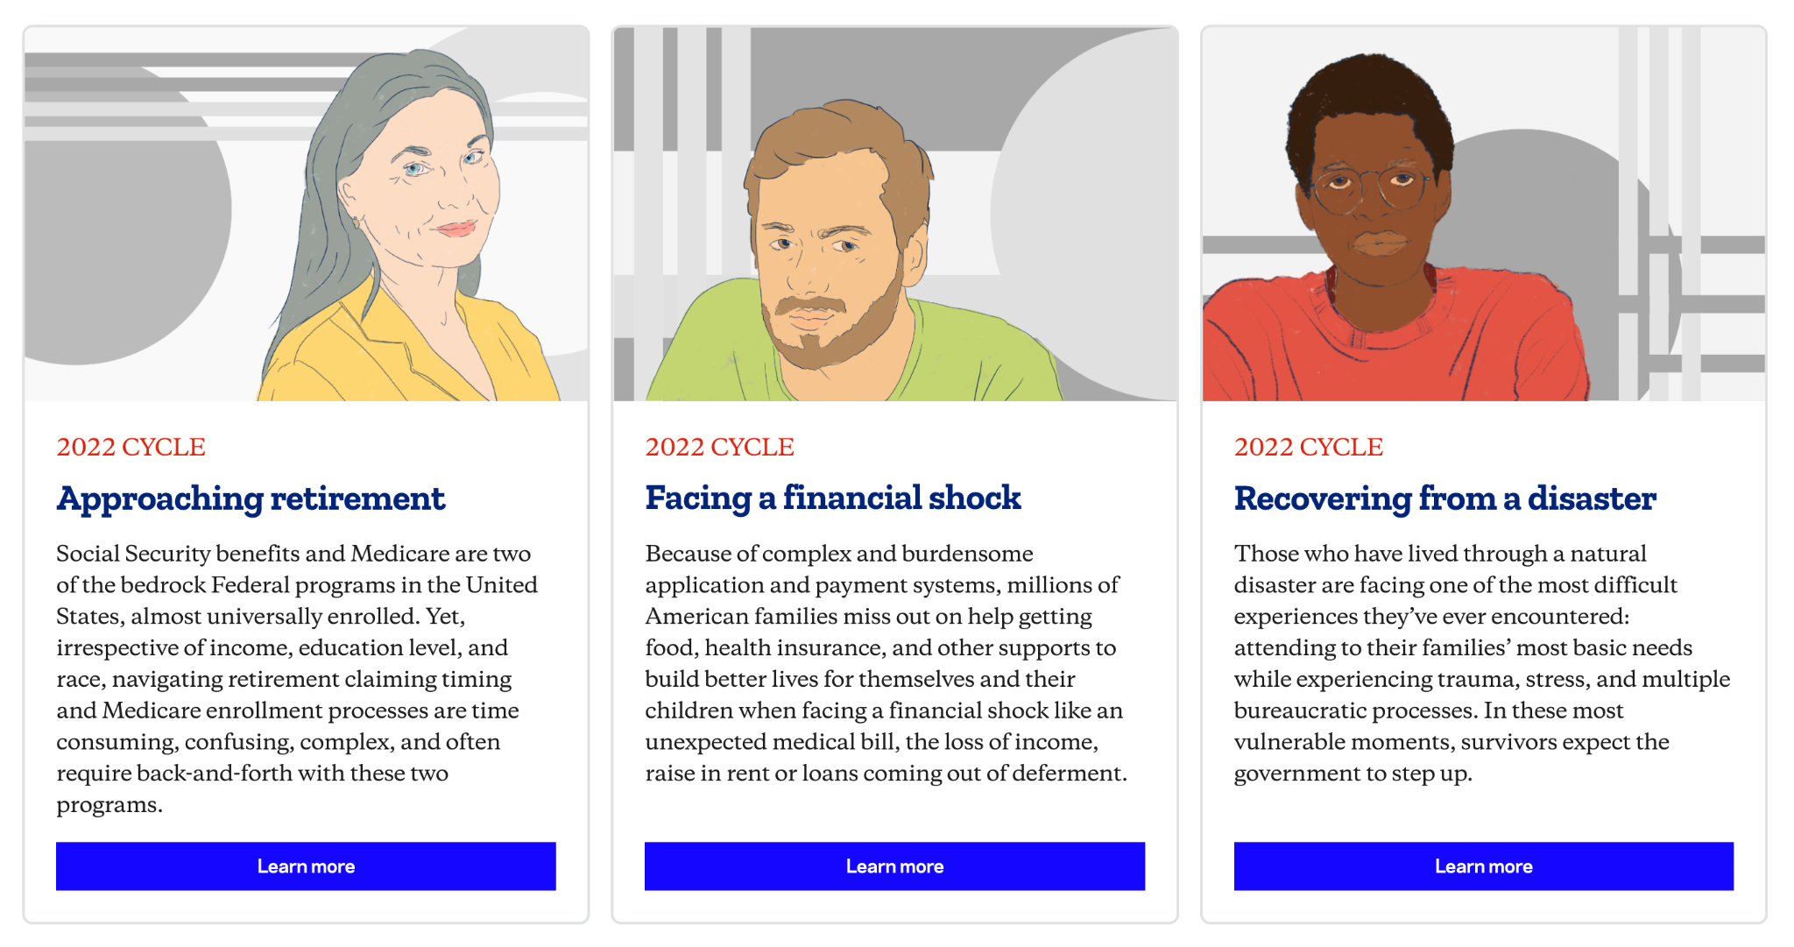
Federal Life Experiences

Slide 19
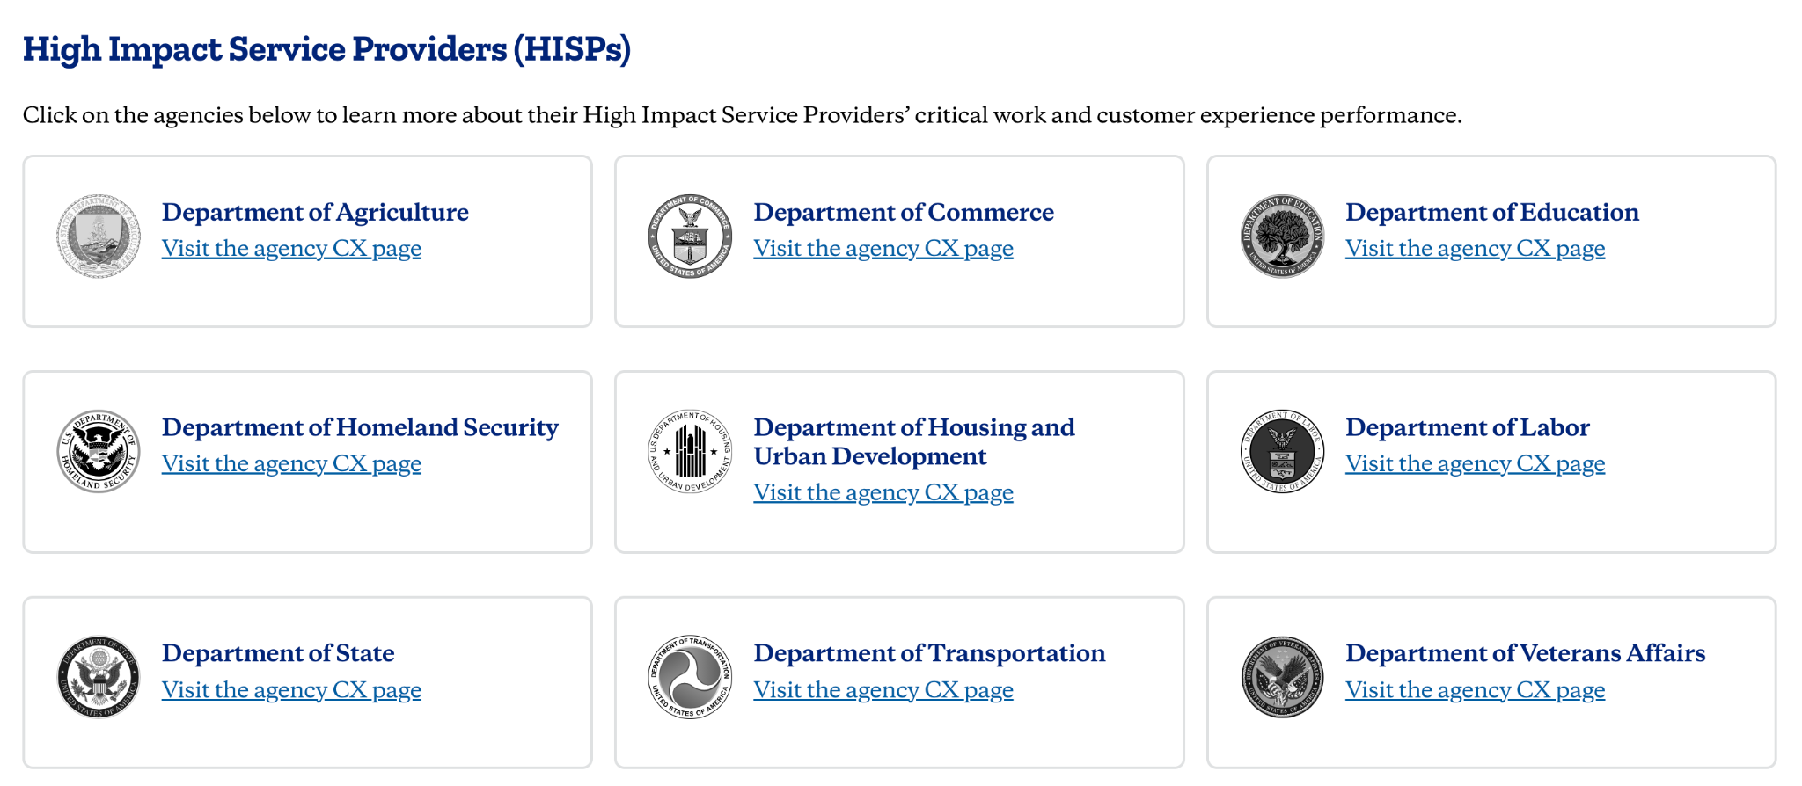
Federal HISPs

Slide 20

HISPs deliver life experiences.
Life Experiences
High Impact Service Providers (HISPs)

Slide 21
HISPs use CX & HCD.
Use Human Centered Design to understand and improve…

Slide 22
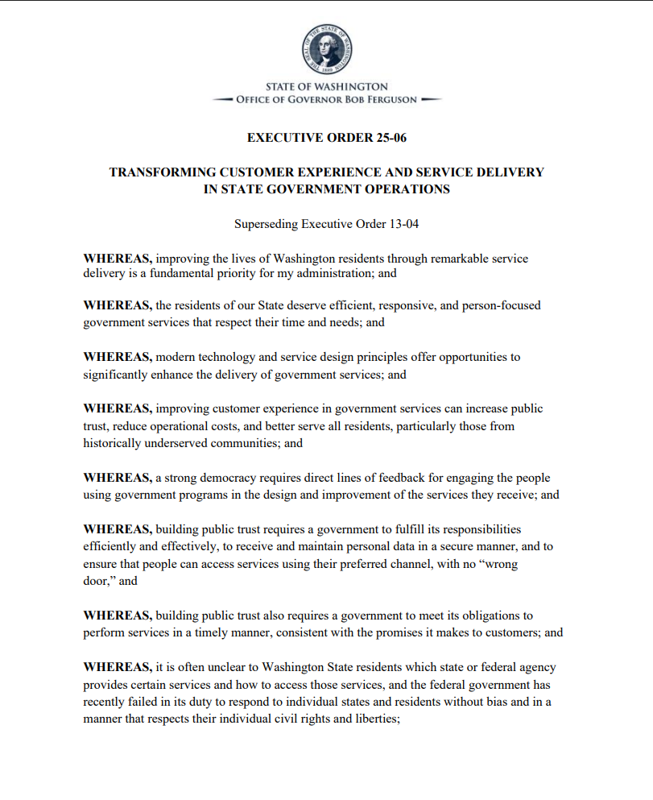
Governor Ferguson’s Executive Order
Improving customer experience in government services can increase public trust, reduce operational costs, and better serve all residents.
STATE OF WASHINGTON
Transforming Customer Experience and Service Deliver in State Government Operations

Slide 23
Agenda
Intros
Hannah & Sydney (hi!).
Customer Story
Statewide state of mind.
A Framework
Lessons from the feds.
WA Experiences
A HMW moment.
Closing
And thank you.

Slide 24
Brainstorm!
Go to chat!
What state “Life Experience” is Vince going through?
VINCE VU
Anh Ơi Bake Shop Owner
@ohanoi

Slide 25
Starting a (food) business
Register a business
Get needed professional licenses
File an LLC
Get local operating permits

Slide 26
Starting a (food) business
Register a business
Get needed professional licenses
File an LLC
Get local operating permits
Google. Look at DoorDash and Reddit (even if it’s inaccurate)

Slide 27
What stands in the way of having a shared understanding of our customer’s life experiences?
Go to chat!

Slide 28
Yeah, it IS hard.
We operate in siloes.
We struggle to share data.
We don’t have visibility into each other’s agencies.
We’re BUSY.
We don’t have all the resources we need.

Slide 29
Moment of opportunity.
Technology
Committed Leaders
Required Creativity

Slide 30









Customer Experience Data Pilot
CX Measurement Pilot
Participating Agencies
Digital CX Program
Statewide Benchmarks: CSAT, Effort, Success
10 Participating Agencies

Slide 31



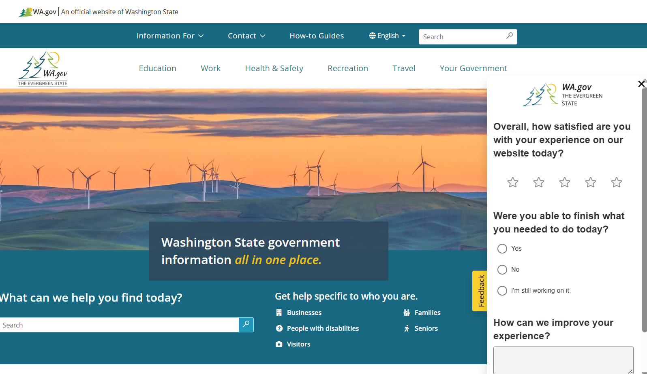
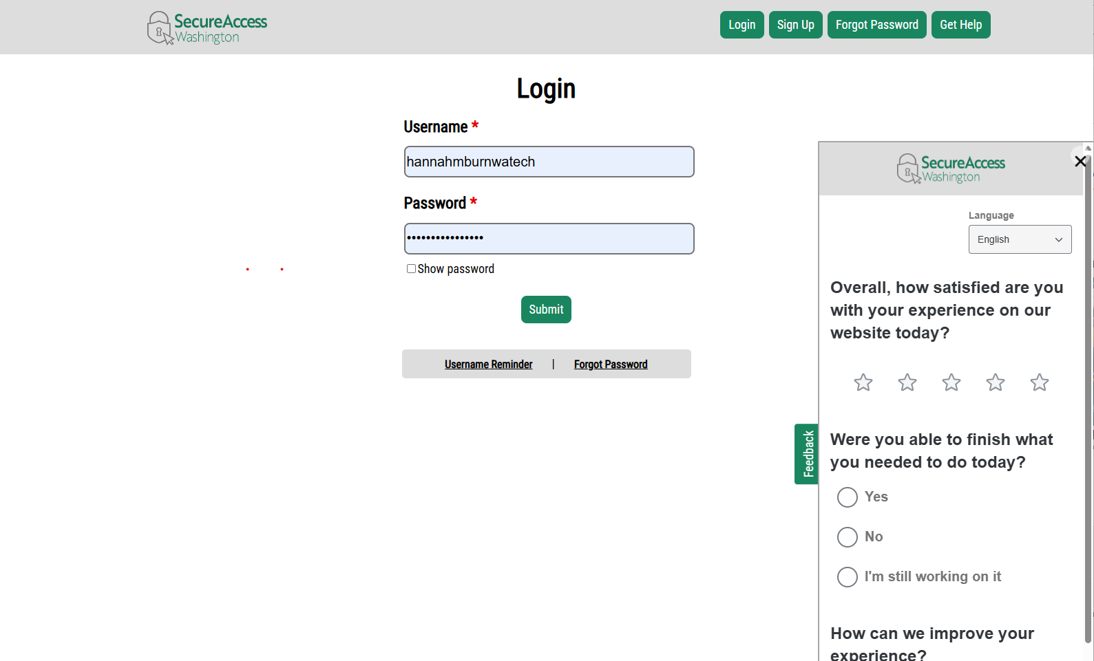
WaTech’s Pilot
Notes:
WaTech – my agency –
Was the guinea pig for this pilot
And we launched customer experience measurement tools
Using Qualtrics
On both WA.gov
And SecureAccess Washington (or SAW)
(which, many of us know, is a product that inspires MANY feelings)
And because these are both central sites that touch MANY service journeys
We’re already getting feedback on things like…
Starting a business.

Slide 32
Starting a business
Theme: 20+ comments wanting to speak to a real person for help.
“It is difficult to find the log in for filing company reports.”
Register a business
Get needed professional licenses
File an LLC
Get local operating permits
“I cannot find any active links to get help with engineering license.”

Slide 33
How might we…
Make our digital services better reflect the end-to-end life experience of starting a business?
Make it easier for people to get human support from someone who understands the end-to-end life experience?
Ensure that agencies who touch this life experience have shared understanding and data?

Slide 34
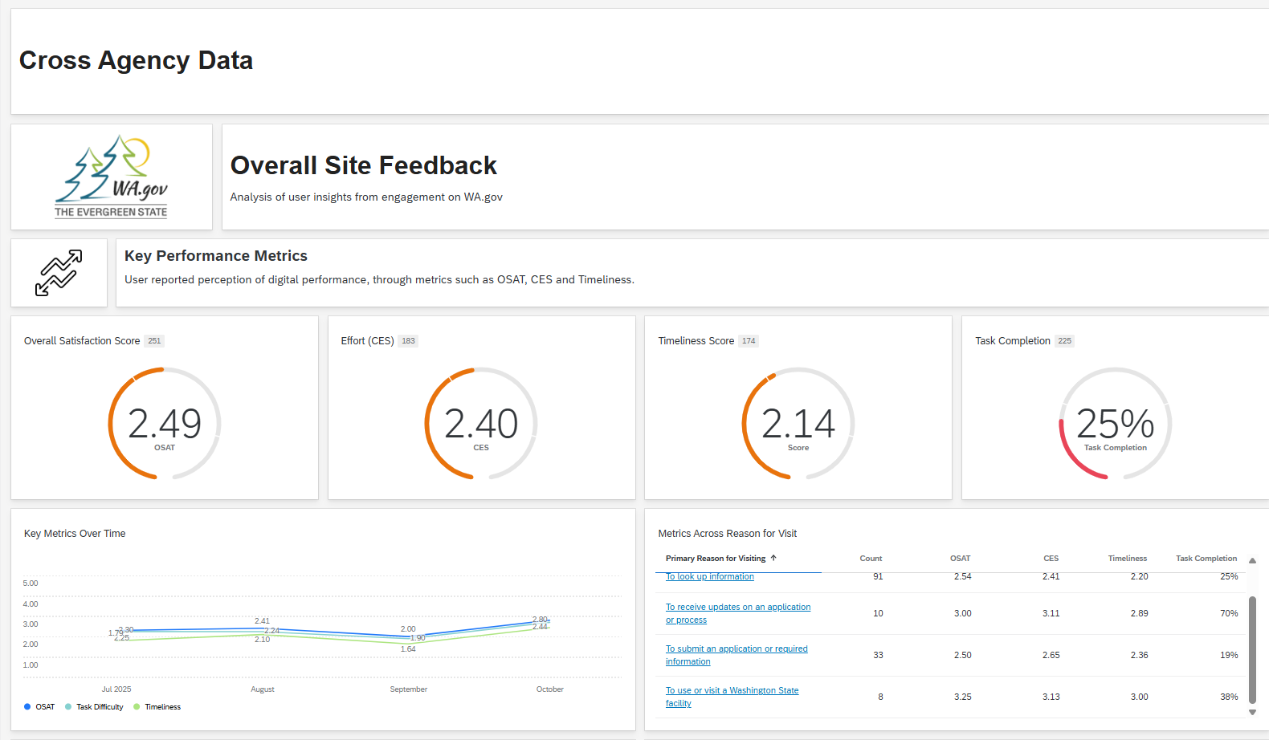
Life Experience Dashboard

Slide 35
Agenda
Intros
Hannah & Sydney (hi!).
Customer Story
Statewide state of mind.
A Framework
Lessons from the feds.
WA Experiences
A HMW moment.
Closing
And thank you.

Slide 36

Do you want to join?
If this is your jam…
State life experiences
Designing digital services to reflect these
Building cross-agency feedback systems
Let’s chat!
Notes:
So…

Slide 37
Thank you!
Get in touch!
Hannah Burn hannah.burn@watech.wa.gov

