Slide 1

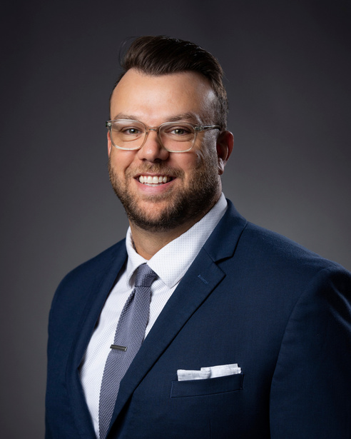
Bobby McKee
Director of Citizen Engagement, Office of Administration

Slide 2



We are all the State of Missouri!

Slide 3

What is Customer Experience?
Customer Experience (CX) is the set of emotions, behaviors, and attitudes of people based off of a series of interactions as part of a transaction.

Slide 4


Customer Experience
Customer
Service
Encompasses the entirety of interactions between a citizen and the State of Missouri
Is one part of the entire journey a citizen would take

Slide 5

Why is Customer Experience important?
Industry research from The McKinsey Institute found that improving customer experience drives better critical outcomes for government agencies, including:
01
Continuous Improvement
02
Decreased Cost to Serve
03
Improved Employee Morale
Work smarter, not harder
Try new tools

Slide 6
Continuous Improvement
When processes are improved and customers are satisfied, customers are more likely to trust the agency and to agree that the agency is delivering on its mission.
9x
9x
More likely to trust the agency providing services
More likely to agree that the agency is delivering on its mission

Slide 7

Decreased Cost to Serve
Dissatisfied customers are twice as likely to reach out to an agency three or more times and to publicly express dissatisfaction. By having satisfied customers, who can self-serve, we are able to gain efficiencies and drive our costs down.
2x
More likely to contact the agency 3+ times
2x
More likely to publicly express dissatisfaction

Slide 8
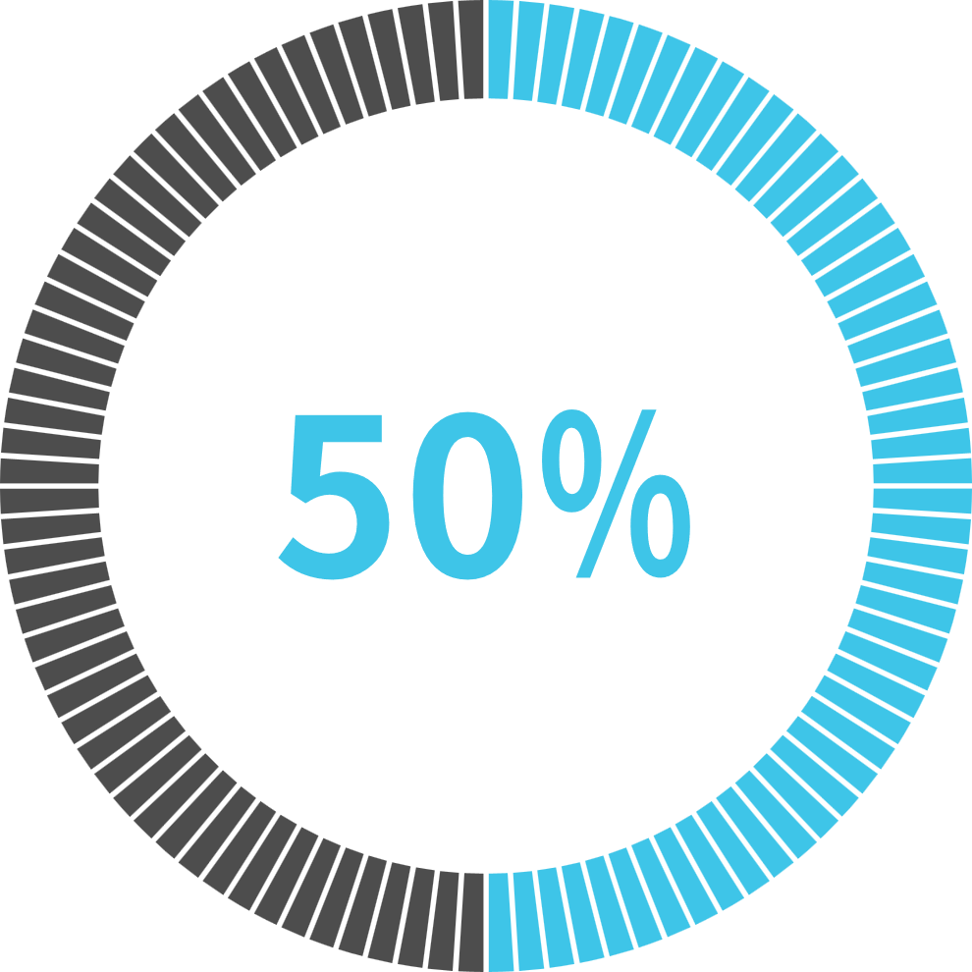

Improved Employee Morale
Long term organizational success is fifty percent driven by organizational health and is mutually reinforced by CX.
By having satisfied customers, we can have a more engaged and happier workforce. This can be tracked easily by QPS.

Slide 9
Why is Customer Experience important?
Decreased Cost to Serve
Easy To Use Services
Reliable and Responsive Services
Improve Trust and Perception
Boost Employee Morale
Satisfied Customers
Satisfied Customers

Slide 10


State of Missouri
LISTEN
UNDERSTAND
ACT
Powered by Qualtrics

Slide 11
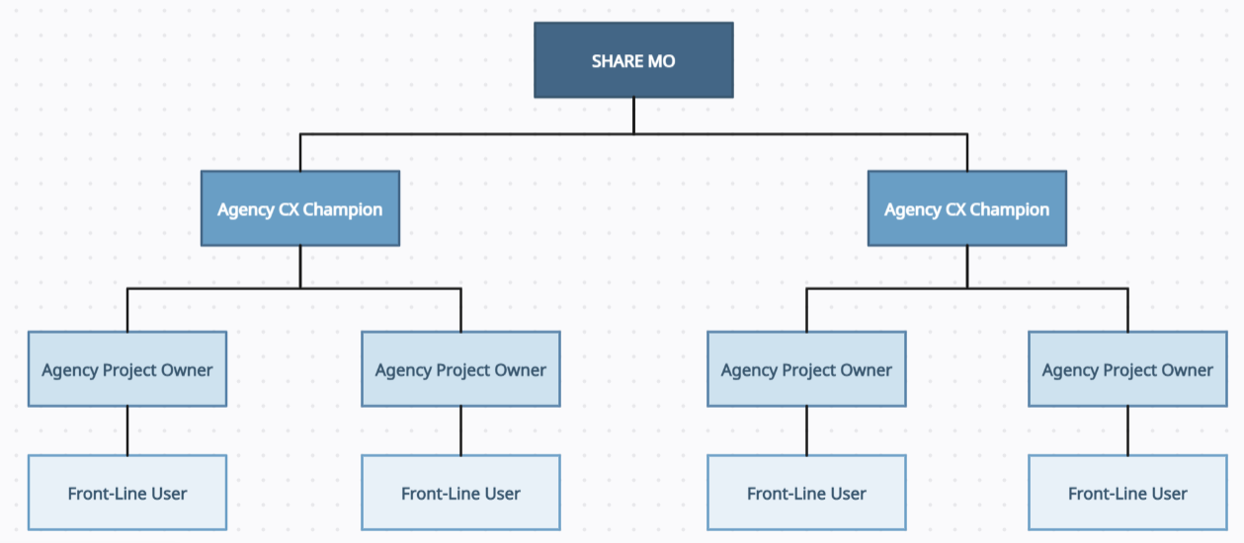
Federated Structure
Using a federated structure, the Office of Administration sets a common vision for the program and enables partner agencies to grow and tailor to meet agency needs. OA provides advisory and technical support and meets with agency representatives monthly to share learnings, track progress, and provide training.

Slide 12

How can SHARE MO help?
01
Provide CX Best Practices
02
Empower stakeholders
03
Provide training and enablement
04
Customer-centric Dashboards
Work smarter, not harder
05
Try new tools
Enable Shared Learnings

Slide 13


Listen
Omni-channel Distribution
Leveraging Qualtrics, SHARE MO provides multiple ways agencies can gather feedback from customers.
Gauge Multiple Touchpoints
Data Consolidation
Automate Distribution
Data Segmentation

Slide 14
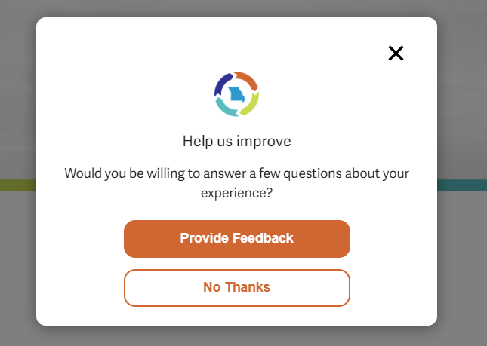
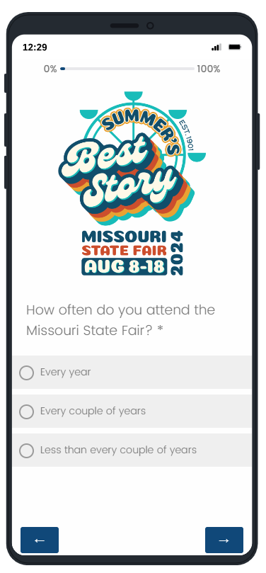
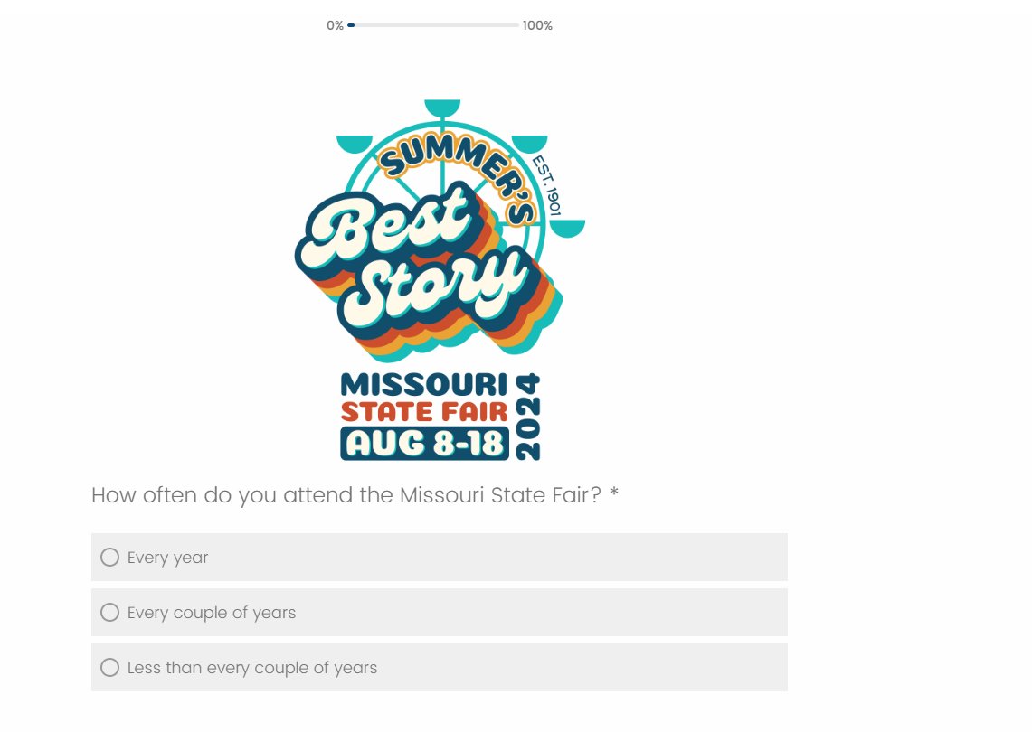
How We Listen
Data Consolidation

Slide 15

Understand
Visualize Data
Once received, SHARE MO can assist in visualizing and analyzing the data
System Integrations
Segmented Dashboards
Automated Reporting
Root Cause Analysis

Slide 16
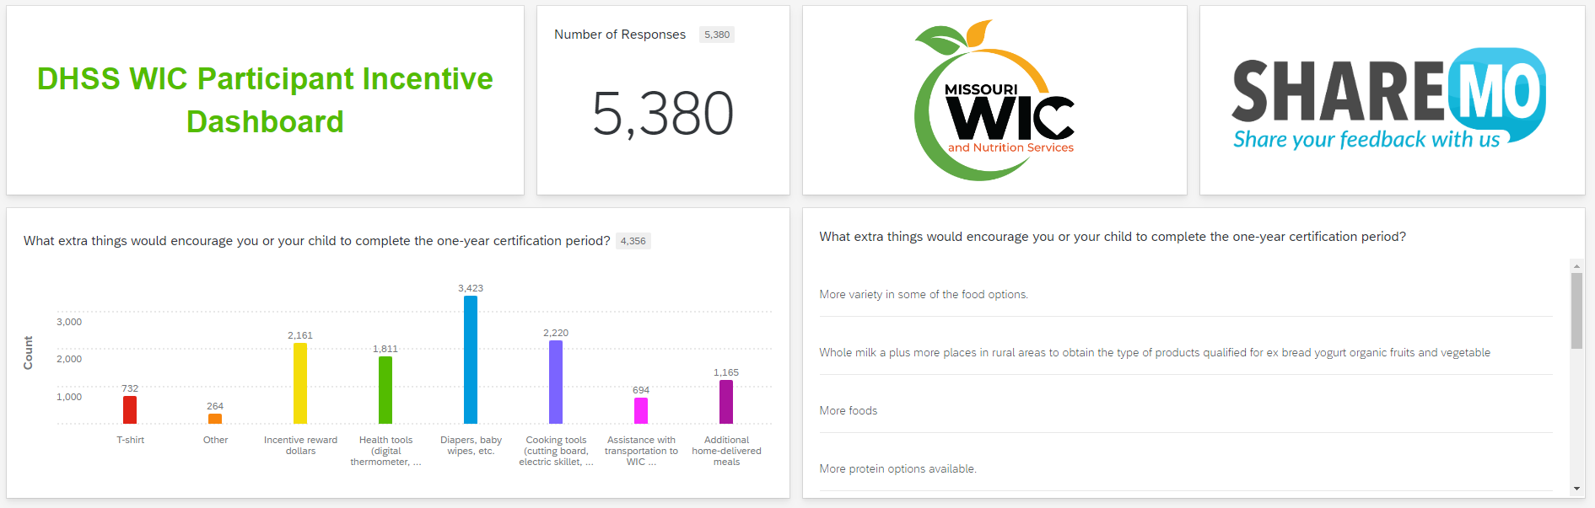
Understand
Gauge Multiple Touchpoints
Data Consolidation

Slide 17

Act
Close the Loop
SHARE MO and the Center of Excellence can assist agencies in Acting on the insights gained.
Improved Processes
Direct Customers
Proactive Responses
Triage Support

Slide 18
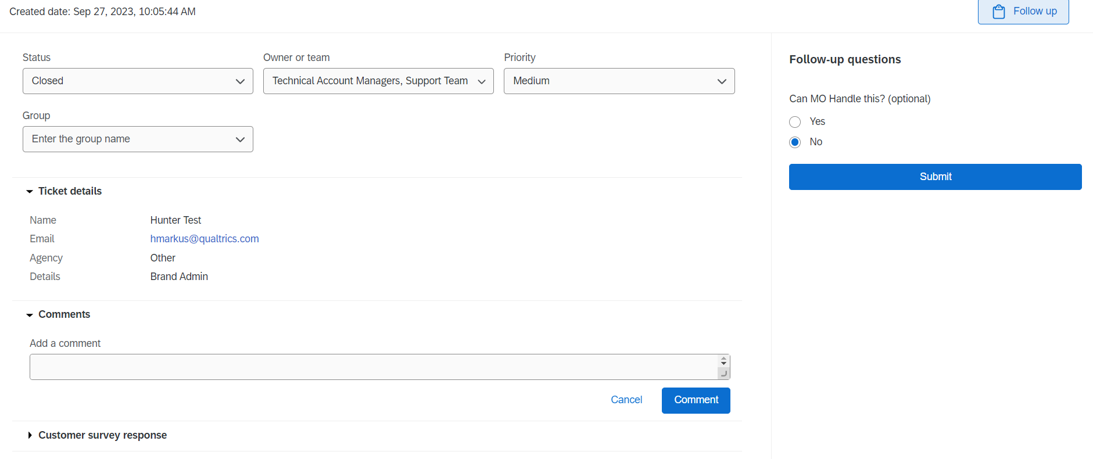
Act
Gauge Multiple Touchpoints
Data Consolidation

Slide 20


(573) 522-9873
bobby.mckee@oa.mo.gov
share.mo@oa.mo.gov

Slide 21
We are all the State of Missouri!

Slide 22

Questions?

