Slide 1









From Lean to CX
OCTOBER, 29 2025
FROM LEAN TO CX:
A New Chapter in Serving Washingtonians
PRESENTED BY:
JEANNIE BOWEN

Slide 2














CX:
THE NEXT EVOLUTION
“CX Means Designing Services WITH the People Who Use and Deliver Them”

Slide 3



Think of a great customer experience you have had. What where you thinking, feeling, saying, and doing?

Slide 4


THE 3 ASPECTS OF CUSTOMER EXPERIENCE
EMOTIONAL | SOCIAL | FUNCTIONAL
It answers: Am I doing this right? | It answers: Do they think I’m capable? | It answers: Can I get this done easily?
“I want to feel confident I submitted everything correctly.” | “I want to be seen as capable and responsible.” | “I need to renew my license.”
People want to feel confident, understood, and respected. | Experiences impact people’s sense of identity, belonging, and respect. | These are practical tasks people need to complete.

Slide 5


FOUNDATIONAL CAPABILITIES
COMMUNICATION
ACTIVE
LISTENING
TIME
MANAGEMENT
ORGANIZATION
EMPATHY
PRIORITIZATION
CULTURAL
COMPETENCY
RELATIONSHIP
BUILDING
COLLABORATION
CUSTOMER
SERVICE
PROBLEM
SOLVING
FACILITATION

Slide 6
LEVERAGING OUR FOUNDATION
LEAN SKILL | ADAPTED FOR CX AND HCD
Asking Questions | Structured Interviews & Human-Centered Research
Research and Information Gathering | Field Observation, Contextual Inquiry
Creativity & Innovation | Divergent/Convergent Thinking Techniques
Systems Thinking | Applied to Service Design & Policy Impact
Risk Assessment | Considering Customer Impact and Equity Risks
Process Mapping and Analysis | Journey Mapping & Service Blueprinting

Slide 7
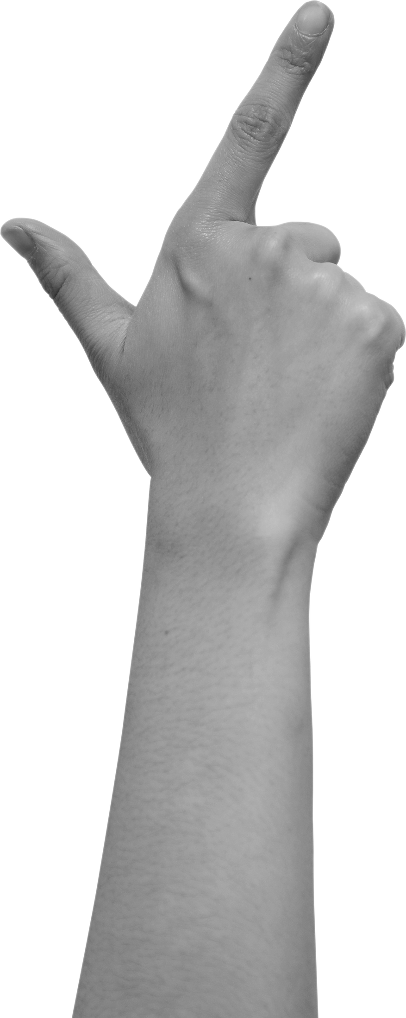



What is Customer Experience
WHAT IS CUSTOMER EXPERIENCE?
Customer experience doesn’t start at the front counter—IT STARTS INSIDE. How leaders support staff, and how managers treat their teams, directly shapes the experience we deliver to the public. – Jesse Jones
WHO IS A CUSTOMER?
Customers are anyone who interacts with a state program or service— residents, businesses, organizations, or staff. In simple terms: those we serve, and those who serve

Slide 8

THE CX VALUE CIRCLE
EMPLOYEES AS PUBLIC CUSTOMERS AND SERVICE RECIPIENTS
EMPLOYEES AS CUSTOMERS OF THE ORGANIZATION
EMPLOYEES AS SERVICE PROVIDERS

Slide 9


CX PRINCIPLES
Lead with Empathy
Embrace Ambiguity
Seek first to Understand
Lead with Optimism
Iterate, Iterate, Iterate
Creative Confidence
Learning from Failure
Make it!

Slide 10
Where do you see great CX in action?
WHERE DO YOU SEE GREAT CX IN ACTION?
Ensure Accessibility for All: Removing physical, digital, and process barriers makes services usable by everyone.
Start with Listening: We begin with the voices of customers and staff to ensure solutions are practical and grounded in real needs.
Design for Equity: Services should work for those who need them most. Equity-centered design helps us close access gaps.
CX isn’t new—many agencies are already applying these principles.
Prototype and Test for Usability Early: Testing helps us improve usability and avoid costly missteps.
Evaluate and Evolve: Ongoing customer feedback and measuring customer satisfaction help us improve over time and build public trust.

Slide 11








LET’S HEAR FROM YOU!
Where have you seen the customer experience matter most in your work?
What excites or concerns you about this shift from Continuous Improvement methodologies to a more holistic approach with Customer Experience?
What could support look like as we do this work together?

Slide 12


YOUR.WA.GOV
YOUR CX TOOLKIT

Slide 13







THANK YOU!
jeannie.bowen@gov.wa.gov

