Slide 1
Design that delivers: Enhancing customer experience through universal design
Sarah Norton
Co-Chair, Disability Inclusion Network (DIN) A WA State Business Resource Group
DIN@ofm.wa.gov

Slide 2

Sarah Norton (She/her)
Multiply Neurodivergent
Tourette’s Syndrome, Autistic, ADHD, OCD, Anxiety, Auditory and Sensory Processing disorders
Bookworm
Favorite genres : Science Fiction and Murder Mysteries
Some favorite books: Ender’s Game, House of Leaves, Great Gatsby, The Giver, Hitchhikers Guide to the Galaxy
Physical Disabled
Psoriatic Arthritis, Psoriasis, Migraines
Favorite dinosaur
The Tri-SARAH-Tops

Slide 3

What will you walk out of here knowing?
I can apply the principles of universal design when creating or improving existing systems, processes, procedures, environments etc.

Slide 4
Important Terms and Concepts

Slide 5
Terms and Concepts (1)
Customer: Person or business that purchases goods or services or a consumer of a product or service.
Accessibility: The ability to independently interact with your environment without the assistance of another person; The ability for all people, to the greatest extent possible, to use goods, services, and products independently without the need for adaptation or specialized design.
Equity: Fairness and justice in how people are treated. Equity is NOT equality. Equity is when everyone has what they need to have the same experiences.

Slide 6

Terms and Concepts (2)
Customer Trust: The confidence the customer has in you to fulfill your promise and uphold your commitments.
Customer Loyalty: The commitment a customer makes to continue as your customer.
Customer Satisfaction: How much the services and products meet and, hopefully, exceed the customer’s expectations.

Slide 7

Terms and Concepts (3)
Curb cut effect – something that was created for disabled people but benefits all people
Elevators and escalators
Automatic doors
Voice to text and text to voice
Trainings in multiple formats
Closed captioning
Breaks in meetings over 1-1.5 hours
Meeting agenda’s ahead of time
Meeting notes sent out after
Plain-language versions of policies

Slide 8
Accessibility = Smart Business

Slide 9

Return on Investment (ROI)
Prioritizing accessibility leads to¹:
Higher revenue (1.6x)
Higher net income (2.6x)
Higher economic profit (2x)
Higher customer loyalty (60%)
Global disability market ~ $18 Trillion
92% - customers who have a move favorable perception of companies that hire people with disabilities.²
1. Companies that Lead in Disability Inclusion Outperform Peers Financially, Reveals New Research from Accenture
2, A Hidden Market: The Purchasing Power of Working-Age Adults with Disabilities

Slide 10

Employee Engagement
Direct link between supervisor support and transformational leadership and employee engagement and well-being
Achievement and development
Empathy and compassion
Support and guidance
Perception of organizations ethical/unethical environment correlates to trust/mistrust in the organization
Higher engagement leads to:
Increased productivity
Better organizational citizenship behaviors
Improved overall job performance
Increased retention
An Exploratory Study of Employee Engagement in Human Service Agencies

Slide 11

Universal Design
“The design of products and environments to be usable by all people, to the greatest extent possible, without the need for adaptation or specialized design.”
Human Centered Design

Slide 12
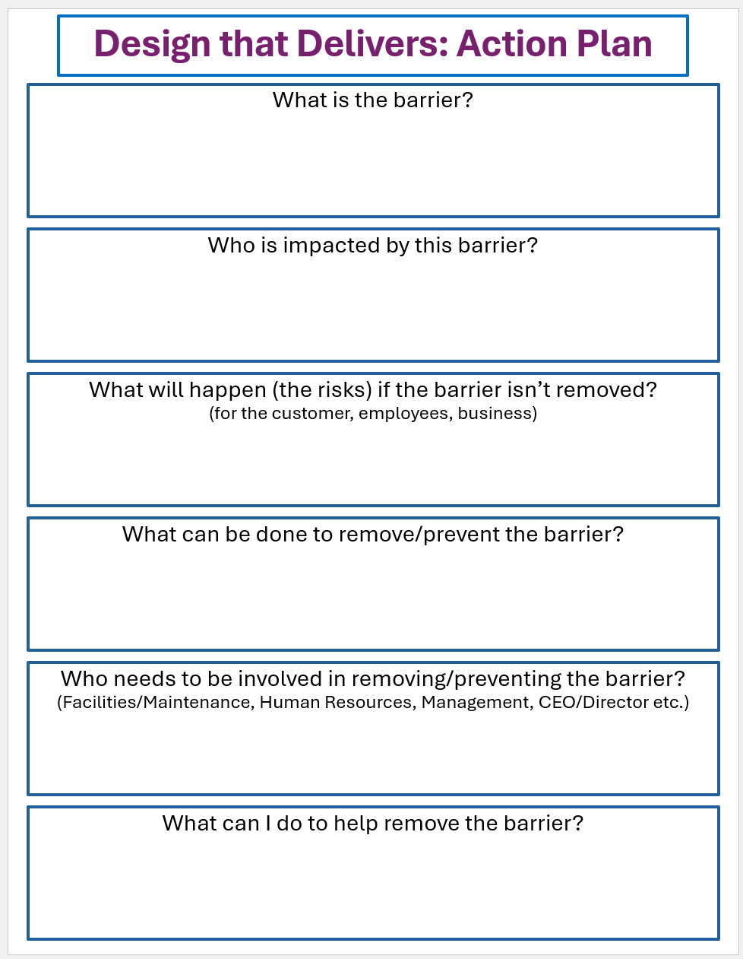
Create Your Plan of Action!

Slide 13
Principle 1 – Equitable Use
The design is useful and marketable to people with diverse abilities.
1a. Provide the same means of use for all users: identical whenever possible; equivalent when not.
1b. Avoid segregating or stigmatizing users.
1c. Make provisions for privacy, security, and safety equally available to all users.
1d. Make the design appealing to all users.
Principles of Universal Design from NC State University

Slide 14
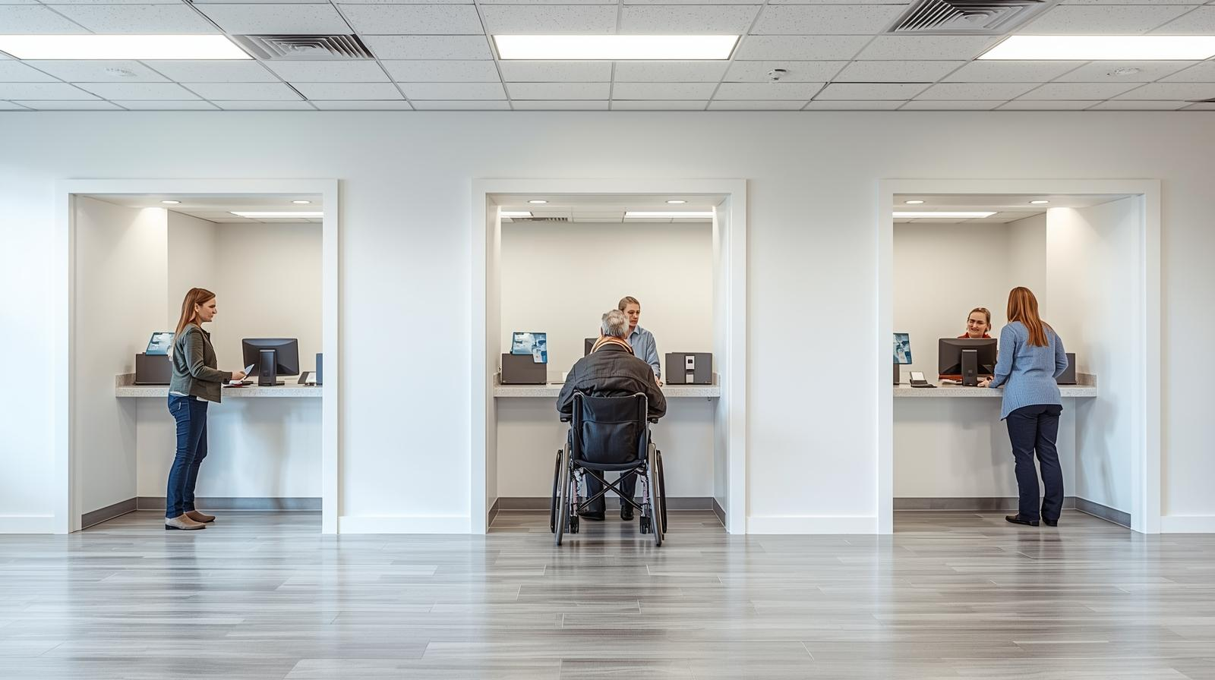
Examples of Principle 1

Slide 15
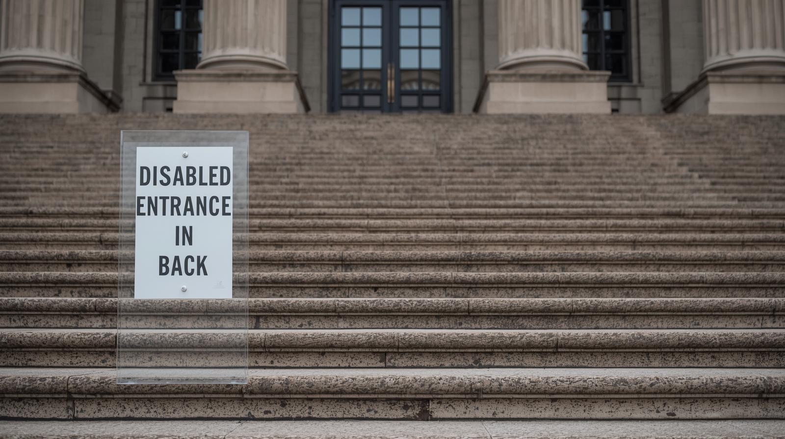
Principle 1 – What not to do

Slide 16


Principle 1 – PDF v. PPTx

Slide 17
Principle 2 – Flexibility in Use
The design accommodates a wide range of individual preferences and abilities.
2a. Provide choice in methods of use.
2b. Accommodation right- or left-handed access and use.
2c. Facilitate the user’s accuracy and precision.
2d. Provide adaptability to the user’s pace.
Principles of Universal Design from NC State University

Slide 18
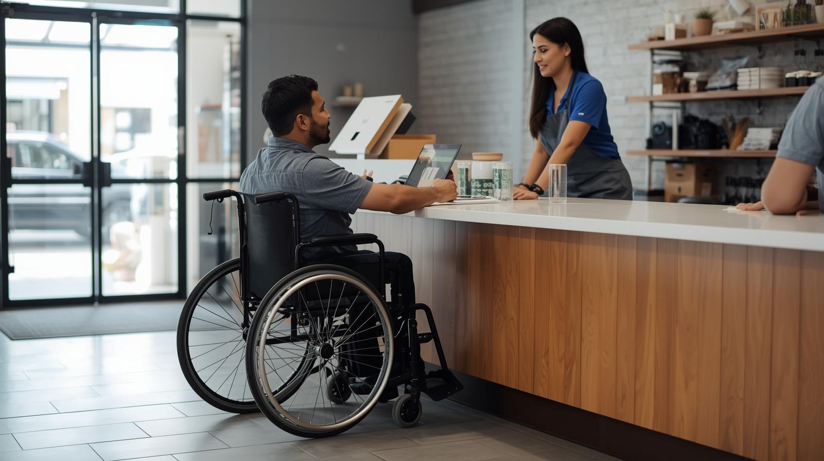



Example – Principle 2
How would you like to receive information from us?

Slide 19
Principle 2 – What not to do
Scenario: You needed to submit a claim to insurance for reimbursement
You sent an electronic request for information on submitting a claim
You received an electronic reply
You were told you had to submit the claim in writing!
Find an envelope
Find a photocopier
Find a printer – with ink and that will actually connect to your printer
Find a stamp (or find a way to get to the store to buy a stamp)
Remember to photocopy the invoice (because that is your only copy)
Remember to write the letter requesting reimbursement
Remember to mail the letter

Slide 20
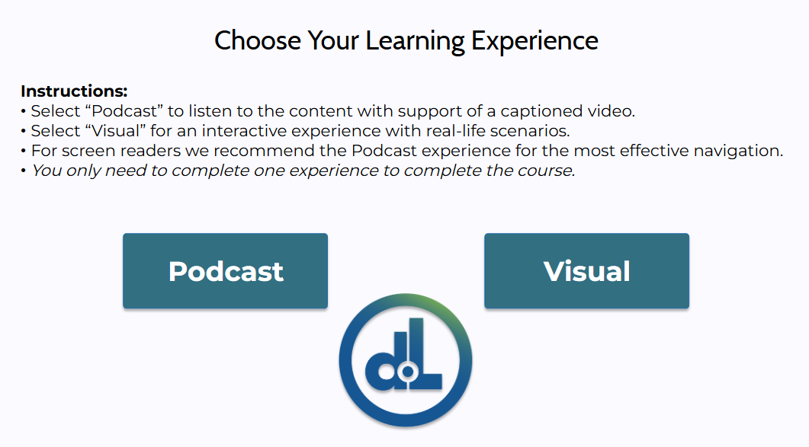
Another Example – Principle 2

Slide 21
Principle 3 – Simple and Intuitive Use
Use of the design is easy to understand, regardless of the user’s experience, knowledge, language skills, or current concentration level.
3a. Eliminate unnecessary complexity.
3b. Be consistent with user expectations and intuition.
3c. Accommodate a wide range of literacy and language skills.
3d. Arrange information consistent with its importance.
3e. Provide effective prompting and feedback during and after task completion.
Principles of Universal Design from NC State University

Slide 22
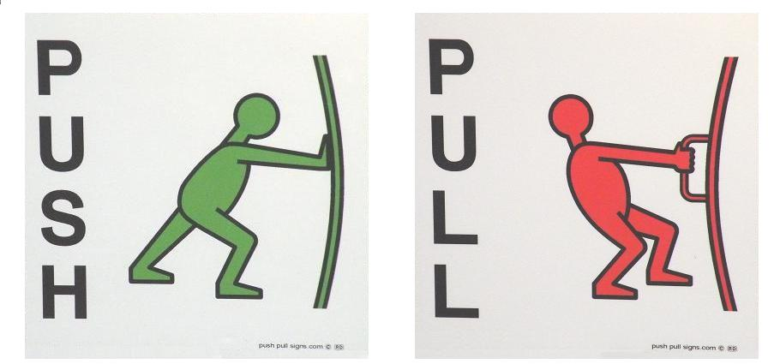
Example – Principle 3
Push Pull Door Sign

Slide 23
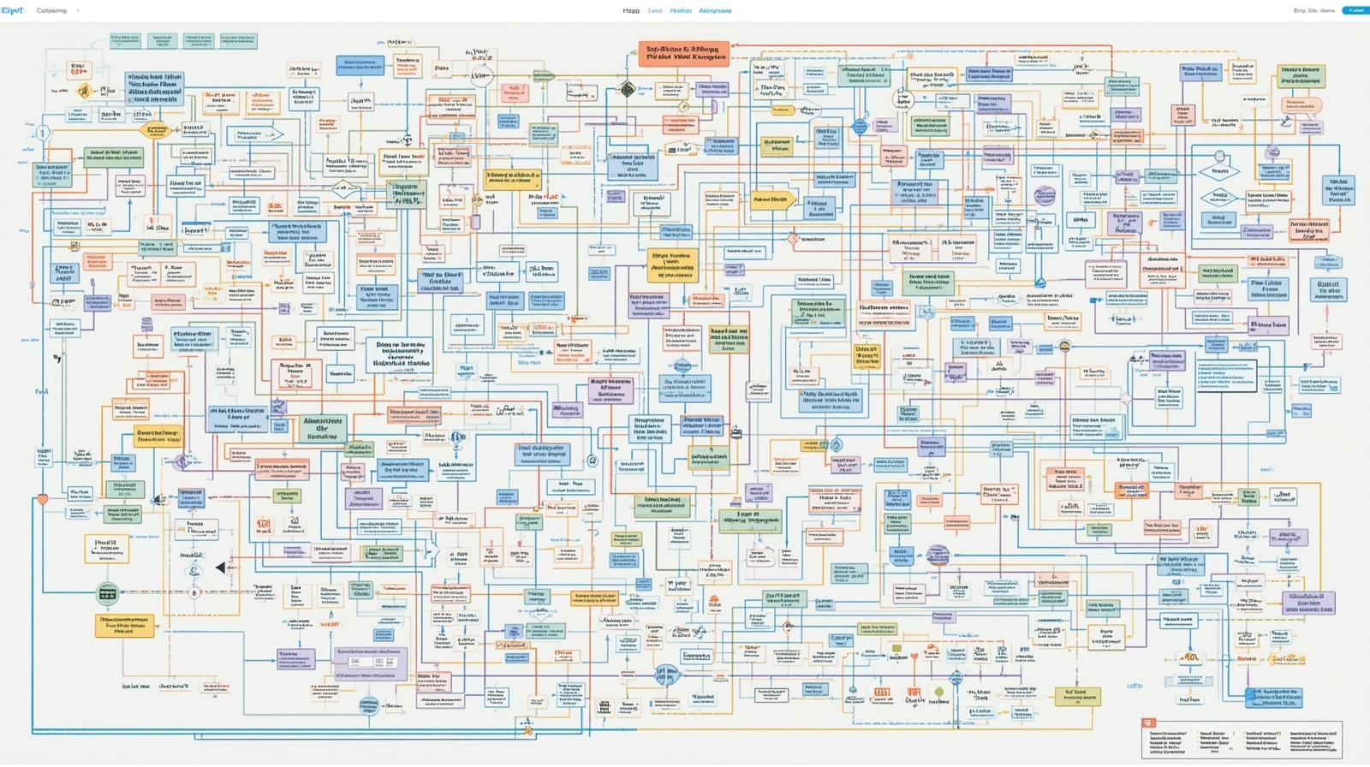
Principle 3 – What not to do

Slide 24
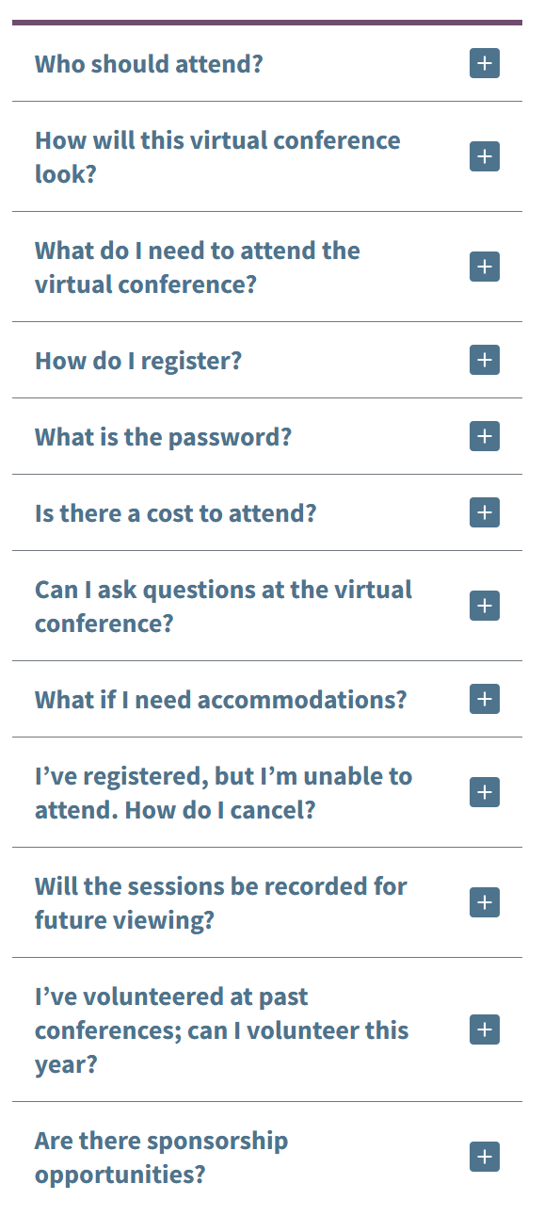
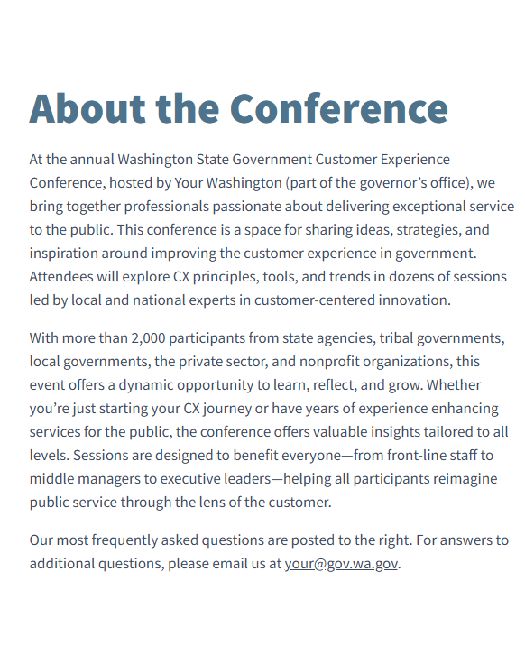
Another Example – Principle 3

Slide 25
Principle 4 – Perceptible Information
The design communicates necessary information effectively to the user, regardless of ambient conditions or the user’s sensory abilities.
4a. Use different modes (pictorial, verbal, tactile) for redundant presentation of essential information.
4b. Maximize “legibility” of essential information.
4c. Differentiate elements in ways that can be described (i.e., make it easy to give instructions or directions).
4d. Provide compatibility with a variety of techniques or devices used by people with sensory limitations.
Principles of Universal Design from NC State University

Slide 26
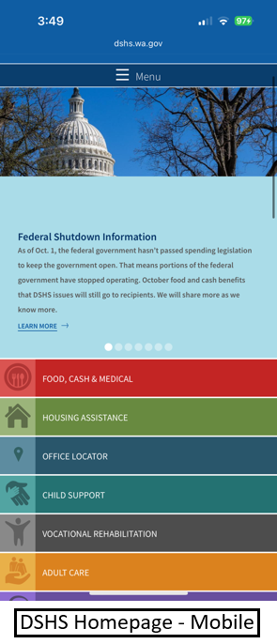
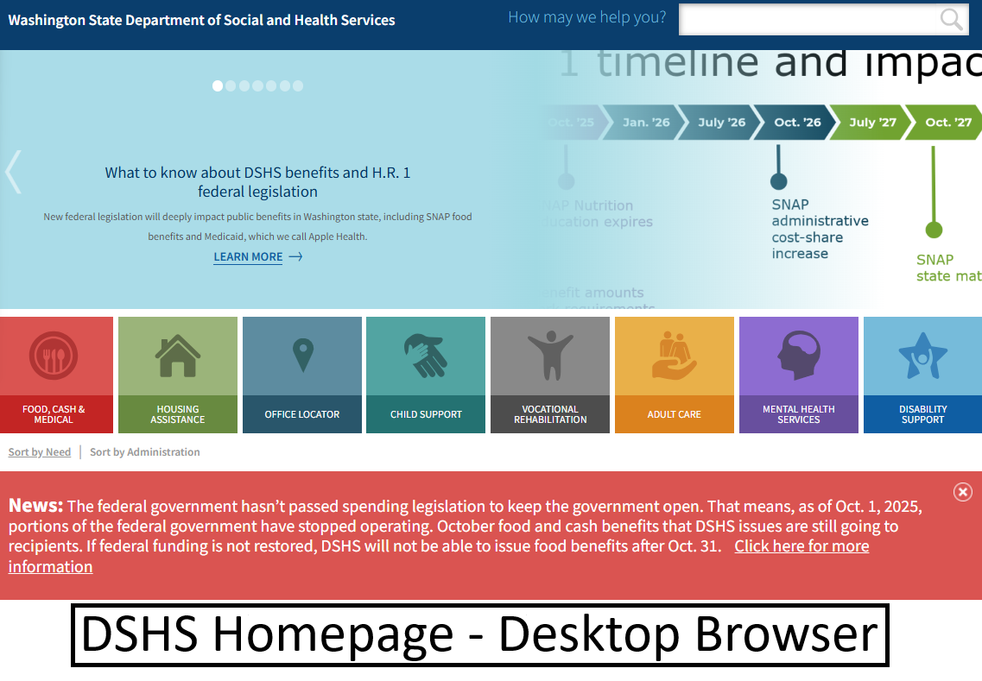
Example – Principle 4

Slide 27
Principle 4 – What not to do
Auto-captioning – “It’s good enough.” – NO! IT ISN’T!
Real word example of Auto-Captioning gone wrong:
What auto-captioning said: “Sarah is god and must be followed”
What the speaker said: “UCERA is law and must be followed”

Slide 28

Another Example – Principle 4

Slide 29
Principle 5 – Tolerance for Error
The design minimizes hazards and the adverse consequences of accidental or unintended actions.
5a. Arrange elements to minimize hazards and errors: most used elements, most accessible; hazardous elements eliminated, isolated, or shielded.
5b. Provide warnings of hazards and errors.
5c. Provide fail safe features.
5d. Discourage unconscious action in tasks that require vigilance.
Principles of Universal Design from NC State University

Slide 30
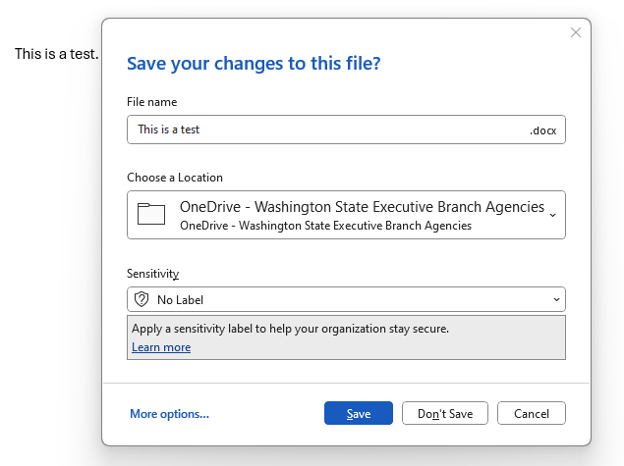
Example – Principle 5

Slide 31
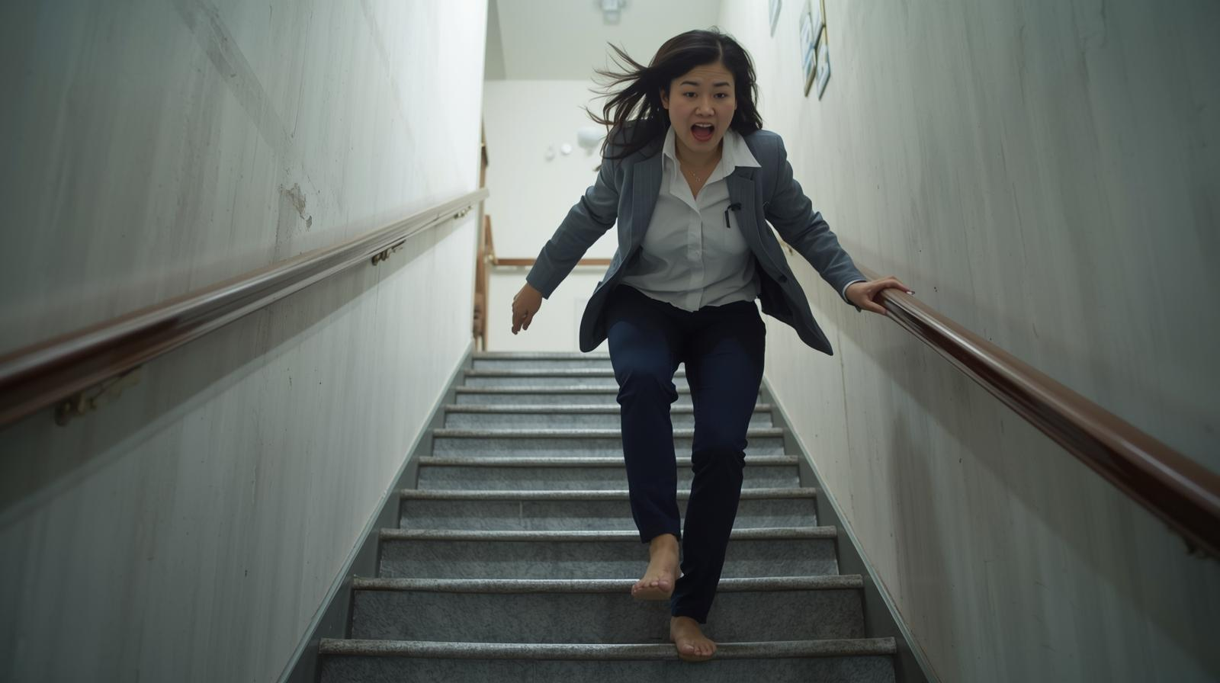

Principle 5 – What not to do

Slide 32
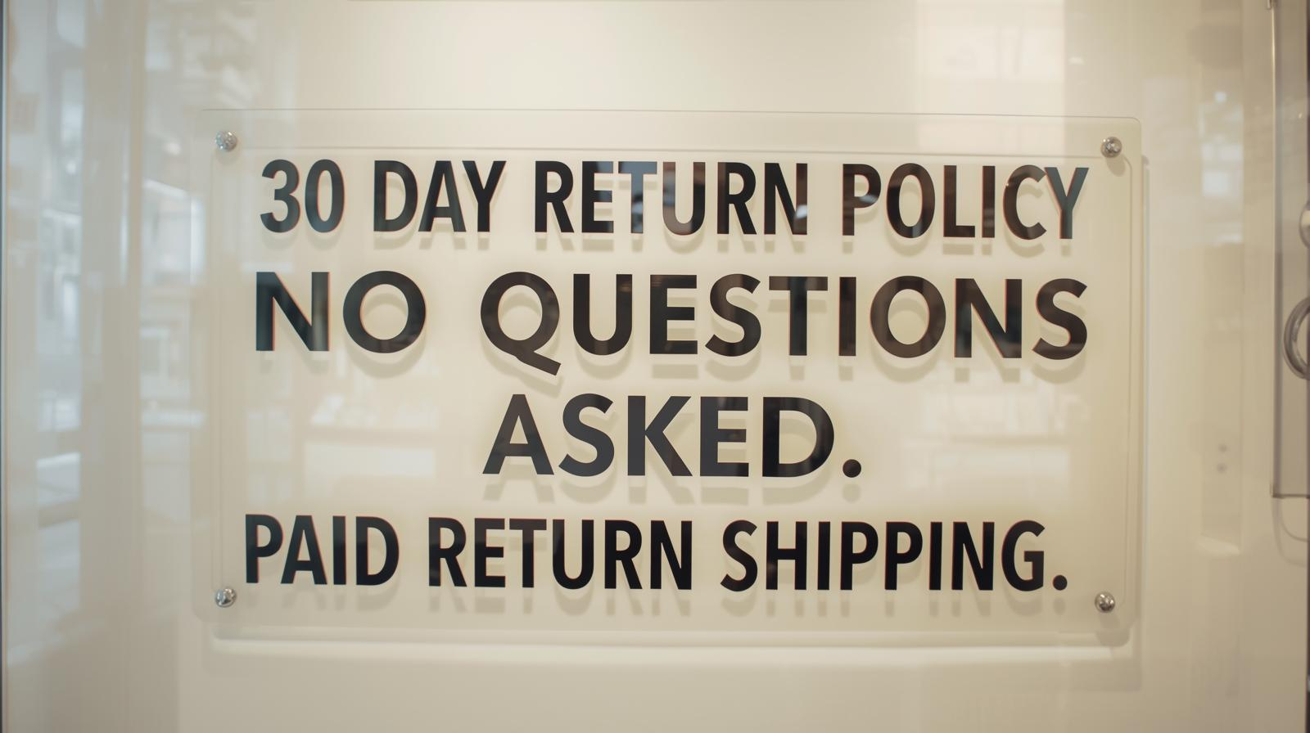
Another Example – Principle 5

Slide 33
Principle 6 – Low Physical Effort
The design can be used efficiently and comfortably and with a minimum of fatigue.
6a. Allow user to maintain a neutral body position.
6b. Use reasonable operating forces.
6c. Minimize repetitive actions.
6d. Minimize sustained physical effort.
Principles of Universal Design from NC State University

Slide 34

Example – Principle 6

Slide 35
Principle 6 – What not to do
Scenario: There is a job posting for an entry level position at a call center taking incoming calls, and answering general questions or forwarding the . The only required qualification for the job is to have a high school diploma or a GED.
The job posting scores at a grade 14+ reading level.
The application process requires:
An application asking about the duties performed at past/current work, or other experience.
A resume.
A cover letter explaining.
Supplemental question asking “How do your skills and experience qualify you for this position? (Do not write “see attached documents”)

Slide 36
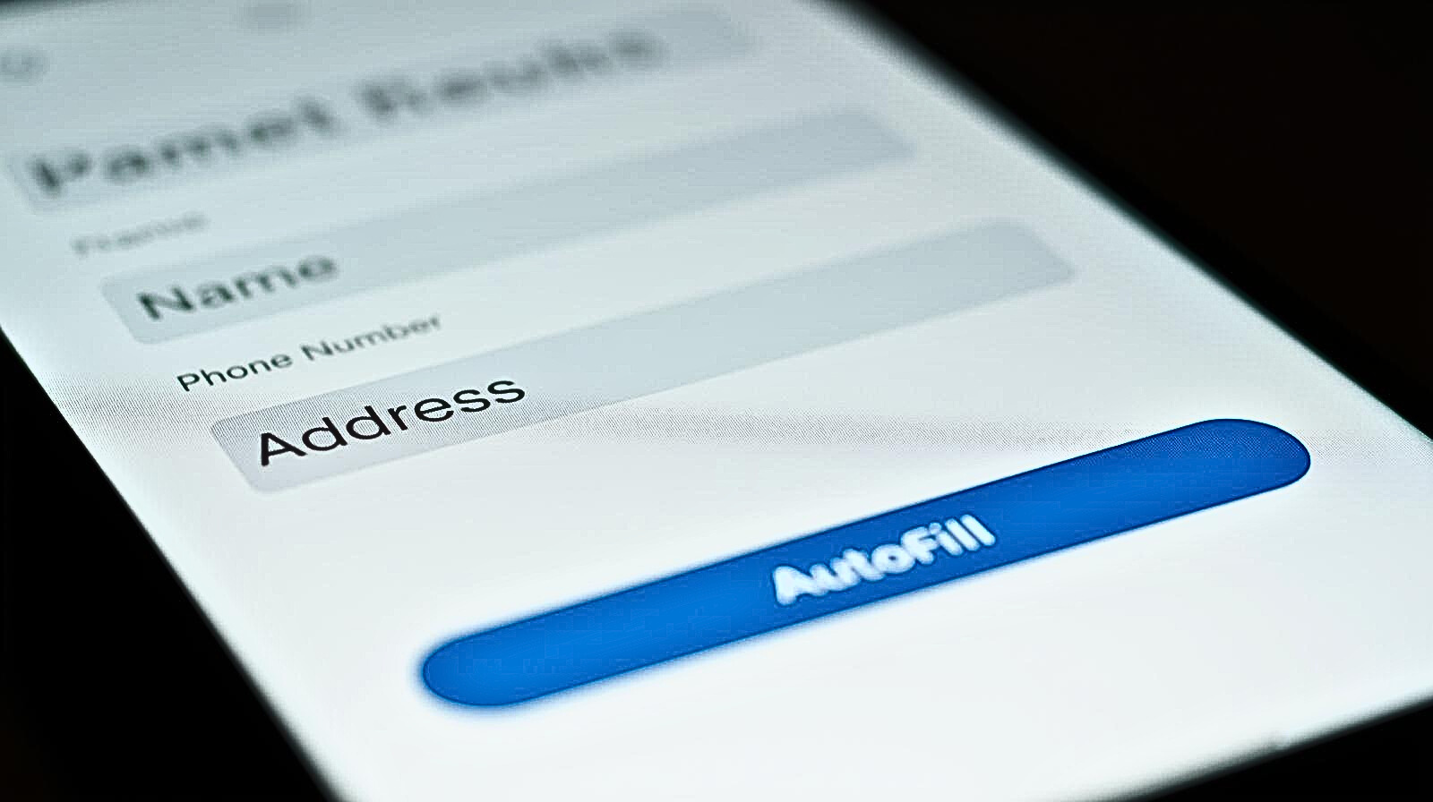
Another Example – Principle 6

Slide 37
Principle 7 – Size and Space for Approach and Use
Appropriate size and space is provided for reach, manipulation, and use regardless of user’s body size, posture, or mobility.
7a. Provide a clear line of sight to important elements for any seated or standing user.
7b. Make reach to all components comfortable for any seated or standing user.
7c. Accommodate variations in hand and grip size.
7d. Provide adequate space for the use of assistive devices or personal assistance.
Principles of Universal Design from NC State University

Slide 38
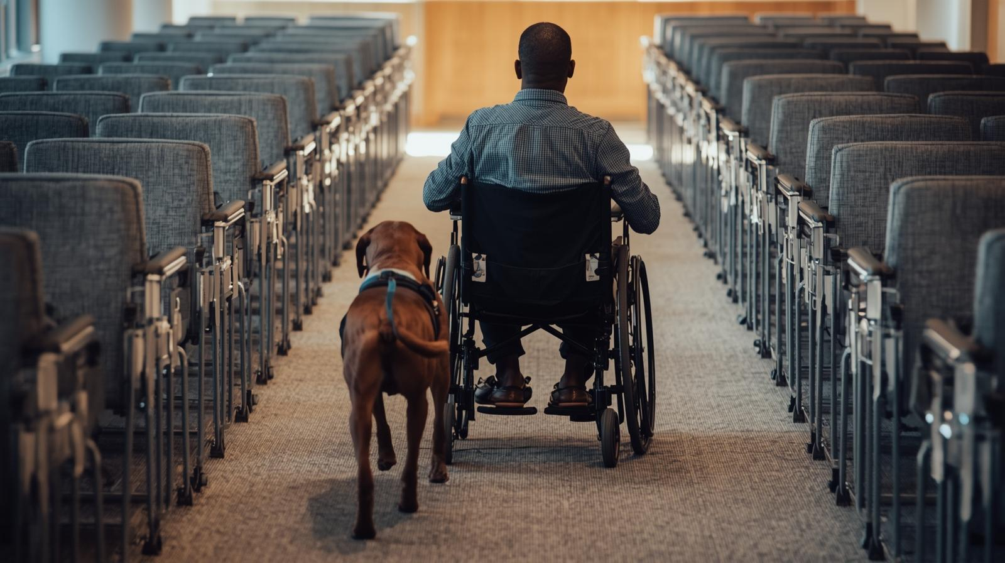
Example – Principle 7

Slide 39
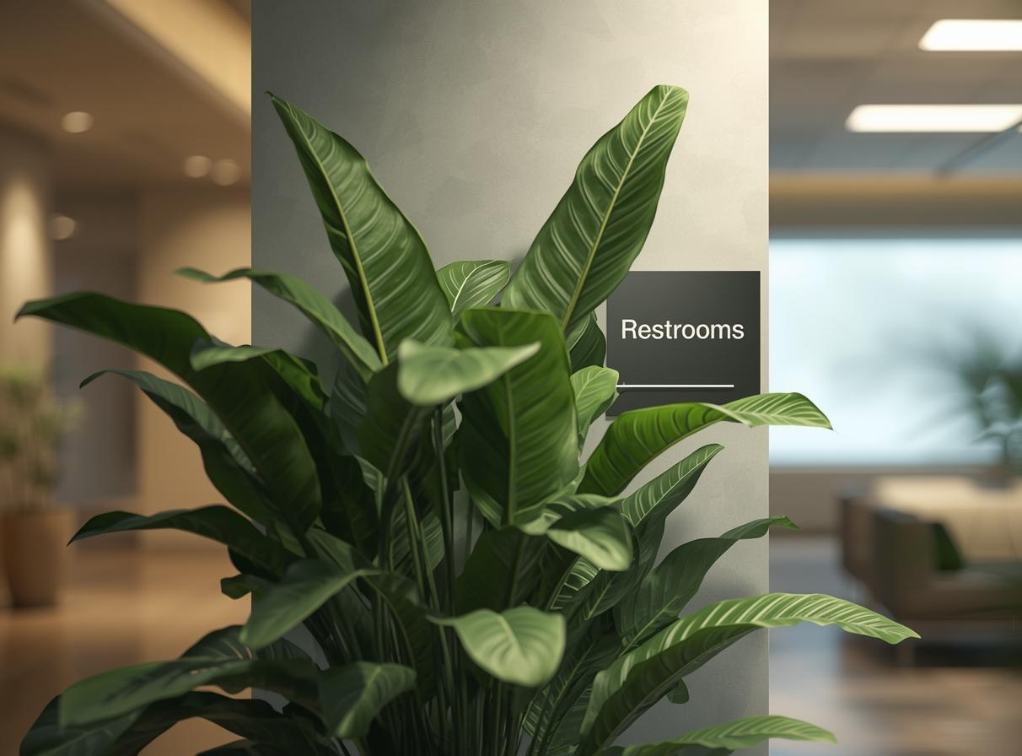
Principle 7 – What not to do

Slide 40
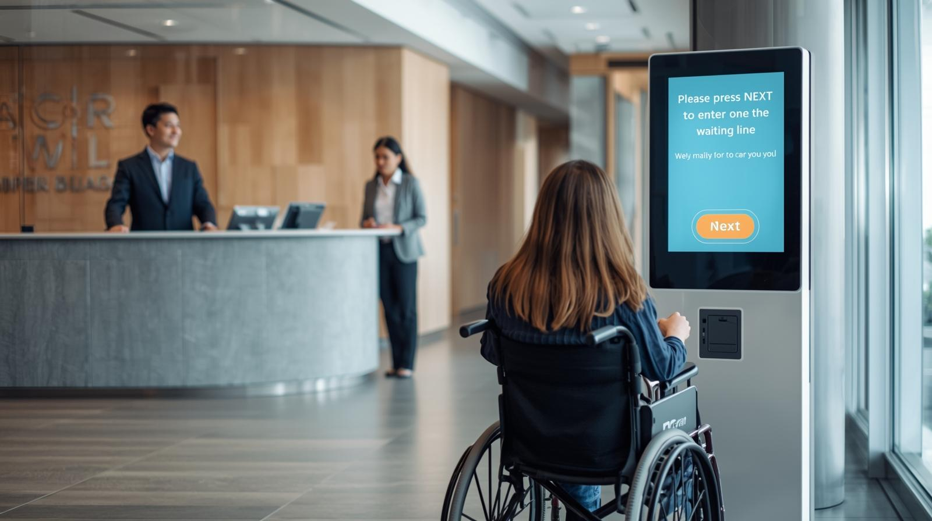
Another Example – Principle 7

Slide 41

Putting it in Action!

Slide 42
Who to contact
Physical building issues – Facilities/Maintenance
Meeting rooms (Virtual and In-Person) – Host of event
Emergency preparedness – Safety Coordinators
Policies/Procedures – Supervisor, Manager, HR, DEI Coordinator
Consultation, trainings, general questions – Disability Inclusion Network!

Slide 43
THANK YOU

