Slide 1
Title Slide
Security Guards Licensing Journey Case Study:
How DOL improved the licensing experience for security guards

Slide 2




Body Content Slide
cx
Alysha Myers
Customer Experience Administrator
Danica Taylor
Professional Licensing Representative 2
Kenzie Rios
Customer Experience Analyst
Dee Sharp
Program Manager

Slide 3


Agenda Slide
Customer experience & customer journey maps
The challenge
Building the map
Our improvements
Our results

Slide 4
Customer Experience Definition
Customer experience is the sum of interactions a customer has with state government services, including digital and in-person touchpoints.

Slide 5
Body Content Slide
cx
What is a customer journey map?
A customer journey map is a model that visually represents an experience that:
Is written from the customer’s point of view
Includes customer tasks, emotions, touchpoints, and moments of pain or satisfaction
Is driven by data

Slide 6
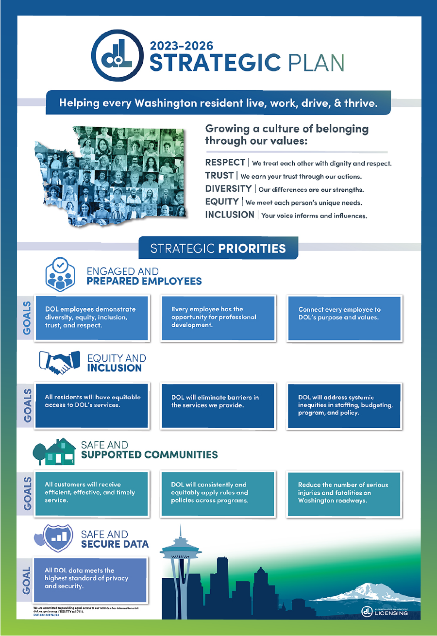








Strategic Plan Design Assets 1
cx

Slide 7
Our business environment
CX
Our business environment:
Department of Licensing licenses professionals and businesses
Over 20,000 licensed security guards and security guard companies
About 8,500 security guard licensed in 2024

Slide 8
Body Content Slide
cx
Our challenge:
Transition from paper to online interactions
Application journey was error prone, challenging to complete, and was a lengthy process
DOL pursued opportunity to understand from a customer perspective

Slide 9
Body Content Slide
cx
To build the map, we:
Analyzed customer feedback
Conducted internal & external interviews
Performed a task analysis
Hosted a journey mapping workshop

Slide 10
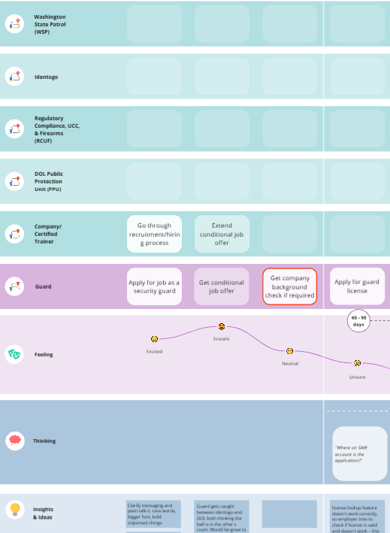
Body Content Slide
cx
Security Guards Customer journey map components

Slide 11
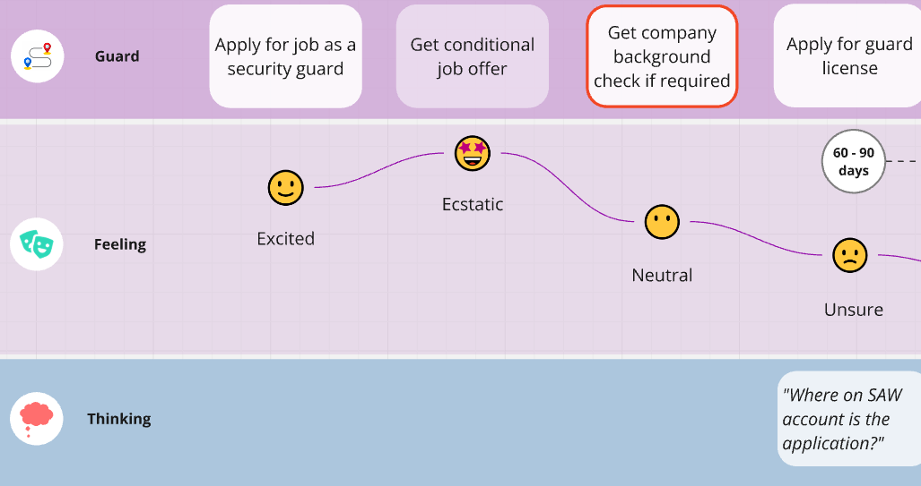
Body Content Slide
cx

Slide 12
Body Content Slide
cx
The customer journey map helped the business team:
Clarify and publish fingerprint requirements for applicants
Collaborate to correct customer portal obstacles
Develop comprehensive training plan and processes

Slide 13
Body Content Slide
cx
We implemented other efficiencies:
Simplified Print Your License option
Implemented call back feature
Improved back-office process to upload applications

Slide 14
Final results
CX
Final results:
Decreased time-to-license by over 50%
Reduced time to complete back-office processes by 60%
Made the licensing process easier for guards to complete and for employees to process applications
Increased team staffing
72% decrease in call volume
9% increase in calls answered
Improved employee training
Improved employee and customer experience

Slide 15
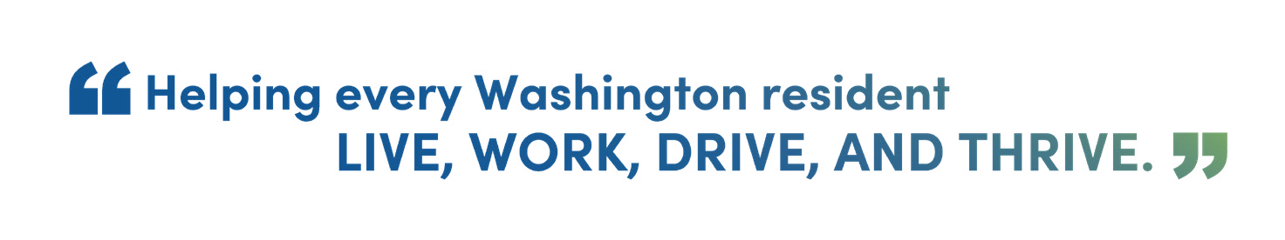
Tag Line Design Asset
cx

Slide 16
Body Content Slide
cx
In summary, we:
  Defined our business challenge
  Gathered and analyzed data
  Created a customer journey map to deeply understand customer thoughts, feelings, tasks, and challenges
  Generated ideas that would benefit customers
  Chose ideas and implemented them
  Made impacts that benefit our customers and our team

Slide 17


Questions and Comments Slide

Slide 18
Agency Logo Design Asset

