Slide 1

Welcome!

Slide 2
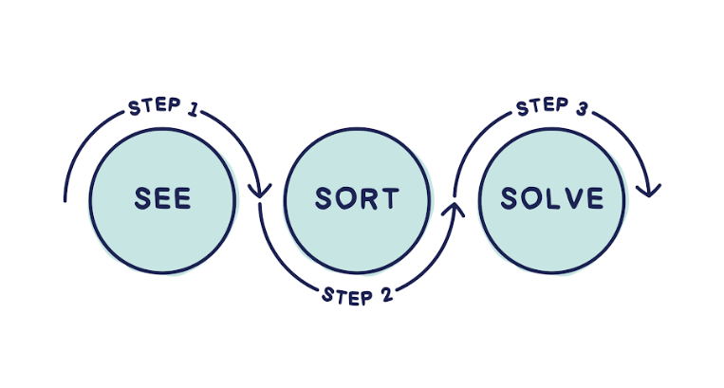


Slide 3


Slide 4
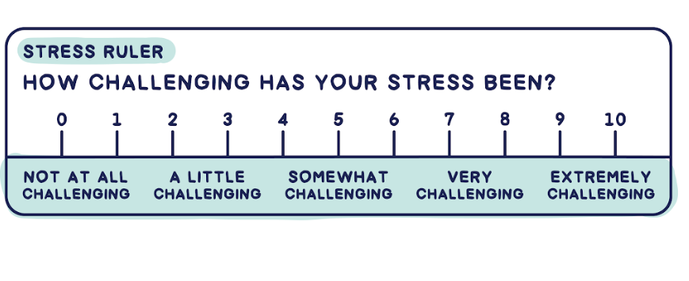

Slide 5
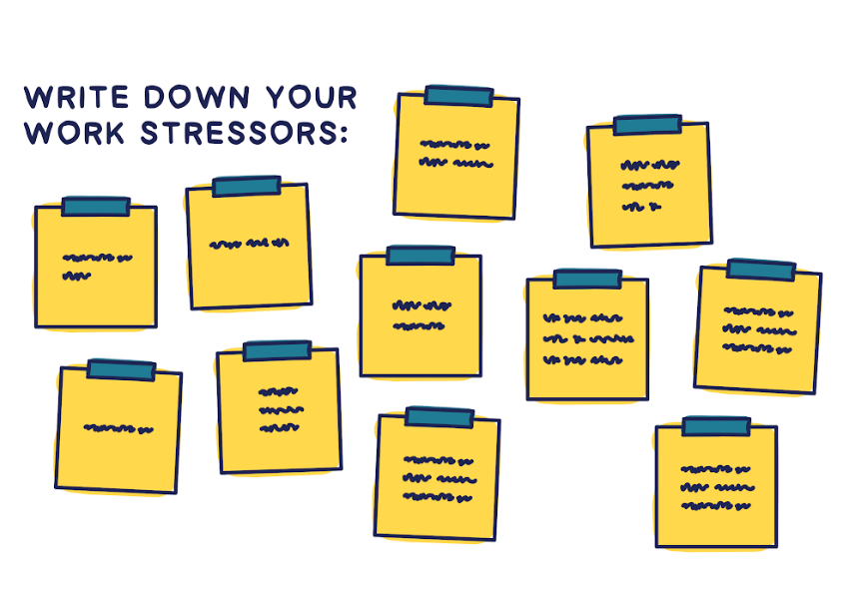

Slide 6
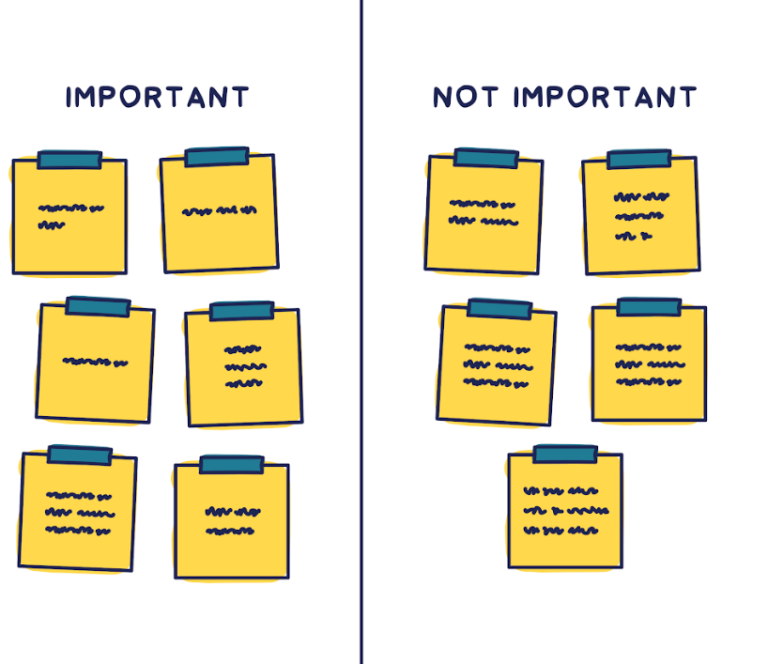

Slide 7
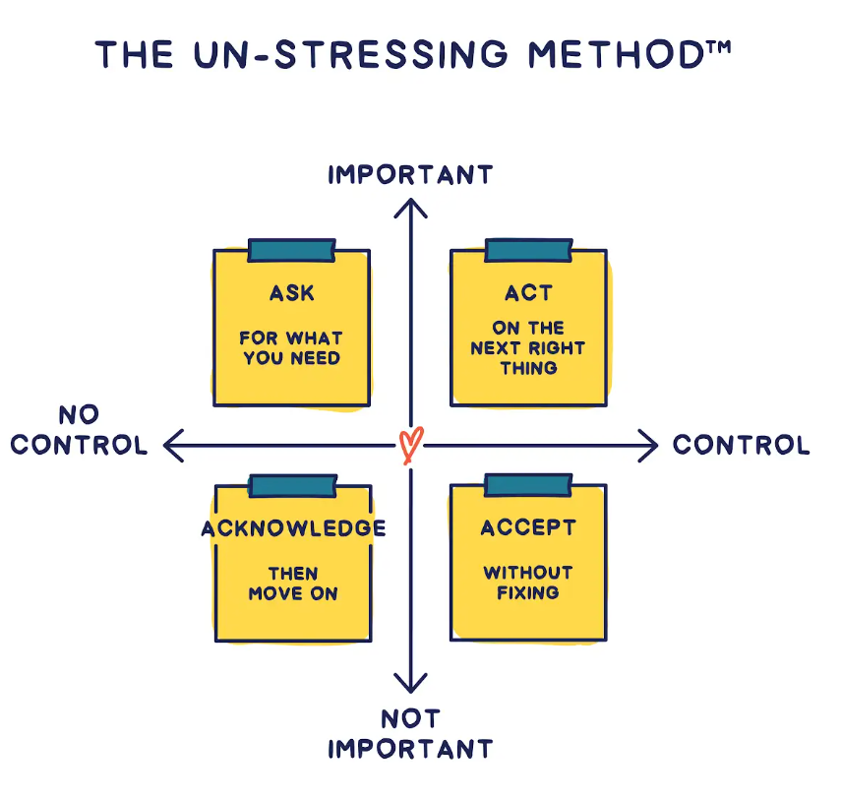


Slide 9
1.
Schedule
Stress
2.
Suspense
3.
Social
4.
Sudden
5.
System
Source: 1-4 align with Karl Albrecht’s research in Stress and the Manager

Slide 10
1.
Schedule
Stress
2.
Suspense
3.
Social
4.
Sudden
5.
System
Source: 1-4 align with Karl Albrecht’s research in Stress and the Manager

Slide 11
1.
Schedule
Stress
2.
Suspense
3.
Social
4.
Sudden
5.
System
Source: 1-4 align with Karl Albrecht’s research in Stress and the Manager

Slide 12
1.
Schedule
Stress
2.
Suspense
3.
Social
4.
Sudden
5.
System
Source: 1-4 align with Karl Albrecht’s research in Stress and the Manager

Slide 13
1.
Schedule
Stress
2.
Suspense
3.
Social
4.
Sudden
5.
System
Source: 1-4 align with Karl Albrecht’s research in Stress and the Manager

Slide 14
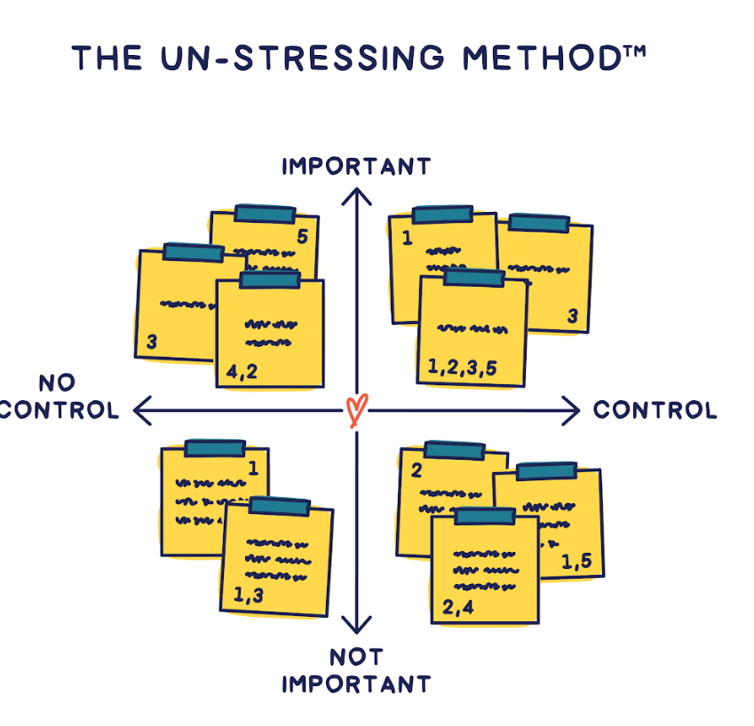

Slide 16
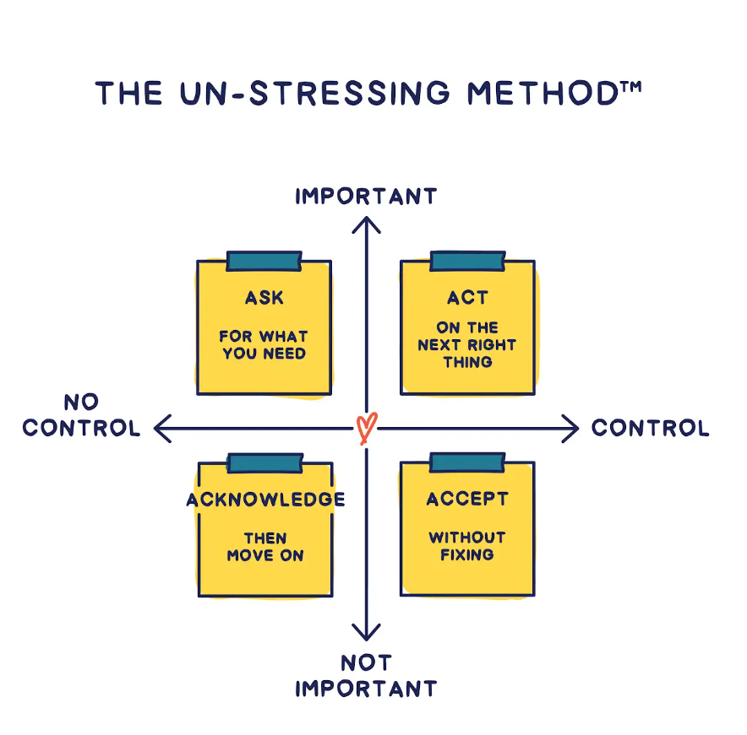


Slide 21
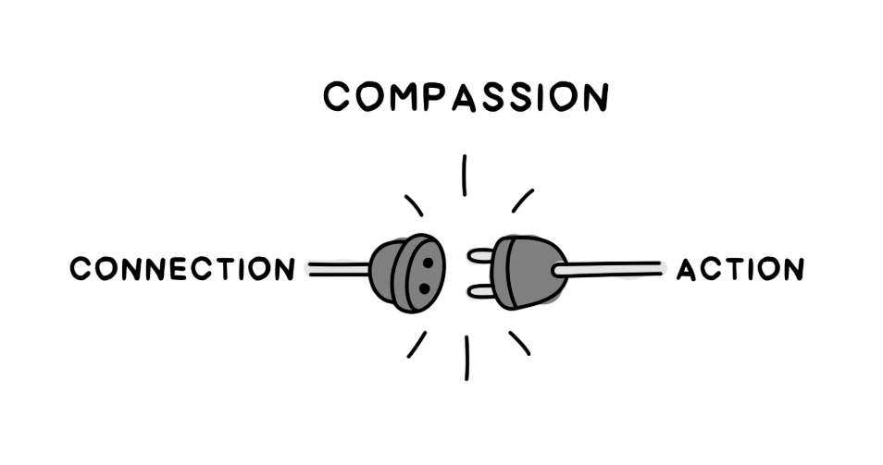

Slide 22
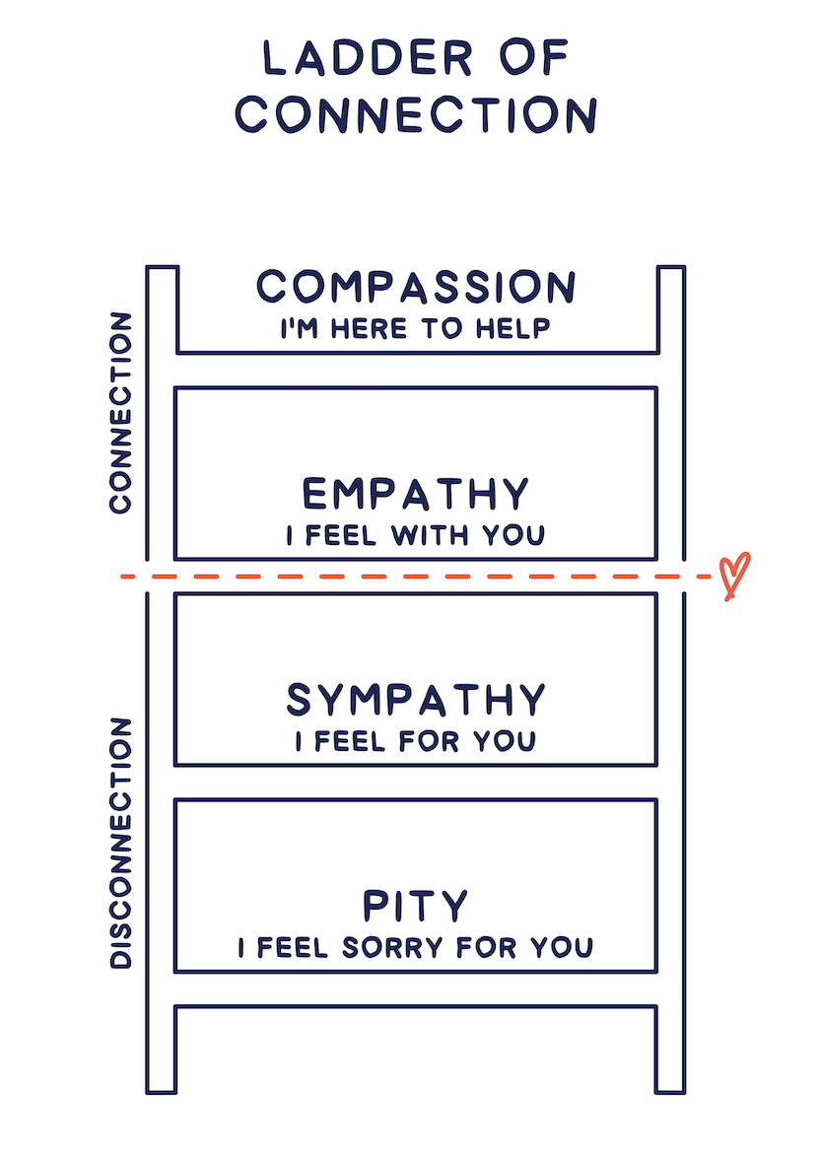

Slide 23
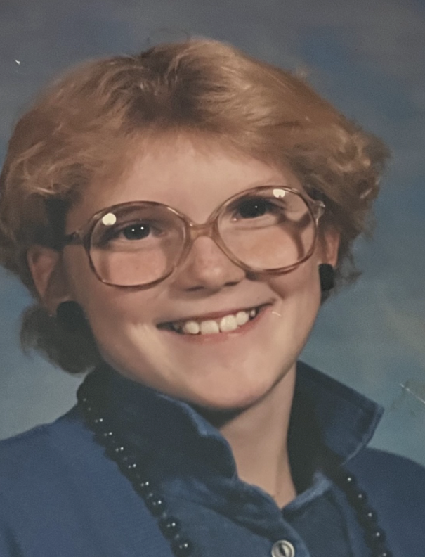

Slide 24


Slide 28
Stress thrives in isolation. Relief comes through connection.

Slide 29

Keep in touch!
Amy Leneker
Amy@TheLenekerTeam.com
(360) 529-0290
AmyLeneker.com
TheLenekerTeam.com
Welcome!

