Slide 1




The Blast Newsletter
The blast
ENTERPRISE-WIDE CONTINUOUS IMPROVEMENT COMMUNITY OF PRACTICE
ISSUE NO. 31 | AUGUST 2025
Our EO is signed, and our name has been changed! More info to come next issue!
WHAT YOU MISSED
At our August CoP, Beth Adams from the Home and Community Living Administration within DSHS shared a much-needed refresher on the “What, Why, and How” of the essential but often forgotten tool, Value Stream Mapping. See page 2 for more!
REFLECTION SERIES
Click here to watch our Reflections Series , featuring Todd Steben from the Washington State Lottery, as he shares how his team impacted countless Washingtonians by optimizing cash management - a project that won them a Productivity Board Award!
QUESTIONS?
For questions on anything CoP related, contact:
Talia Mazzara, Your WA Senior Performance Advisor
Theresa Dew, Your WA Senior Performance Advisor
Your Washington’s Annual Conference coming soon to a computer near you!
Save the date for the 14th annual Continuous Improvement Conference. This year’s conference will be focused on the vital theme of Customer Experience. Over three inspiring days, you will hear from top public and private-sector leaders on how to turn customer feedback into real-time solutions and lasting improvements.
Join us virtually from October 28th to 30th for four enriching hours each day, dedicated to innovation, strategy, and practical tools to enhance customer experience and continuous improvement. Connect with experts, gain actionable insights, and help shape the future of public service.
We are currently finalizing our schedule and expect to have registration available on our website by mid-September.
If you have any questions, please contact us at Results@gov.wa.gov.

Slide 2

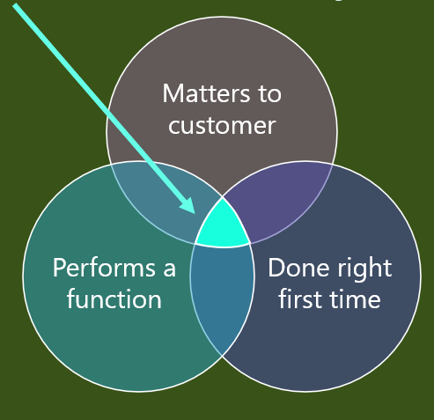


The Blast Newsletter – Page 2
Issue No. 31 | Page 2
An Introduction to Value Stream Mapping
During our August Community of Practice (CoP) meeting, we had the pleasure of welcoming Beth Adams, a dedicated representative from the Home and Community Living Administration at the Department of Social and Health Services (DSHS). Beth delivered an informative presentation that acted as a comprehensive refresher on the principles of Value Stream Mapping.
In an era where many of our interactions have shifted to virtual platforms, we may feel that we’ve lost the opportunity for traditional in-person mapping sessions. However, Beth’s presentation bridged that gap by reminding us of the essential digital tools still at our disposal. These tools remain crucial for identifying inefficiencies in our workflows and for driving process improvements. Beth delved into customer identification, components of a VSM, the bringing together of data elements, and how to use TAKT Time (a long-lost skill of the LEAN ancestors). Every bit of her presentation emphasized the VSM’s importance in refining processes and enhancing the quality of service delivery.
Click here to download the slide deck and SIPOC handout.
Click the play button below to watch the August CoP presentation!
COMING UP NEXT
September 16th, 2025
10:30 a.m. – 12:00 p.m.
Zoom Meeting
Topic:
Steeple Analysis
Presenter:
Brittany Wilhelm |
Department of Labor and Industries
Updates to our 2026 CoP series
We will be transitioning to a schedule of meetings every other month, which will allow for a break in between learnings while we prep to explore important topics in greater depth.
While maintaining our commitment to continuous improvement, we will increase our emphasis on Customer Experience through interactive presentations. We look forward to growing together with this new approach!

