Slide 1

Implementing Evidenced Based Quality Indicators
To Improve Treatment Outcomes & Job Satisfaction...
Rain Carei, PhD, Psychologist 4,
Washington Corrections Center for Women (WCCW)
Kate Morisset, Quality Assurance Manager,
WA Department of Corrections (WA DOC)
MaryAnn Curl, MD MS, Chief Medical Officer
WA Department of Corrections (WA DOC)

Slide 2
Continuous Quality Improvement Program Disclosure
Created for CQIP || Per RCW 43.70.510 this document is protected from Public Disclosure and is to be maintained in a highly confidential manner. It is to be used solely for the purposes of clinical quality improvement. Valid until rescinded.

Slide 3

Educational Objectives
Discuss the link between quality indicators, service provision, client recovery, and reduction of staff burnout
1
Identify key steps in creating correctional health care quality indicators, including client voice and choice
2
Analyze positive outcomes for clients and facility staff when quality indicators are used
3

Slide 4
Overview
Who
What
Why
How
Results
Next steps

Slide 5
Starting With a Story….
Pathway to Prison

Slide 6


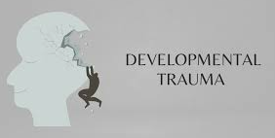
Women’s Pathway to Prison
50-66% Childhood sexual abuse
Substance Use Disorder (SUD)
Incarceration
50.8% of women meet criteria (compared to 38.5% men)**
Trauma
26-68% Adult sexual abuse
56-82% Lifetime sexual assault*
*Karlsson & Zielinski, 2020
**Staton et al, 2023

Slide 7
Women’s Pathway…..
Through Prison

Slide 8


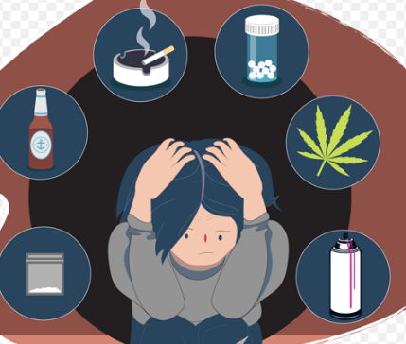
Women’s Pathway Through Prison
80% of women at intake have experienced lifetime trauma
Coping Behaviors*
Sanctions*
Aggression/fighting
Trauma and SUD*
61% of women are diagnosed with a trauma disorder
Individuals with trauma symptoms pre-treatment have highest rate of problematic behaviors
Greatest reductions with treatment.
62% of women are diagnosed with SUD
Self Harm
Crisis
*Carei et al, 2024
**Carei et al, 2024

Slide 9
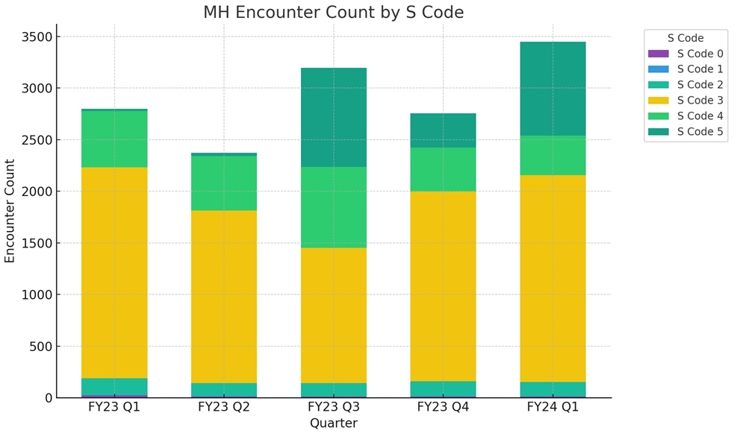
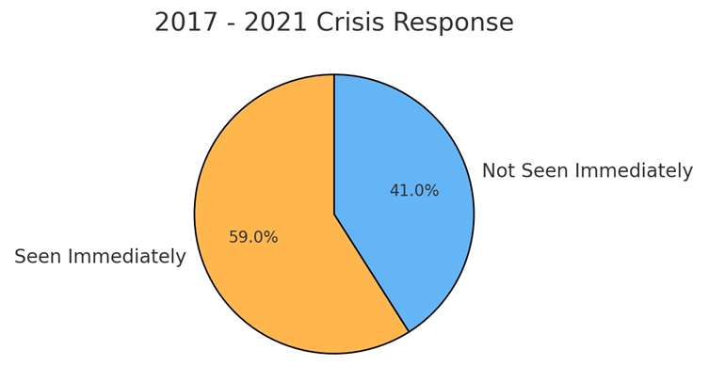
Impact of Pathway, on Mental Health Staff…
Figure 1 & 2 Generated using ChatGPT. Retrieved (11-28-24)

Slide 10
Why implement and measure Evidence Based Practices (EBPs) for trauma?...

Slide 11
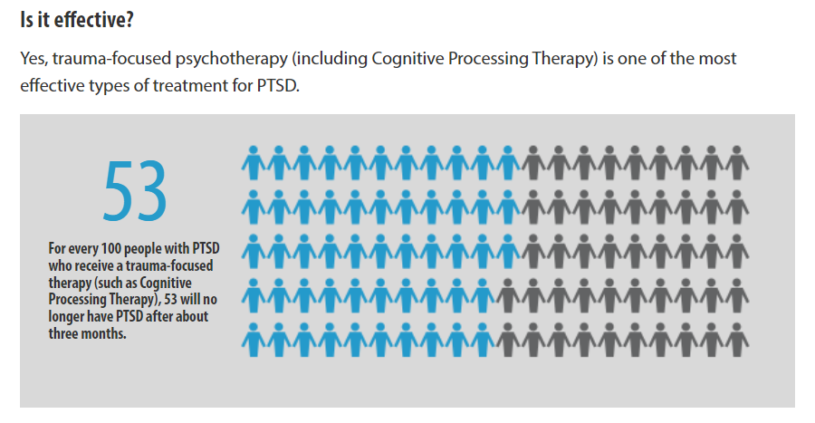
Treatment works.
Cognitive Processing Therapy (CPT).
Trauma-focused psychotherapy is one of the most effective types of treatment for PTSD.
PTSD : Decision Aid (va.gov)

Slide 12
Prison is a critical intervention point to provide Evidence Based Practices (EBP’s).
Implementation science tells us that it takes 17 years for evidence-based practices (EBP's) to make it into routine healthcare.
1
Prison provides time and space for treatment. Research shows that prison is safe for intervention (Bridges et al, 2020).
2
Most of our clients have only had access to case management or medication. Providing care increases equity.
3
Healing is foreign. Most women believe healing is impossible. EBP's show women they can heal.
4

Slide 13
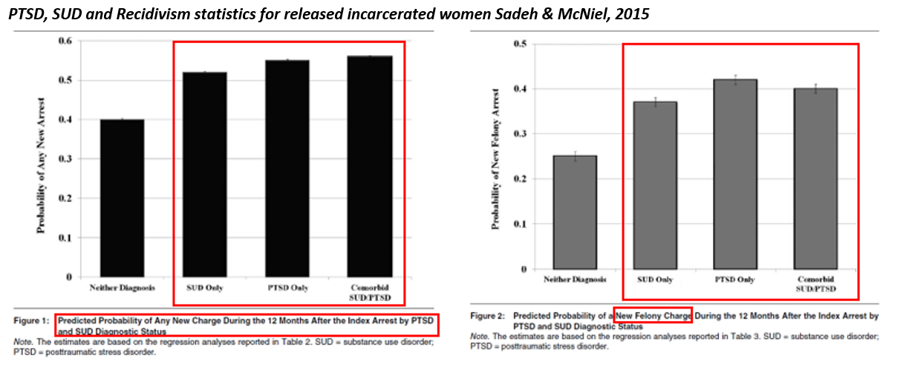
Untreated trauma and untreated SUD links to recidivism.

Slide 14

Global public health policy directs standards of care.
Reducing health inequalities is a fundamental principle of global public health policies (Stürup-Toft et al., 2018).
Statutory responsibilities towards the human rights of prisoners – including their health - are outlined in the United Nations’ Standard Minimum Rules for Treatment of Prisoners (known as the Nelson Mandela Rules).
  People living in prison ‘should enjoy the same standards of health care that are available in the community’ (Rule 24.1, a stance known as the equivalence principle)
  Prison healthcare services are responsible for ‘evaluating, promoting, protecting and improving’ the health of incarcerated people (Rule 25.1) (United Nations General Assembly, 2015).

Slide 15
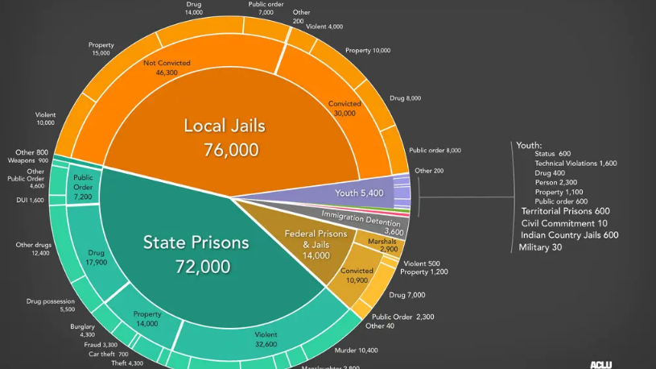
Health inequity is massive, and we can do something about it.

Slide 16
Providing EBP's for trauma treatment increases empathy and attunement and nourishes and sustains clinicians.
"When clinicians maintain clarity about interpersonal boundaries, when they are able to get very close without fusing or confusing the client's story, experiences, and perspective with their own, this exquisite kind of empathic attunement is nourishing for the therapist“ (Harrison & Westwood, 2009).
Empathy reduces burnout (Yue, Z. et al., 2022).
Research on mental health staff burnout showed that positive experiences with incarcerated individuals improved work life (Gallavan and Newman, 2013).

Slide 17
Our Story...
The Why to the How

Slide 18
TIMELINE SLIDE
Fully Functioning Team
Presented to HQ
Access to RDA
CQIP Approved
Presented proposal to CSB
Started outcome quality indicators
2017
2020
2023
2019
2022
2015
Started inputting paper/pencil data
into excel
Started team focus on process quality indicators
Reviewed progress, updated

Slide 19
Challenges of a fully functioning team….
….How many can relate?
Lack of training resources
Accountability and competence
No research software
No electronic health record
Limited staffing, burnout from crisis work, case management.

Slide 20

Our Turning Point…
We realized that it was easy to focus on the challenges. We were living in a reactive and crisis driven state.
  It was accepted as our "normal".
  We empower what we allow.
As correctional professionals, we live with limited perspectives daily:
  One of the hallmarks of correctional environment is a “all or nothing” viewpoint
  We internalize what we are saturated in.
We decided to stop surviving and start living!
  We accepted we would not get more resources, more staffing, or more money.
  What could we do with what we have?

Slide 21
Radical Acceptance and Creativity
Enhancing correctional health care with evidence-based quality indicators!
We decided to build something.
We started at the ground level with scheduling and small steps.
This led to partnering.
This led to creating metrics.
This led to results!

Slide 22

Data Barriers
We took small steps.
Team members interested in entering paper and pencil data into Excel and did so with no extra resources. (See Appendix A).
  Operational data clarified women's needs: trauma care and women's pathway through prison (intervention points).
  Presented operational data to HQ's leading to provision of resources.
  Built relationships with Research, Data, and Analytics (RDA) staff. Began to find ways to use Microsoft forms, SharePoint, & Power BI to track outcomes (See Appendix B).
Prison barriers to meaningful quality indicators include resource constraints and data system functionality (Bellass et al, 2022).
Most outcomes in prisons are focused on process of care, versus outcomes (Blackaby et al, 2023) due to limited systems.
Given the need for equity, prison healthcare needs to generate reliable evidence on healthcare provision and be more accountable. Our clients deserve equitable care. Bellass (2022) recommends monitoring of EBP’s, quality care, and points for intervention.
But How Do We Do That?...

Slide 23
We created a Shared "data" language…..
Clinical Narrative...
How do we track PTSD symptoms? How do we know when patients are ready to change?
How to we address service levels?
Administrative Narrative...
How will we track utilization? How do we track access barriers to address care needs?
Utilization & EBP
Variables

Slide 24
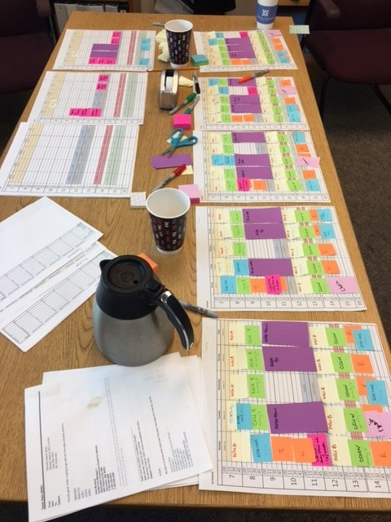
We used the data that we had…
Need: More patient care time to provide services
How:
  We sat down and outlined windows of care based on movements, provider schedules, and client needs (waterfall schedule). Post it's and coffee.
  Health Service Managers (HSM's) advocated for more time for care and succeeded
Results:
  All clients fit within the schedule
  Provided the ability to change schedules for mental health staff when performance measures were met.
  Since implementing, performance measures have not fallen below acceptable ranges.

Slide 25
Sharing Data Up…….
Women and Data Invisibility
Personal Context: Local Clinical Scientist (LCS) model
Utilization Improvements
National context - invisible
MHA Intake 2015 to current
MH Crisis 2017-current
MH Recidivism 2016-Current
MH Treatment Outcomes 2018-Current
MH Research 2000 - Current
Yakima County Jail (YCJ) adjustment 2018- Current
Visibility and equitability

Slide 26
Partnership & Collaboration at All Levels
1
2
Statewide Quality Improvement Teams
3
Clinical Services Board
Facility Quality Improvement Teams
Expansion via Patient Centered Medical Home

Slide 27
Recap: From Process to Outcomes
Process Indicators
Binary (met / not met)
Continuous measures
Answered policy questions: did “X” get done?
Culture Change:
Process indicators helped us create a culture around quality.
We started pre/during/post meetings to connect staff, HSM's, and HQ's on indicators (see Appendix C)
We moved from "Did X get done?" To "Did x work?"
How is care going in the moment?
What are the trends over time?
Once those measures were all green (see Appendix D), we moved from process to outcomes.
Outcome Indicators:
Answer: Was care effective?
What else is needed?

Slide 28
Metrics…..
Outcome Indicators and Results

Slide 29

Metrics Overview
Readiness to Change
Trauma Treatment Client Improvement
Facility Safety

Slide 30


Recap: From Process to Outcomes
Facility Connections
Administrative
Scheduling Teams
Health Care Managers
Research and Analytics
Data Teams
Clinical
Mental Health Service Delivery Teams
Mental Health Clinical Managers
Our Patients.
Research Teams
Custody Partners
Administrative Services Board
Clinical Services Board
Behind The Scenes…..
….Those responsible for making it work
From Ideas…. To Quality Indicators

Slide 31
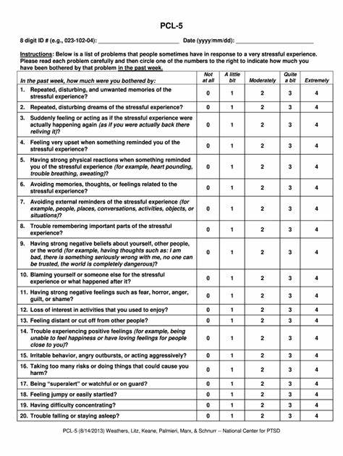
Metric: Trauma Treatment Client Improvement
Purpose: Measure recovery, ensure treatment works. 97% of incarcerated women want access to trauma treatment (Fradley et al, 2023).
PTSD Checklist-5 (PCL-5) is a 20-item self report measure
Can be used for a provisional diagnosis and for measuring change during treatment
Clients complete a PCL-5 before every EBP Trauma session
Post treatment: 5-10 point change represents reliable change (i.e., change not due to chance) and a 10-20 point change represents clinically significant change (National Center for PTSD)
Click Here To See How It Works

Slide 32
How it works.
Trauma Treatment Client improvement
Pre Quarter:
HSM
Quarterly Activities
HSM’s
PSR’s
Maintain flow of cases, notifies if problems
OA
Office Assistant (OA) makes copies of PCL-5 for clinicians
Clinicians
Supervisors
Supervisors use this data weekly and monthly to assess client progress and to work with staff on intervention success
Post quarter:
HSM/Clinician/Quality/Supervisor meeting (post quarter)
RDA pulls data and assesses recovery in clients using PCL-5 cutoff scores for assessing progress for clients who have completed treatment, dropped out, and are in progress
OA
Makes copies of PCL’s for clients/staff
Clinicians:
Clinicians enter treatment frequency for clients based on stage of change into OMNI
Reviews caseload and looks for places new treatment will start, or treatment will finish, to help prioritize cases that need to come in or be moved off of their schedules
Clinicians tell schedulers when clients are starting EBP trauma therapy
Supervisors:
Provide supervision for EBP cases (weekly individual and group supervision) and co-lead treatment for treatments that are new to providers
Health Service Manager’s (HSM’s’) pay for once a year training in Motivational Interviewing (MI) for new staff
HSM/Clinician/Quality/Supervisor meeting (pre quarter)
Helps clinicians organize schedules and resolve conflicts
Helps with any movement issues, resolves barriers
Clients fill out the PTSD Checklist-5 (PCL-5) before each EBP trauma therapy session and clients and therapist review scores in session.

Slide 33
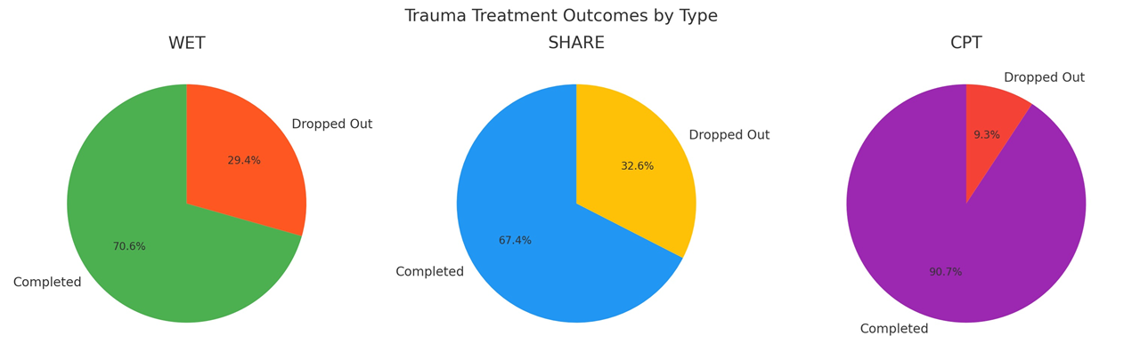
Treatment Works. Women Recover.
76% of women completing trauma treatment no longer have clinically significant symptoms….
Figure 3 Generated using ChatGPT. Retrieved (11-28-24)

Slide 34
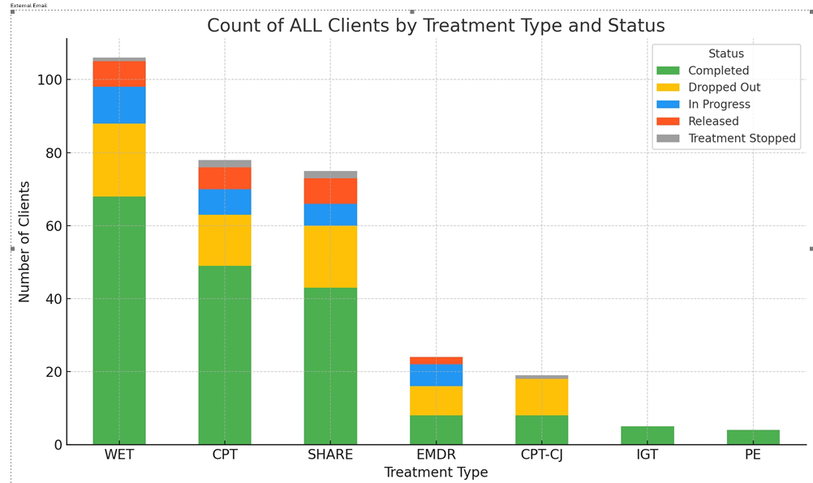
RESULTS: Clients Stay in Treatment If not now, when… (Bridges et al 2020)?
Clients Stay in Treatment: WCCW CPT drop out rates are under 20%.
CPT community drop out rates are higher 29% (Alpert et al, in press).
Figure 3 Generated using ChatGPT. Retrieved (11-28-24)

Slide 35
Metric: Facility Safety
Behaviors:
Anger & Substance Use
Substance Use: People with PTSD are more likely to misuse substances. This can lead to infractions.
Anger: In people with PTSD, their response to extreme threat can become "stuck." This may lead to responding to all stress in survival mode. If you have PTSD, you may be more likely to react to any stress with "full activation." You may react as if your life or self were threatened (National PTSD website). This can lead to infractions.
Click Here To See How We Make It Work!

Slide 36
How it works.
Facility Safety Quality Indicator
Pre-Quarter Planning
Multidisciplinary Meetings and Planning
Quarterly Activities
Clinicians
Therapists and clients talk about avoidance symptoms as EBP trauma therapy starts, which include (but not limited to): aggression and substance use and self harm behaviors
Supervisors
Therapists work with supervisors in supervision to talk about behaviors and treatment and any concerns
Post Quarter Review
HSM/Clinician/Quality/Supervisor meeting (post quarter)
RDA pulls data on infractions for clients in EBP trauma therapy 6 months prior to treatment started, during treatment, and 6 months after treatment has completed

Slide 37
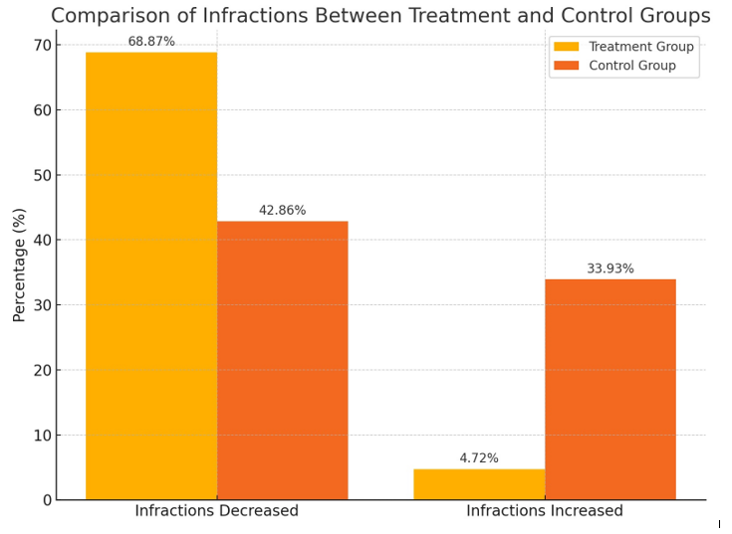
Metric: Facility Safety
Research shows a significant Reduction in Infractions* after Completing Trauma Treatment.
*Infractions directly related to substance abuse and aggressing.
Figure 5. Generated using ChatGPT. Retrieved (12-9-24)

Slide 38
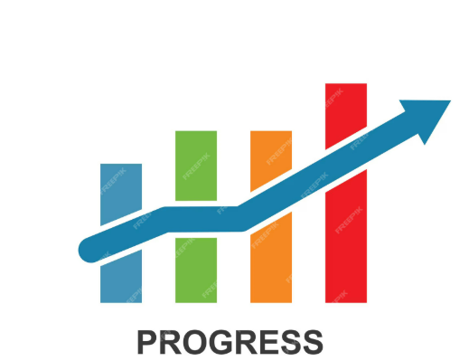
Improving Client Outcomes…
2024: 309 EBP Trauma cases
2014: 1 EBP Trauma case
Growth

Slide 39
Bringing it Back… A Joint Story
When I offer the Evidenced Based, Written Exposure Therapy (WET) to patients, I am confident in what I’m offering, because I know it works. I have seen their scores decrease. Knowing it has been researched, as well as my own experience with prior patients, helps me “roll with the resistance” when some patients decline trauma treatment. Knowing that a treatment works, helps me stay open and ready to start treatment when they feel ready. It feels wonderful to be able to provide treatment that works to people who have been suffering so long and haven’t had access to proven methods. – S. Hoag, Psychologist 3, WA DOC
“When I provided EBP's, I reduce traumatic stress in my life by actively practicing skills to heal trauma in the session. When I'm helping clients heal, I'm also healing. EBP's work for clients and for staff. Healed people heal people.”
-Dr. Rain. Carei, Psychologist 4 WA DOC
Being able to provide evidence-based trauma therapy helps reduce burnout for me in that I feel like we are getting to the root cause of the issues. When doing case management, it often feels like we are putting out fires that inevitably continue to pop up elsewhere. This is exhausting and often makes me feel ineffective. It also tends to put the impetus for change on me, and that is neither sustainable for me nor helpful for client empowerment. By treating trauma, I see global change that prevents the fires in the first place! Helping my clients recognize their ability to grow and heal through trauma treatment feels incredibly fulfilling and worthwhile. They take back the reins in their healing journey, and I get to utilize my energy more effectively. – R. Gardner, Psychology Associate, WA DOC
“It has been scientifically established that empathy not only better supports those for whom we care, but also reduces trauma and burnout for the caregiver. The simple act of taking a genuine interest in our patients changes the dynamic toward a more meaningful engagement that invests, rather than spending or squandering, the practitioner’s effort. Building a system that develops the capacity for empathy will, in fact, increase resilience, reduce error, and lead to better satisfaction and caregiver retention. Empathy heals us all.”
- Dr. MaryAnn Curl, CMO WA DOC

Slide 40
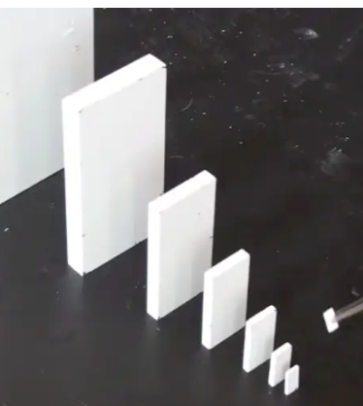
Culture is the vital link for positive growth
Peter Drucker said, “Culture eats strategy for breakfast.”
Resonant – the team needs to believe
Positive – humor, uplifting messaging, gratitude
Sustainable - starting small is smarter than crashing; seek iterative forward progress…
Synergistic – each success increases the likelihood of the next; the energy to keep going is substantially less than the starting investment

Slide 41

Leadership, Change, and Healing Our WA DOC Strategy
  Providing ongoing support
  Reducing silos and removing barriers
  Creating service boards and committee structures for staff to access resources more easily
  Connecting leaders and staff through book clubs, huddles, and open discussions
  Developing models of care that elevate quality indicator goals
  Elevating the voices of staff and patients - empowering people

Slide 42

The importance of a "culture of caring"
Power of caring has transformative ripple effects
Acts of kindness have profound impacts
Treating patients as people results in better outcomes for everyone
Healed people, heal people
Receiving feedback from patients and families
Book clubs: The Florence Prescription, The Coaching Habit, 5 Dysfunctions of A Team, Called to Care

Slide 43
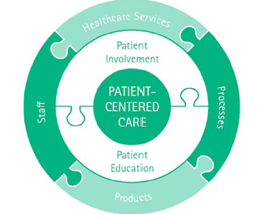
Connecting to Change:
Patient Centered Model of Care
Transforming healthcare services through data.
Developing an empowered ownership culture.
Creating goals to continuously improve systems, engage staff, & deliver excellent care.

Slide 44

Evidenced based care improves equality in correctional healthcare settings
Better Health Care Outcomes -Bringing evidenced based healthcare and metrics to women living in prisons – Pursuing the appropriate Standard of Care
Healthier Communities – We are proud Washingtonians dedicated to helping those in our care to recover and build on their strengths. We invest in housing, goods and services, and support of family members post release.
Utilization Services - Analyze patients who are and are not accessing care at the same frequency to ensure equitable care delivery between all patients.
Informed Decision Making – Data driven decision making allows for resource allocation, evaluating program effectiveness and allows us to respond to areas that need assistance.
Improving Patient Centered Care

Slide 45

Next Steps of our journey…
Continuing to build quality indicators to support incarcerated women and Washingtonians
Continue to build a healthy work environment through decreasing waste and increasing efficient and compassionate work
Continuing to build relationships and expand capacity
Continue equitable work
Collaborate with others who share the vision for healing, recovery, LEAN, and patient centered work

Slide 46
Questions/Comments?
→ WCCW Mental Health is recognized by the Council of State Governments (CSG) as a Criminal Justice-Mental Health Learning Sites - CSG Justice Center .
→ Peer support and consultation is part of work. Please reach out if we can be of support.

Slide 47
References
Alpert, E., Hayes, A., Barnes, J. & Sloan, D. (jn press). Predictors of Dropout in CPT. Behavior Therapy.
Amador, X. I’m Not Sick. I Don't Need Help. How to Help Someone Accept Treatment. (2020). Vida Press. New York.
Bellass, S., Canvin, K., McLintock, K. et al. Quality indicators and performance measures for prison healthcare: a scoping review. Health Justice 10, 13 (2022). https://doi.org/10.1186/s40352-022-00175-9
Blackaby, J., Byrne, J., Bellass, S. et al. Interventions to improve the implementation of evidence-based healthcare in prisons: a scoping review. Health Justice 11, 1 (2023). https://doi.org/10.1186/s40352-022-00200-x
Bridges, A. J., Baker, D. E., Hurd, L. E., Chamberlain, K. D., Hill, M. A., Karlsson, M., & Zielinski, M. J. (2020). How Does Timing Affect Trauma Treatment for Women Who Are Incarcerated? An Empirical Analysis. Criminal Justice and Behavior, 47(6), 631-648. https://doi.org/10.1177/0093854820903071
Carei, T.R. (2024, March 1).Women’s Pathway To, and Through, Prison. Women’s Justice Health Alliance.
Carei, T. R., & Brodie, L. A. (August 2019). Building and Maintaining a Strong Clinical Team in a Correctional Environment: A Trauma Informed Staff Supervisory Model. Platform presentation at the annual Academy of Corrections Convention in Boston, MA.

Slide 48
References
Carei, R., Steely Smith, M. K., Bagdon-Cox, C., Church, C., Cheong, C. K., & Zielinski, M. J. (Under Review). Treatment works, behaviors change: Investigating the impact of treatment for posttraumatic stress disorder on substance and aggression infractions among women in prison. Submitted October 2024.
El-Bassel, N., Schilling, R.F., Ivanoff, A., Chen, D.R., Hanson, M. & Bidassie, B. (1998).Stages of change profiles among incarcerated drug-using women. Addictive Behaviors,23, 389-394.
Fradley, M. F., Kathryn Allison, M., Steely Smith, M. K., Bossard, M., & Zielinski, M. J. (2023). Justice-Involved, Sexually Victimized Women’s Perspectives on the Acceptability of Receiving Trauma-Focused Therapy in Prison. Violence Against Women, 29(14), 2964-2985. https://doi.org/10.1177/10778012231200480
Gallavan, D. B., & Newman, J. L. (2013). Predictors of Burnout Among Correctional Mental Health Professionals. Psychological Services, 10 (1), 115-122.
https://www.prisonpolicy.org/
Harrison RL, Westwood MJ. Preventing vicarious traumatization of mental health therapists: Identifying protective practices. Psychotherapy (Chic). 2009 Jun;46(2):203-19. doi: 10.1037/a0016081. PMID: 22122619.
National Center for PTSD: PTSD: National Center for PTSD Home (va.gov)
Pantalon, M. V., & Swanson, A. J. (2003). Use of the University of Rhode Island Change Assessment to measure motivational rediness to change in psychiatric and dually diagnosed individuals. Psychology of Addictive Behaviors, 7 (2): 91-97. https://doi.org/10.1037/0893-164X.17.2.91

Slide 49
References
Sadeh, N., & McNiel, D. E. (2015). Posttraumatic Stress Disorder Increases Risk of Criminal Recidivism Among Justice-Involved Persons With Mental Disorders. Criminal Justice and Behavior, 42(6), 573–586. https://doi.org/10.1177/0093854814556880
Spinaris, Caterina Ph.D., Denroff, Michael Ph.D., and Kellaway, Julie, Ph.D. (2012). PTSD in US Corrections Professionals: Prevalence and Impact on Health and Functioning. Desert Waters Correctional Outreach.
Strolin-Goltzman, J., Breslend, N., Hemenway Deaver, A., Wood, V., Woodside-Jiron, H., & Krompf, A. (2024). Moving beyond self-care: Exploring the protective influence of interprofessional collaboration, leadership, and competency on secondary traumatic stress. Traumatology, 30(1), 69–76. https://doi.org/10.1037/trm0000244
Stürup-Toft S, O'Moore EJ, Plugge EH. Looking behind the bars: emerging health issues for people in prison. Br Med Bull. 2018 Mar 1;125(1):15-23. doi: 10.1093/bmb/ldx052. PMID: 29394343.
United Nations General Assembly (2015).
Yue, Z., Qin, Y., Li, Y. et al. Empathy and burnout in medical staff: mediating role of job satisfaction and job commitment. BMC Public Health 22, 1033 (2022). https://doi.org/10.1186/s12889-022-13405-4
OpenAI (2024) Figures 1-5. Generated using ChatGPT. Retrieved (November 28, 2024)

Slide 50
Appendix C:
Performance Cycles
“The How”
Pre-Performance Cycle Tasks:
Provider Tasks:
  Trust OMNI to give them accurate data and depend on it to function.
Supervisor Tasks:
  Trust providers to manage their workflow and hold them accountable.
  Meet with providers weekly and look in real time at numbers/progress
  Provide support
HSM Tasks:
  Listen for needed scheduling adjustments
  Ensure scheduling will run reports as needed, problem solve cease movements, restricted movements, cohort challenges
Pre-Performance Cycle Meeting:
Participants:
  HSM
  Psychologist 4
  Individual Provider
  HQ’s if needed (included Dr. Abplanalp during one cycle)
Meeting Tasks:
  What’s working?
  Highlight strengths
  What do you need?
  What do you foresee in terms of barriers; what can we move out of your way?

Slide 51
Appendix C:
Performance Cycles
“The How”
Post-Performance Cycle Tasks
Provider Tasks:
  Look at weekly and quarterly data results as a team and individually
Supervisor/Data Tasks:
  Provide data and analysis quickly
  Focus on strengths
  Analyze trends by team and by client
HSM Tasks:
  Evaluate progress
  Move barriers
Post-Performance Cycle Meeting:
Participants:
  HSM
  Psychologist 4
  Individual Provider
  HQ’s if needed
Meeting Tasks:
  Highlight success
  Problem solve barriers
  Set goals for next cycle
  Adjust/fix/problem solve

Slide 52

Eliminating Waste with EBPs and Data…..
Identifying Inefficiencies
Optimize Process and Systems
Streamlining Operations: Maximizing provider access and client readiness to change to drive patient care outcomes.
Maximizing Patient Movement Schedules: Increasing access to care.
Monitor and Respond
Quality Improvement: MH Quality Indicators – metrics that show treatment success, access ad frequency improve outcomes while eliminating inefficiencies.
Data Driven Decisions: Analyzing data and make data driven decision to improve patient outcomes and improve efficiency.
Reduce Staff Turnover
Meaningful Work Reduces Burn Out: meaningful work leads to staff and patient success.
Staff Connectivity & Ownership: Monthly or weekly reviews of data reduce reporting errors and give staff a voice to help reduce redundant procedures & improve treatment outcomes.
Utilization Review – Improving access to evidenced based care.
Improve Patient Safety - EPBs allow for interventions that reduce efforts and complications that lead to waste.
Prevent Readmissions – EBPs reduce waste to allow for healing that lessons the likelihood of a readmission.
Time Waste: Time is a precious resource. Metrics can pinpoint delay in workflows.
Resource Utilization: Moving from a paper system to an electronic system increases staff administrative burden. productivity and helps to reduce

