Slide 1

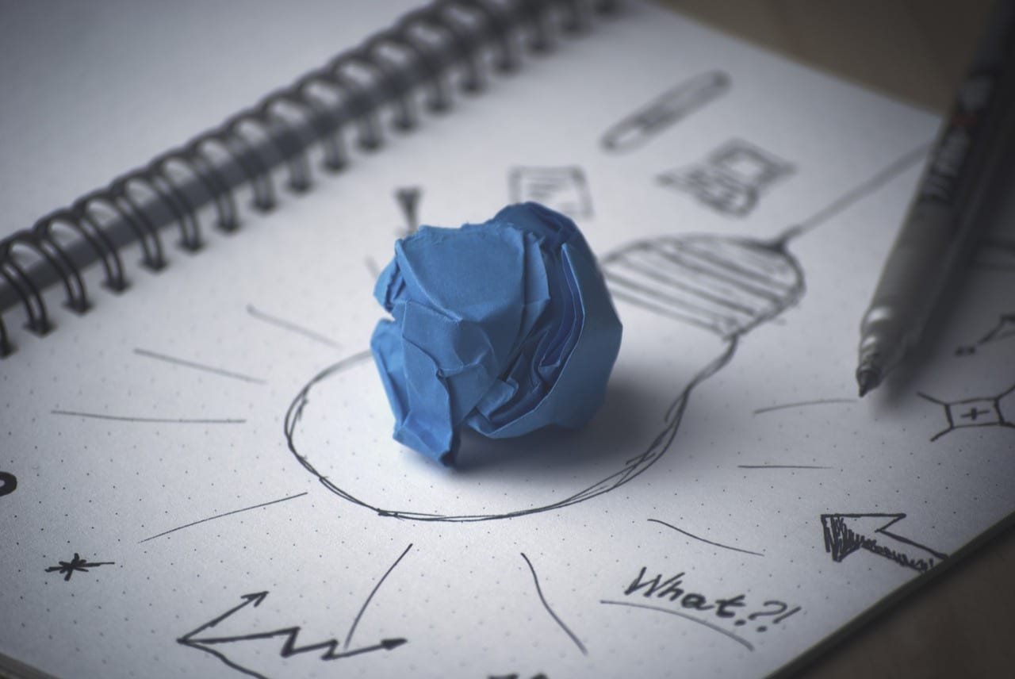

The Blast Newsletter
The blast
ENTERPRISE-WIDE CONTINUOUS IMPROVEMENT COMMUNITY OF PRACTICE
ISSUE NO. 30 | JUNE 2025
WHAT YOU MISSED
At our June CoP, Theresa Dew and Talia Mazzara, with Results Washington, acknowledged the uneasiness within the enterprise due to the state budget and held space for thoughtful discussion and a presentation on Thriving Through Uncertainty. See page 2 for more!
REFLECTIONS SERIES
Click here to watch our Reflections Series featuring Allyson Brooks from the Department of Archaeological and Historic Preservation, as she discusses their work, Preserving Heritage and Promoting Justice.
Questions?
For questions on anything CoP related, contact:
Talia Mazzara, Results WA Senior Performance Advisor
Theresa Dew, Results WA Senior Performance Advisor
The Intersection of Human-Centered Design & Lean Thinking
In today’s fast-paced world of innovation and service delivery, two powerful approaches are helping organizations solve complex problems more effectively: Human-Centered Design (HCD) and Lean Thinking. While they stem from different traditional designs and manufacturing, they converge in one critical area: creating value by focusing on people.
Human-Centered Design is a problem-solving process that puts people at the heart of decision-making. It involves a deep understanding of the needs, experiences, and behaviors of those impacted by a product, service, or system. The goal? To design solutions with people, not just for them.
Lean, rooted in manufacturing but widely adopted across sectors, is all about maximizing value while minimizing waste. It emphasizes continuous improvement and delivering what customers actually need, nothing more, nothing less.
By integrating HCD into Lean practices, teams can go beyond process efficiency and dig deeper into why problems exist in the first place. Lean provides the structure for improvement, and HCD ensures that improvement is meaningful and responsive to real human needs.
When we design for people and improve with people, we build systems that truly serve.

Slide 2



The Blast Newsletter – Page 2
Issue No. 30 | Page 2
Thriving Through Uncertainty
At our most recent Community of Practice, Theresa Dew and Talia Mazzara hosted a timely and heartfelt session titled “Thriving Through Uncertainty: Leveraging Continuous Improvement Skills to Adapt, Evolve, and Find New Opportunities.” With ongoing layoffs and staffing shifts due to the state budget, this gathering came at a critical moment for many across the enterprise.
The session provided more than just practical guidance; it created a meaningful pause. Participants were invited to breathe, reflect, and connect with others navigating similar transitions. Theresa and Talia revisited foundational tools like PDSA (Plan-Do-Study-Act) as strategies for personal planning, career mapping, and daily focus. They also shared curated resources for learning, networking, and job-seeking in Washington State. These tools, typically applied to systems and services, were reframed to help individuals move forward with intention, even in the face of uncertainty. The conversation reminded us that continuous improvement isn’t just a workplace strategy. It’s a mindset that can support resilience, adaptability, and growth in every aspect of life.
Click the play button below to watch the June CoP presentation!
COMING UP NEXT
July 15th, 2025
10:30 a.m. – 12:00 p.m.
Zoom Meeting
Topics:
LEAN Approach to Improved Access to Care and Improved Quality of Care
Presenter:
Candy Tribett,
DOC
Helpful State Resources
Statewide resource links:
Chapter 357-46 WAC:
Collective bargaining agreements | Office of Financial Management
Home | Employee Assistance Program
Layoff and General Government Transition Pool | Department of Enterprise Services (DES)
EAP resources
10 tips for dealing with the stress of uncertainty
Job Loss: 7 Tips to Cope I Psych Central
Coping with the Emotional Impact of a Layoff | Faculty Staff Help Center

