Slide 1

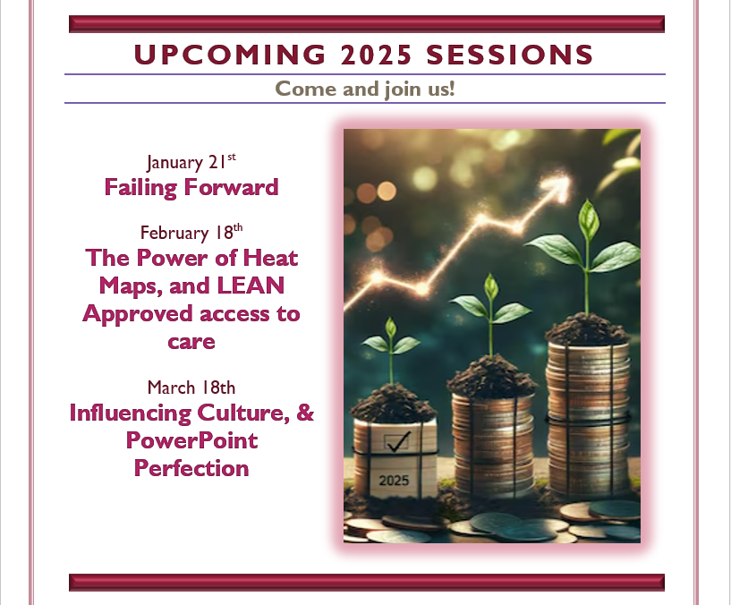

The Blast Newsletter
The blast
ENTERPRISE-WIDE LEAN AND CONTINUOUS IMPROVEMENT COMMUNITY OF PRACTICE
ISSUE NO. 24 | DECEMBER 2024
Transparency - Innovation - Results
WHAT YOU MISSED
At our December CoP meeting, we were joined by Dr. Rain Carei, Dr. MaryAnn Curl, and Kate Morisset with the Department of Corrections, who shared about the important work they are doing to improve treatment outcomes for residents and job satisfaction for staff.
See page 2 for more!
REFLECTIONS SERIES
Click here to watch our Reflections Series, featuring
Jeremy Walker, with the Department of Commerce, as he speaks on Integrating Lean for Equity Impact.
Questions?
For questions on The Blast, the CoP, or to present a teaching or project share, contact:
Talia Mazzara, Results WA Senior Performance Advisor
Theresa Dew, Results WA Senior Performance Advisor
Don’t Miss Out! Add the 2025 CoP Series to your calendar now!
🎉 Exciting News! 🎉We’re thrilled to share
that the first half of our 2025 schedule is live, and the meeting series invites have been sent out to everyone on our distribution list! If you haven’t accepted the invite yet, we’ve attached it to the email sending this Blast, so be sure to add it to your calendar!
We’re also in the process of connecting with individuals who are interested in presenting in the latter half of the year (July-Dec 2025). If you have a great topic teaching or a recent project success story and want to share it, now is the perfect time! 💡✨ Don’t wait! Fill out this Presenter Interest form, and we’ll reach out to chat about your idea. We can’t wait to hear from you!

Slide 2
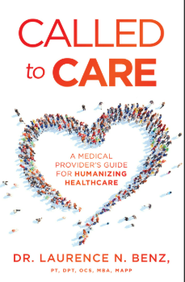

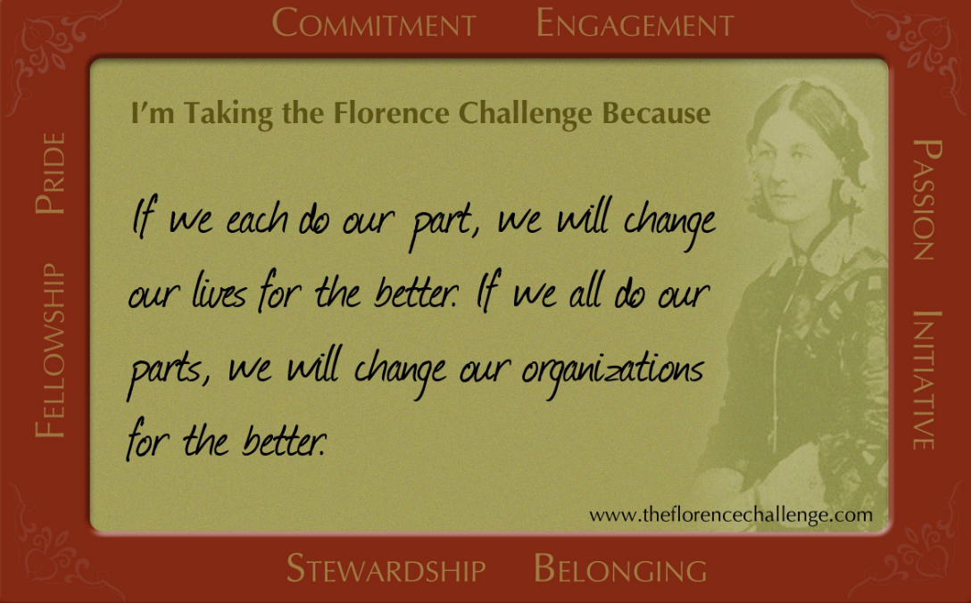
The Blast Newsletter – Page 2
ISSUE NO. 24 | DECEMBER 2024
Redesigning Quality Indicators to Improve Treatment Outcomes and Job Satisfaction
In our final meeting of the year, we had the privilege of hearing from Dr. Rain Carei, Kate Morisset, and Dr. MaryAnn Curl from the Department of Corrections, who delivered a truly impactful presentation that resonated deeply with all of us. They provided a comprehensive look into their groundbreaking work within the women’s correctional facility, showcasing how they are not only transforming the lives of their residents but also enriching the experiences of their staff. Their discussion highlighted the intricate relationship between treatment outcomes and job satisfaction, revealing how improvements on both fronts can foster a healthier, more supportive environment.
We explored the pathways that lead women to prison, shedding light on the profound impacts of trauma and substance use disorders. The insights into how specific therapeutic approaches are linked to successful outcomes—leading to reduced infractions—were particularly enlightening. Moreover, they emphasized the importance of identifying evidence-based practices and process indicators that have catalyzed a significant culture shift within the facility. This shift has paved the way for meaningful growth for both residents and staff alike, creating a more dynamic and compassionate correctional environment. For those interested in diving deeper into their findings and initiatives, the captivating presentation is available for viewing here!
Click the play button below to watch the December CoP presentation!
COMING UP NEXT
January 21, 2025
10:30 a.m. – 12:00 p.m.
Zoom Meeting
Topics:
Failing Forward
Susan Nguyen|
Center For Public Impact
Book Recommendations from our friends at DOC:
* Called to Care by Dr. Lawrence N Benz
* The Florence Prescription by Joe Tye

