Slide 1
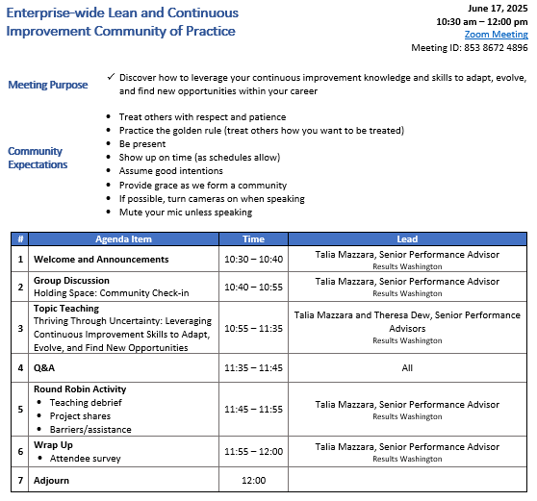

Agenda

Slide 2

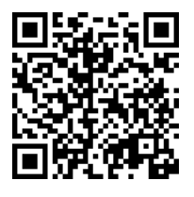
ROLL CALL!
Please take a moment to complete our Attendance Form

Slide 3

Poll
Announcements
SAVE THE DATE – we’re adding a community meeting in October!
Tuesday, October 21st @ 10:30am-12:00pm PST
Journey Mapping with Darleen Simkins with the Washington State Parks and Recreation Commission
Meeting notice was sent with our May Blast newsletter

Slide 4

Poll
Poll: Are you currently being impacted, either directly or indirectly, by the uncertainty of layoffs within your organization?

