Slide 1


THRIVING THROUGH UNCERTAINTY
Leveraging Continuous Improvement skills to adapt, evolve, and find new opportunities

Slide 2

Agenda
Coping through change
Permission to rest
Thriving through uncertainty
Embracing change as opportunity
Applying PDSA to career planning
Value stream mapping yourself
Encouragement & mindset: Lean thinking in tough times
Resources and support

Slide 3


Coping through change: human first, always
COPING THROUGH CHANGE- HUMAN FIRST, ALWAYS
Acknowledge the disruption- it’s okay to feel disoriented
Name what you’re feeling
Create a pause space
Practice micro-wins
Lean on your circle
You are not broken
Honor the cycle- observe → stabilize → reflect → learn → redesign

Slide 4


CONTINUOUS IMPROVEMENT ≠ CONSTANT PRESSURE
Give yourself permission to rest. Rest fuels clarity
Quality vs quantity: CI is about value, not volume
Build systems that include rest
Self-worth is NOT a KBI
Practice gentle iteration
There is a season for wild growth and a season for deep rest. Both are valuable. Both are progress.

Slide 5


THRIVING THROUGH UNCERTAINTY- RESILIENCE AS A SKILL
Continuous Improvement doesn’t just help us perform- It helps us adapt
Identify what you can influence
Standard work for mental wellness
Practice learning loops
Visualize a future state you’d be proud of

Slide 6

EMBRACING CHANGE AS OPPORTUNITY
“Without standards, there can be no improvement.”
– Taiichi Ohno

Slide 7
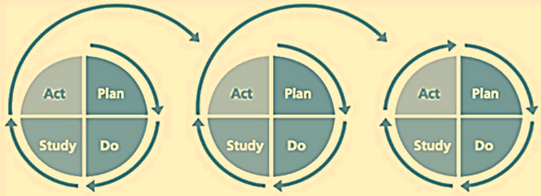
APPLYING PDSA TO CAREER PLANNING
Plan
Do
Study
Set aside time to reflect
Pause to assess what’s working, what’s not, and why
Act
Set a clear goal, frame your challenge, and outline what you’ll try first
Take small, intentional steps forward-
progress over perfection

Slide 8

VALUE STREAM MAP YOURSELF
Evaluate and optimize how you spend time and
effort during tough transitions
Map your current state job-seeking or skill-building process
Identify steps that are value-added, non-value added, and necessary but non-value added

Slide 9

MAPPING WHAT MATTERS
What might my current VSM look like?
Job search
Wake up
Check job boards
Feel discouraged
Tweak resume
Submit apps
No response
See the whole system, not just the symptoms
Make the invisible visible
Align effort with value
Reclaim time and energy
Design a system you can sustain
Reflective insight > guilt-driven hustle
Create a compass during chaos
Skill building
Log in to LinkedIn
Check posts for upcoming courses
Take the course
Register for a few
Where in your current day are you spending energy but not gaining value?
What one small change might help flow, not just output?

Slide 10
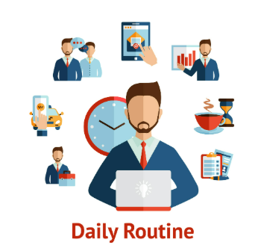
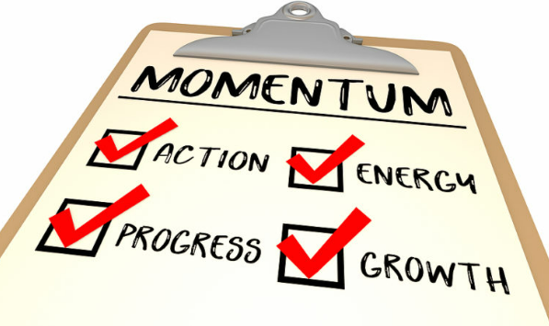
Future state
FUTURE STATE
Set a daily or weekly “standard work” routine to maintain energy and focus.
Prioritize steps that build momentum: networking, LinkedIn activity, learning.

Slide 11
VALUE-ADDED
FUTURE
STATE
STEPS
Build
Build a targeted portfolio
Role-Play
Job tracker
Use job tracker with CI metrics
Engage in active Learning
Practice mock interviews weekly
Cont. Edu
Update resume
Update resume with measurable impact
Network
Grow professional network with purpose
Apply CI
Stay focused
Draft a “future self” vision statement
Contribute to a CI community
Apply CI thinking to personal routines
Stay active
Pause & reflect
Schedule weekly reflection time

Slide 12

What’s the takeaway?
WHAT’S THE TAKEAWAY?
Optimize and visualize!!

Slide 13

Encouragement and Mindset: Lean thinking in Tough Times
ENCOURAGEMENT & MINDSET
LEAN THINKING IN TOUGH TIMES
How to keep our resolve and “community spirit” when our own spirit might be struggling?
Mental framing
Small wins matter
Community encouragement

Slide 14

RESOURCES AND SUPPORT
Job Search & Career Tools (WA-Focused):
Careers.wa.gov - State jobs portal, includes Lean/CI-focused roles.
WorkSourceWA.com - Resume help, job matching, unemployment resources.
CI Learning & Certifications:
GoLeanSixSigma.com (Free Yellow Belt & project templates)
Coursera/Udemy/edX - Look for Lean, Agile, and Human-Centered Design courses.
Washington State Learning Center (for current state employees) - search for Lean training.
Results Washington - Stay connected and in-tune for future conferences
Networking & Peer Communities:
Continue to attend our CoP!!
Join Lean/CI LinkedIn groups or Slack spaces (e.g., Lean Communicators).
Attend WA State Continuous Improvement COP events regularly.
Consider forming a “CI Job Seekers Huddle” to meet bi-weekly and co-work or support each other.

Slide 15
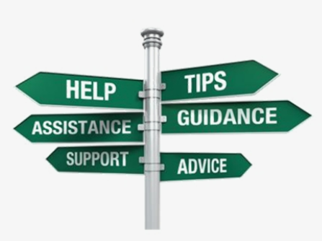
RESOURCES CONT.
Statewide resource links:
Chapter 357-46 WAC:
Collective bargaining agreements | Office of Financial Management
Home | Employee Assistance Program
Layoff and General Government Transition Pool | Department of Enterprise Services (DES)
EAP resources
10 tips for dealing with the stress of uncertainty
Job Loss: 7 Tips to Cope I Psych Central
Coping with the Emotional Impact of a Layoff | Faculty Staff Help Center

Slide 16

Questions?
Talia Mazzara, Senior Performance Advisor
Talia.Mazzara@gov.wa.gov
Theresa Dew, Senior Performance Advisor
Theresa.Dew@gov.wa.gov

