Slide 1
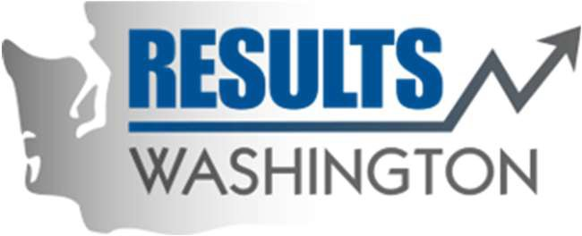


The Blast Newsletter
The blast
ENTERPRISE-WIDE CONTINUOUS IMPROVEMENT COMMUNITY OF PRACTICE
ISSUE NO. 27 | MARCH 2025
Transparency - Innovation - Results
WHAT YOU MISSED
At our March CoP, we heard from Jeannie Bowen with Results Washington, who presented on Powering Up Your PowerPoint, and MarthaJane Vincent with the Arizona Government Transformation Office, who shared on Influencing Culture.
See page 2 for more!
REFLECTIONS SERIES
Click here to watch our Reflections Series, featuring
Rain Carei, with the Department of Corrections, as she shares her experience with improving outcomes and enhancing well-being for both staff and clients.
Questions?
For questions on The Blast, the CoP, or to present a teaching or project share, contact:
Talia Mazzara, Results WA Senior Performance Advisor
Theresa Dew, Results WA Senior Performance Advisor
Step Up and Share your presentation with our Continuous Improvement CoP!
If you are receiving this, you are a valued contributing member of our Community of Practice (CoP) for continuous improvement—you understand the value of collaboration and learning from one another. Now, we’re looking for members like you to step up and present!
Have you led a great improvement project? Learned a valuable lesson from a project management or continuous improvement methodology? Your insights can help others across the enterprise grow and improve. Whether you have a polished presentation or just an idea to workshop, we’d love for you to share your knowledge.
Presenting is a great way to connect, inspire, and leave a lasting impact. You don’t have to be an expert—just willing to share your experiences and spark discussions.
Interested? It’s easy to get started. Reach out to Talia at talia.mazzara@gov.wa.gov, and she’ll contact you to get the conversation going!
Let’s keep the momentum going and continue driving improvement together!

Slide 2
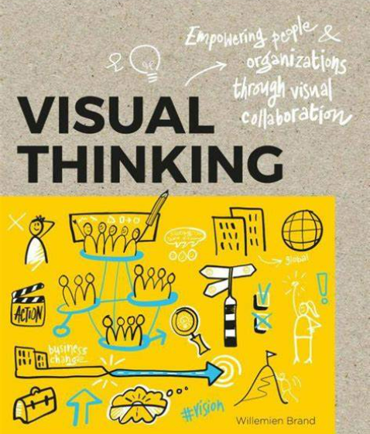

The Blast Newsletter – Page 2
ISSUE NO. 27 | MARCH 2025
Excellent Resource
Alert!
POWER UP YOUR POWERPOINT
Jeannie Bowen of Results Washington recently delivered an outstanding presentation titled "Power Up Your PowerPoint," where she shared a wealth of tools and techniques to elevate the quality and effectiveness of presentations. Her session provided invaluable insights into creating visually appealing and seamlessly flowing slides, leaving attendees well-equipped and inspired to enhance their own presentations.
A few of the helpful topics discussed:
(Note: see the slide deck for thorough breakdown of each)
Build accessibility into your presentation from the beginning
Select a font that is easy to read & visually appealing
Embed a custom color palette; a good place to start is your orgs branding colors
Make your slides more engaging by including icons and graphics~ Free sources shared in the presentation!
A good slide design and information organization is important to creating consistency and flow of the information
So many infographics and templates shared- click here to view the presentation!
Jeannie’s session was an invaluable experience, filled with practical, tangible takeaways that left attendees energized and ready to enhance their PowerPoint skills.
Whether you're a beginner or an experienced presenter, applying these techniques will undoubtedly elevate your slides and captivate your audience!
Click the play button below to watch the March CoP presentation!
COMING UP NEXT
April 15th, 2025
10:30 a.m. – 12:00 p.m.
Zoom Meeting
Topics:
Dynamic System Development Methodology (DSDM) and the Lake Burien Transitional Care Facility Project
Sumeda Madhuri| DSHS,
Developmental Disabilities Administration
ARIZONA MANAGEMENT SYSTEM: INFLUENCING CULTURE
MarthaJane Vincent delivered an insightful session on the Arizona Management System (AMS), a structured, outcomes-driven approach that connects Arizona’s long-term goals to the daily work of state employees. A few key insights were:
Transforming Government Services: MarthaJane shared real-world examples of AMS in action, including significant reductions in service backlogs, fewer hours spent at motor vehicle departments, and improved recognition and efficiency of online services. Shaping Workplace Culture: Through intentional, continuous improvement efforts, AMS has transformed workplace culture, fostering innovation and efficiency across state agencies.
Recognized Excellence: The AMS approach has led to multiple government excellence awards, showcasing the system’s effectiveness in improving public services.
The presentation underscored the profound impact of AMS in making government operations more effective, inspiring attendees to embrace continuous improvement for lasting change.
Click here to view the presentation!

