Slide 1

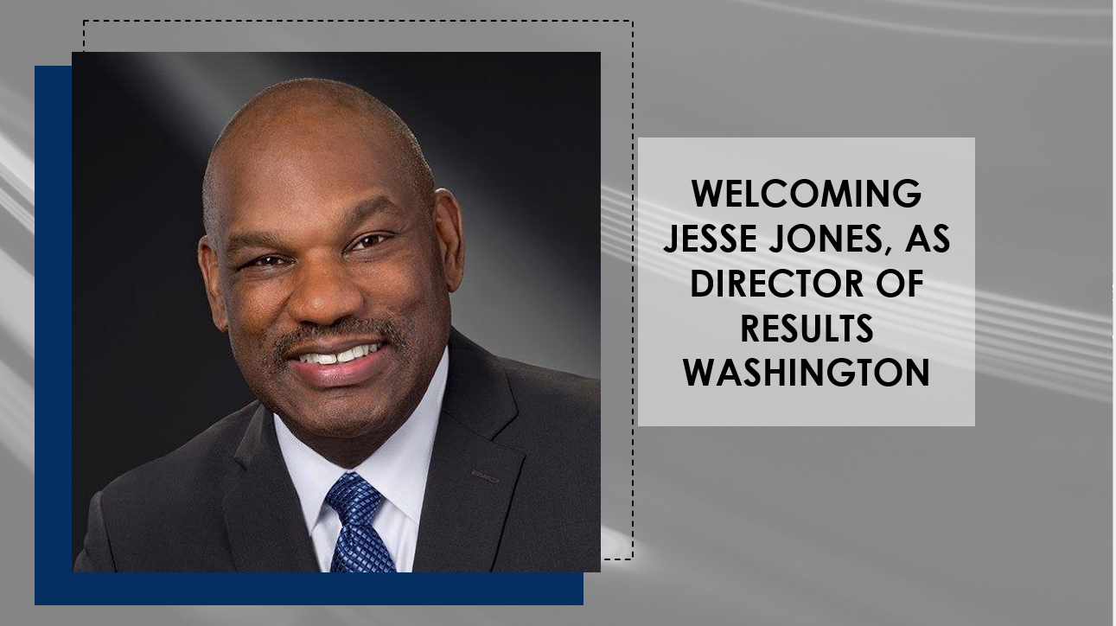


The Blast Newsletter
The blast
ENTERPRISE-WIDE CONTINUOUS IMPROVEMENT COMMUNITY OF PRACTICE
ISSUE NO. 25 | JANUARY 2025
Transparency - Innovation - Results
WHAT YOU MISSED
At our January CoP, we heard from Jeannie Bowen with Results Washington as she shared an interactive presentation titled Beyond Resolutions: The Science of Building Lasting Habits.
See page 2 for more!
REFLECTIONS SERIES
Click here to watch our Reflections Series, featuring
Eliza Craig, with the Washington State Women’s Commission, as she speaks on Bridging the Pay Gap:
Empowering Washington's Women and Girls Through Collective Action.
Questions?
For questions on The Blast, the CoP, or to present a teaching or project share, contact:
Talia Mazzara, Results WA Senior Performance Advisor
Theresa Dew, Results WA Senior Performance Advisor
Results Washington Got Jesse!
We’re absolutely thrilled to welcome Jesse Jones as our new Director! Jesse’s unwavering passion for people, his dedication to accountability, and his pursuit of excellence make him the perfect fit for our agency’s mission and values. His visionary leadership promises to elevate our focus from managing performance to transforming it through a customer-centric lens.
As Continuous Improvement experts, we know that a program, service, or process is only as strong as the experience it delivers to its customers. With Jesse at the helm, we are confident that his leadership will take our work to new levels and further cement our role as Washington’s accountability office.
Governor Ferguson said it best.
“Washingtonians know that when there’s a problem to solve, you call Jesse. Government must work better, and Jesse’s track record proves he’s the ideal candidate for this role.”
Here’s to a transformative journey ahead!

Slide 2
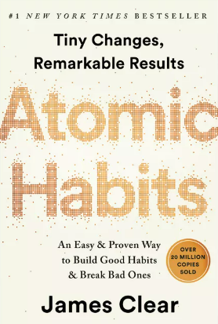

The Blast Newsletter – Page 2
ISSUE NO. 25 | JANUARY 2025
Beyond Resolutions:
The Science of Building Lasting Habits
In our first meeting of the year, we were privileged to hear from Jeannie Bowen, a dynamic speaker from Results Washington, who captivated us with her insightful presentation on the science of building habits that stick. Drawing inspiration from the highly regarded book *Atomic Habits*, her discussion offered a compelling blend of psychology and practical strategies.
Jeannie guided us through a downloadable action plan that was both engaging and transformative. She encouraged us to begin by vividly envisioning our goals, helping us to articulate not just what we wanted to achieve but also to craft a strong identity that aligns with those aspirations. This process emphasized the importance of how we see ourselves in relation to our ambitions.
Throughout her presentation, she highlighted the significance of recognizing and celebrating small wins, which serve as critical milestones on our journey toward larger goals. By acknowledging these incremental achievements, we can build momentum and reinforce the habits that lead to lasting change. Jeannie’s interactive approach sparked reflection and left us inspired to apply these concepts in our own lives.
Click here to download the presentation & action plan.
Click the play button below to watch the January CoP presentation!
COMING UP NEXT
February 18, 2025
10:30 a.m. – 12:00 p.m.
Zoom Meeting
Topics:
Lighting Up Insights: The Power of Heat Maps in Process Data Visualization
Presenter:
Olga Zhuravel | Snowflake Inc
Share Your Expertise with Our Community!
Do you have a successful project or teaching on a continuous improvement methodology that could inspire and empower others? We’re looking for passionate individuals to present and share their knowledge with our community!
This is a fantastic opportunity to:
✅ Showcase your expertise and accomplishments.
✅ Connect with like-minded professionals.
✅ Contribute to our shared growth and success.
If you’re interested, please take a moment to fill out this form and we’ll be in touch!
Let’s learn and grow together by sharing what works. Your experience could be the key to someone else’s success!

