Slide 1



The Blast Newsletter
The blast
ENTERPRISE-WIDE CONTINUOUS IMPROVEMENT COMMUNITY OF PRACTICE
ISSUE NO. 26 | FEBRUARY 2025
Transparency - Innovation - Results
WHAT YOU MISSED At our February CoP, we heard from Olga Zhuravel with Snowflake, Inc, as she shared an informative presentation on the Power of Heat Maps in Process Visualization. See page 2 for more! REFLECTIONS SERIES Click here to watch our Reflections Series, featuring Megan Matthews, with the Office of Equity, as she shares her reflections on the journey toward equity in our state and the work still to be done. Questions? For questions on The Blast, the CoP, or to present a teaching or project share, contact:
Talia Mazzara, Results WA Senior Performance Advisor
Theresa Dew, Results WA Senior Performance Advisor
When there’s change, there’s opportunity
We’ve had some exciting changes here at Results Washington! We have a new director, Jesse Jones, who joined the team in February and brings intensive knowledge on problem solving and leading change – not only in Washington state but across the country. We’re grateful to have his strategic vision and passion for people at the helm of our ship as we embark on a new adventure with our state’s new administration!
As Jack Welch once said – when there’s change, there’s opportunity. Well, Results Washington is leaning into the opportunity and will be slightly shifting our focus to customer experience. We know that Washingtonians are at the heart of everything we do as public servants, and we want to ensure that they can get the most out of the services we provide and are satisfied with their experience.
To do this, we must continue to lean (no pun intended) on continuous improvement and ensure that the customer is at the center of all we do. We are excited to continue to share knowledge, skills and expertise through this community so we all have the tools necessary to improve.

Slide 2
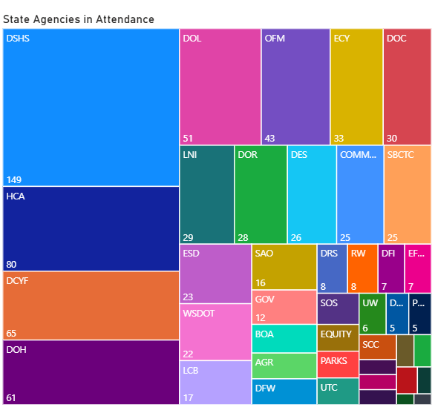

The Blast Newsletter – Page 2
ISSUE NO. 26 | FEBRUARY 2025
Heat mapping CoP attendance by agency
The Power of Heat Maps in Process Visualization During our latest meeting, the spotlight was on the transformative power of heat maps in process data visualization, a topic expertly presented by Olga Zhuravel, the Senior Manager of HR Process and Operations at Snowflake. Olga delved into the intricate details, underscoring how heat maps serve as a vital tool for prioritizing tasks by assigning numerical scores and vibrant colors to various processes. These assessments were based on key criteria such as process maturity, the extent of documentation, the level of automation, and the overall experience of both customers and fulfillers.
Olga's emphasis was on the importance of starting small—she suggested beginning with a straightforward questionnaire that includes predefined weights for each criterion. This approach allows for a gradual and manageable expansion of the scope over time. Her session was particularly engaging due to the live demonstration of the heat map tool. This hands-on example highlighted the tool's flexibility and its practical application in decision-making and process improvement initiatives, making it clear just how valuable it can be in driving efficiency and effectiveness in operations.
We left with a fillable worksheet and a deeper understanding of how heat maps can be leveraged to visualize process data in a way that brings clarity and focus to task prioritization and operational improvements. Click here to download the presentation & worksheet.
Click the play button below to watch the February CoP presentation!
COMING UP NEXT
March 18, 2025
10:30 a.m. – 12:00 p.m.
Zoom Meeting
Topics:
Arizona Management System: Influencing Culture MarthaJane Vincent | Arizona Government Transformation Office
Power Up your PowerPoint Jeannie Bowen | Results Washington
Share Your Expertise with Our Community!
Do you have a successful project or teaching on a continuous improvement methodology that could inspire and empower others? We’re looking for passionate individuals to present and share their knowledge with our community!
This is a fantastic opportunity to: ✅ Showcase your expertise and accomplishments. ✅ Connect with like-minded professionals. ✅ Contribute to our shared growth and success.
If you’re interested, please take a moment to fill out this form and we’ll be in touch!
Let’s learn and grow together by sharing what works. Your experience could be the key to someone else’s success!

