Slide 1
Dynamic System Development Methodology (DSDM) and example
Sumeda Madhuri

Slide 2
AGENDA
PM
DSDM
LB-TCF
Q
1
2
3
4
Project Management
Dynamic system development method
Lake Burien
Quality and Questions
What is project management?
PM styles
Government settings
What is DSDM?
How to use in Government setting?
Private setting?
Scope/Strategic Goal
Dynamic Development
Early Delivery
DSDM and Quality
Pros/Cons

Slide 3

Project Management
Effectively plan, execute, and oversee a goal to success
Project Management
Pursue scalable customer service through sustainable strategies
Cultivate one-to-one customer service with robust ideas​
Traditional and Agile Methods
Dynamic system development methodology
Improved Project Success Rates
Increased Efficiency and Productivity
Enhanced Problem-Solving Skills
Structure
Goal/Objective
Responsible
Team accountability
Changes
Risk
Monitor progress
Performance
Effective value
Traditional
Linear
Sequential
One after another
Agile
Iterative approach
manageable phases
Incorporating feedback
Rapid Application Development
Agile
strategic goals and focus upon early delivery
Eight Principles
Backbone to AgilePM®
World’s leading Agile Project management method ​
4
5
1
3
2

Slide 4
8 DSDM PRINCIPLES
Focus on the business need
Build incrementally from firm foundations
Deliver on time
Develop iteratively
DSDM
Collaborate
Communicate continuously and clearly
Never compromise quality
Demonstrate control

Slide 5
DSDM PHASES
Understanding Project Variables
Development Team
Foundations
Time Boxing
Feasibility study
feel ownership of the solution
Process
People
Products
Practices
.
Building an effective team for successful delivery focuses on four elements:
Empowerment
Stability
Skills
Size
Set sprints
Set time
Set cost
Variable features
Quality to not compromise
Scope
80/20 principle
Iterative approach
business requirements will change Deployment
Fixed variables
  - Time
  - Cost
Variable variables
  - Features
Determinant variables
  - Quality
Evolutionary Development Phase
Assemble
Deploy
Deployment and complexity
Understanding Project Variables
Post-Project Phase
Development Phase
Accountability
Closing the project
Review
MoSCoW prioritization (Must, Should, Could, Won't)
Prototyping and iterative development

Slide 6
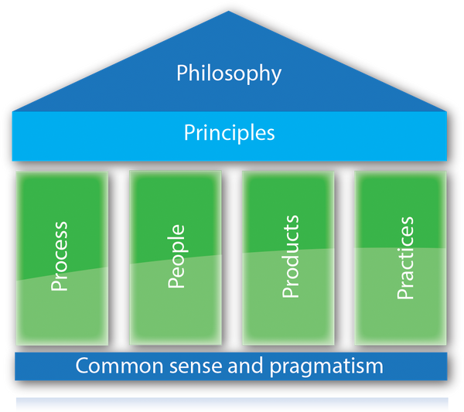
FEASIBILITY AND FOUNDATIONS
Foundations
feel ownership of the solution
Process
People
Products
Practices
Feasibility study
Scope
80/20 principle
Iterative approach
business requirements will change Deployment
Foundations
feel ownership of the solution
Process
People
Products
Practices

Slide 7
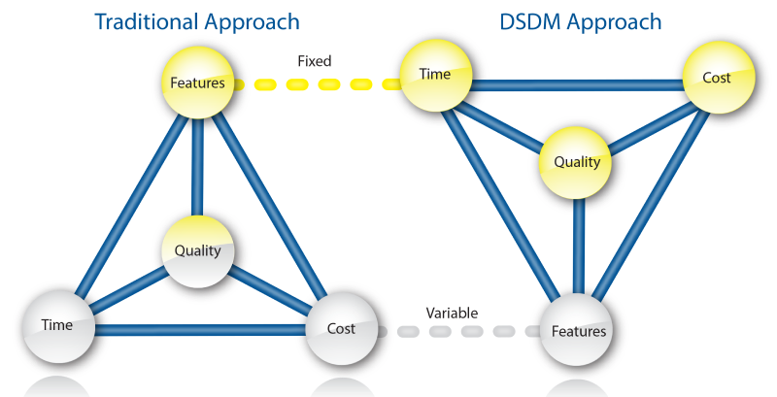
Project analysis slide 3
EVOLUTIONARY DEVELOPMENT
Understanding Project Variables
DSDM in Government projects
What sets DSDM apart from other methodologies?
.

Slide 8
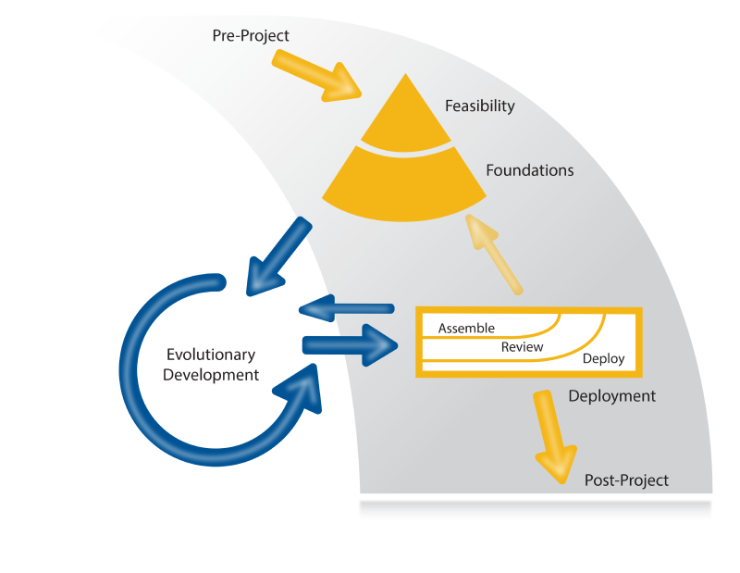
TEAM AND TIME BOX
Development Team
DSDM Phase
Team has all the power
Solution focused
Time Boxing
Set sprints (max 2 week)
Set time
Set cost
Variable features
Quality to not compromise
Notes:
Roles in DSDM
Building an effective team for successful delivery focuses on four elements
Empowerment
Stability
Skills
Size.
Business Sponsor
Project Manager
Team Leader
Solution Developer
Advantages
Flexibility in changing requirements
High stakeholder engagement
Focus on delivering value
Slide 8: Challenges
Requires strong collaboration
Timeboxing may lead to scope limitations
Steep learning curve for new teams

Slide 9
Examples of the 1st two DSDM Phases
How did DSDM look in the Lake Burien – TCF project?
Scope - 12 bed, Transitional Care, Age
20% work accounts for 80% of the project
Facility
Staff
Legislative mandated timeline
Not much control for team
Feasibility study
Understanding Project Variables
Time Boxing
Scope
80/20 principle
Iterative approach
business requirements will change
Deployment
.
Weekly plan
Weekly report
Percentage of work
Legislative mandated timeline
Not much control for team
Set sprints
Set time
Set cost
Variable features
Quality to not compromise
Fixed variables
  Time
  Cost
Variable variables
  Features
Determinant variables
  Quality
Time boxed weekly thus change is acceptable
Can change every week if needed
Rent/Construct/Buy – as based on business
Bed styles/Mandates – as based on team
Easy to Deploy
Team has the power
People management at it’s best
Monitored weekly
Notes:
Scope
80/20 principle
Iterative approach
business requirements will change
Deployment

Slide 10
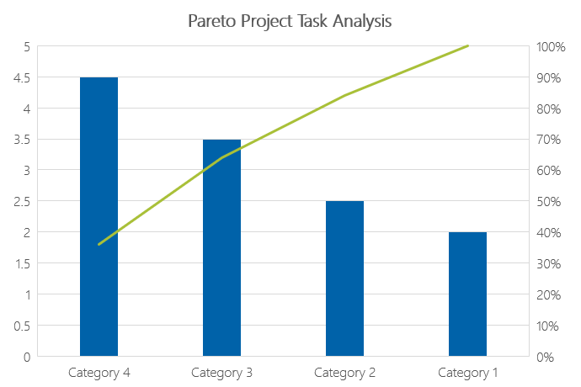
DSDM is Task focused Focus
80/20 rule
What’s most important
MoSCoW Model for everything
Adapt and Move on
Change Acceptable
Risk acceptable
Communication is high
Goal Focused
Customer focused
Plan flexible
Task Focused
Category 4 Tasks were affecting 80% of the project
Prioritize Prioritize Prioritize

Slide 11
Examples of the remaining DSDM Phases in the LB project
UNDERSTANDING PROJECT VARIABLES
DEPLOYMENT AND COMPLEXITY
Evolutionary Development Phase
Deploy
Development Phase
ACCOUNTABILITY
Review
MoSCoW prioritization (Must, Should, Could, Won't)
Assemble
Closing the project
Prototyping and iterative development
Post-Project Phase
Legislative Mandates and Analysis
Analyzing what might change and what
needs to change
What can we control and what can be moved?
In tasks, what are the highest priorities? MosCow
Definition of done or Minimum viable product
80/20 Pareto chart analysis
Did we meet the Mandates?
Did we manage the controls?
Are we able to manage the change?
Did we meet the must haves?
Is the MVP good?
20% of work that we finalized = 80% of the work
20% work Deployment and Change Management
Testing and deployment
Reviews and approvals
Assemble the DOD or the MVP and managing the needs
Closing the Project and lessons learned
Post project phase
Notes:
Scope
80/20 principle
Iterative approach
business requirements will change
Deployment

Slide 12
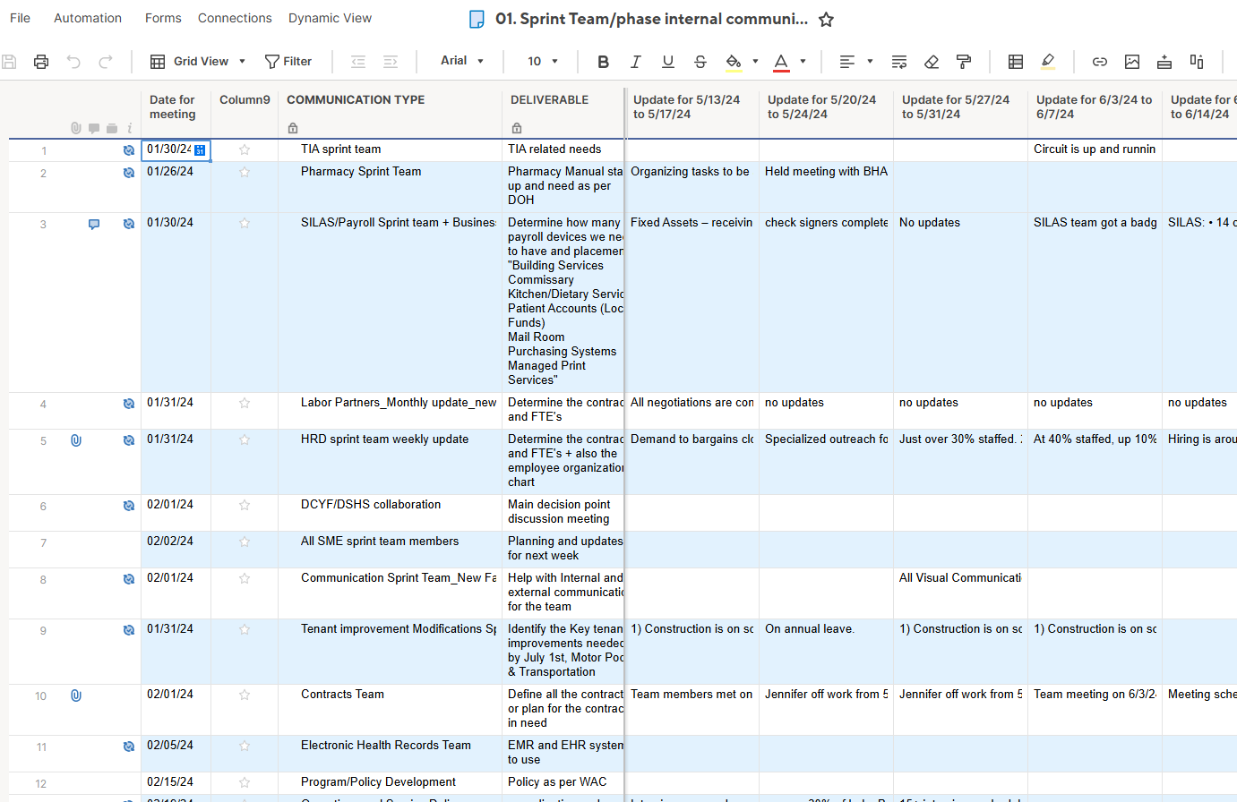
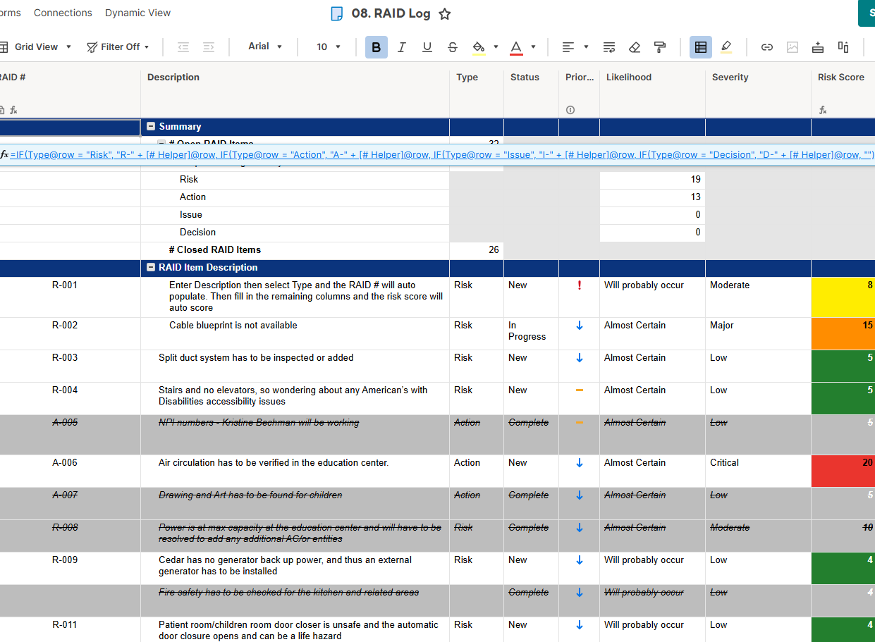
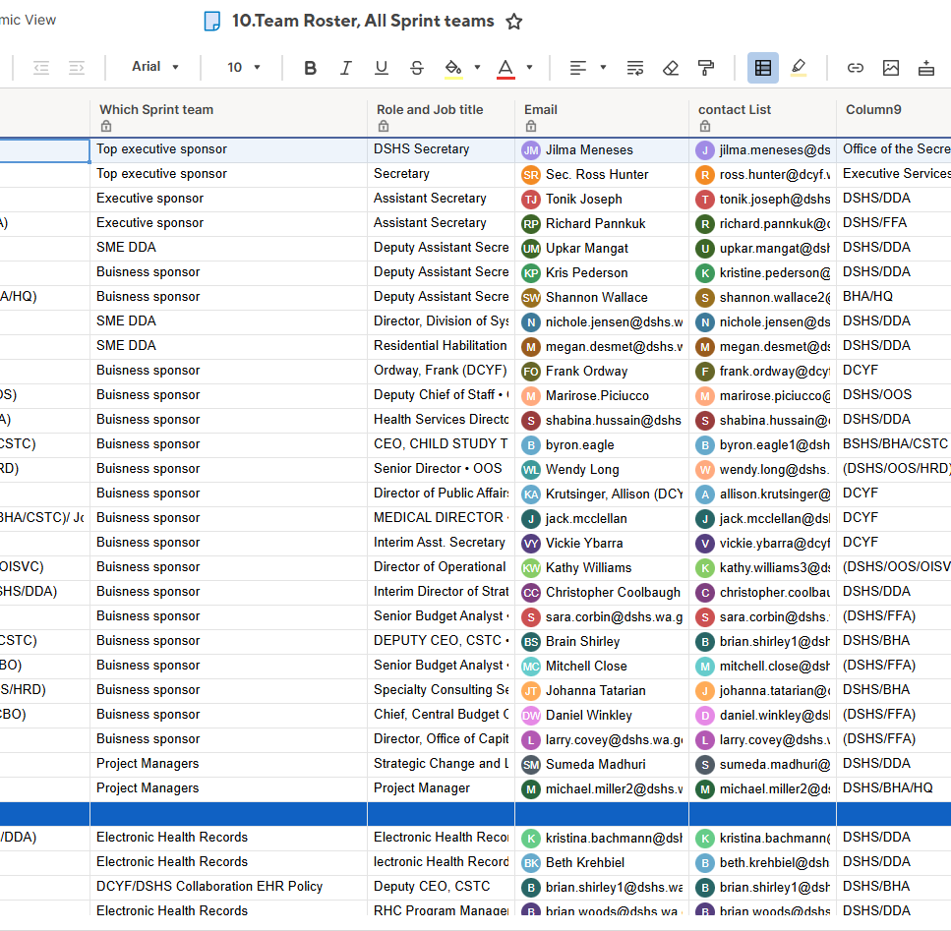
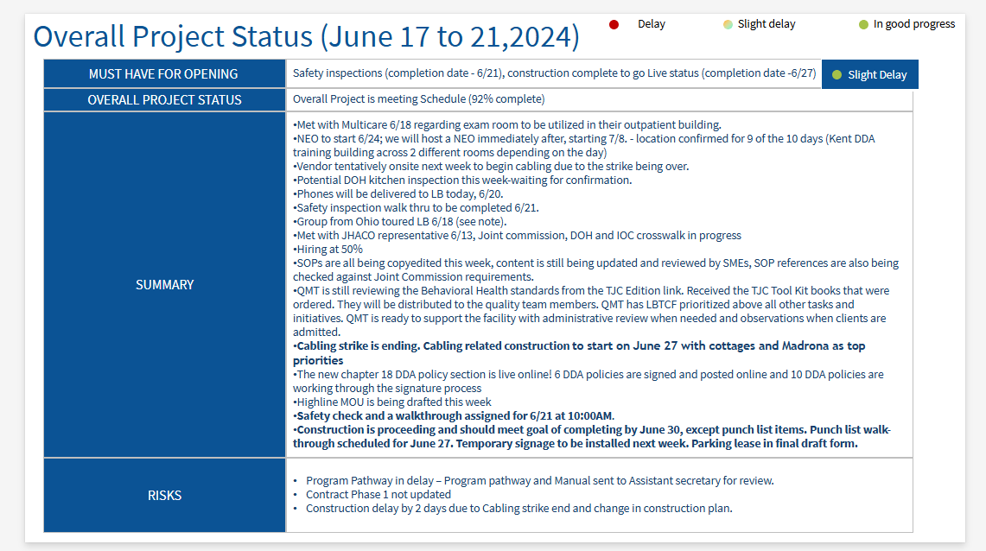
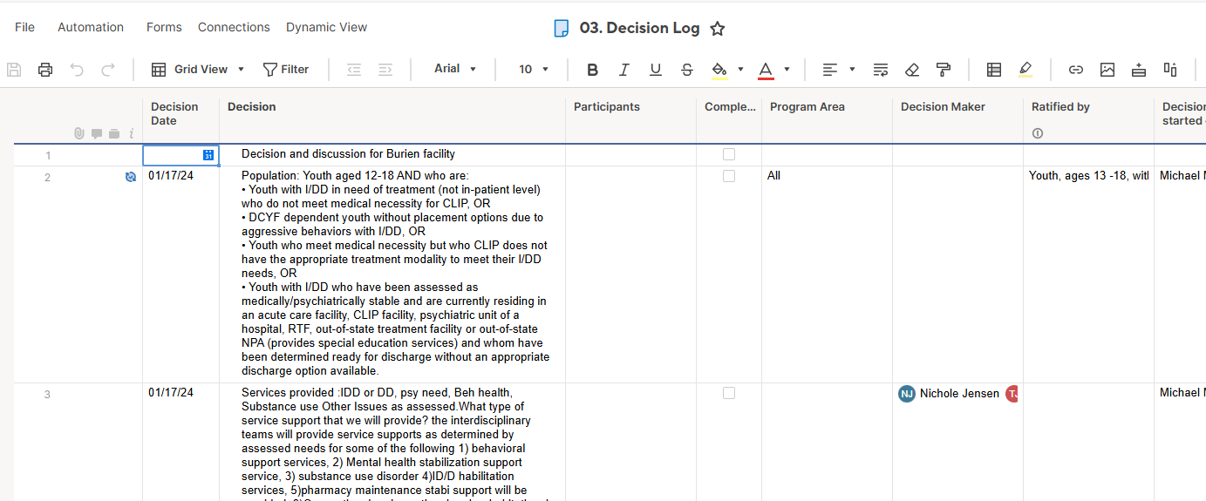
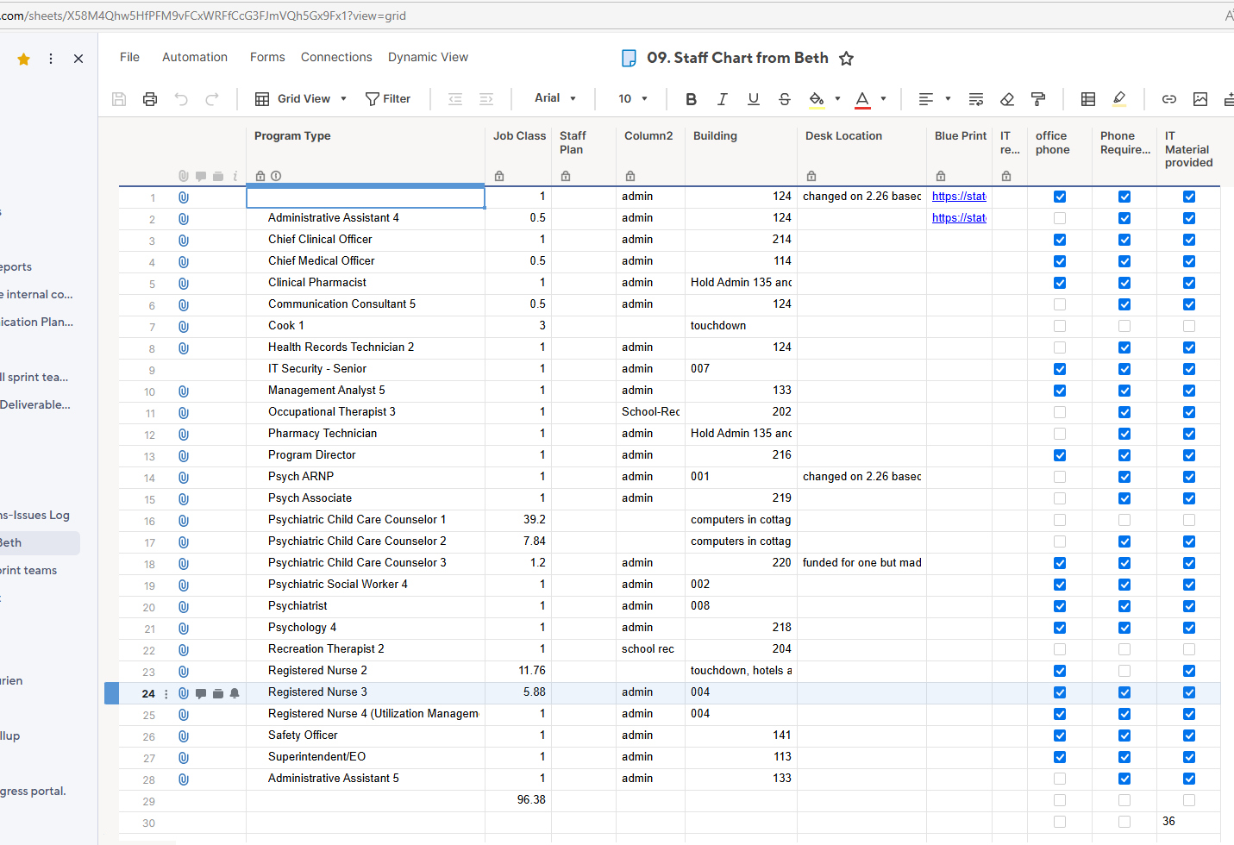
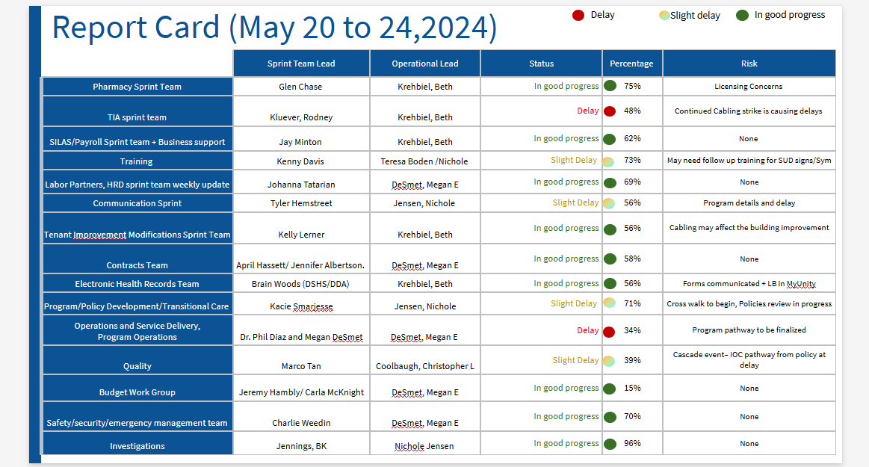
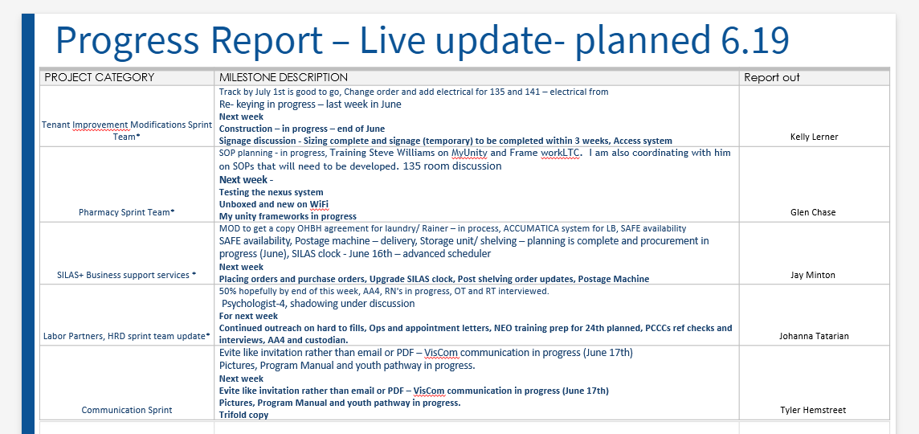
CRITICAL TOOLS
Let’s not forget the basic
Basic Project Management
New tools
Some fun DSDM tools
Progress/Planning Status
Report Card
Communication
RAID Log
Team Roaster
Project Status
Decision Log
Staff Log

Slide 13
Communication Log

Slide 14
CRITICAL TOOLS
Let’s not forget the basic
Basic Project Management
New tools
Some fun DSDM tools
Progress/Planning Status
Report Card
Communication
RAID Log
Team Roaster
Project Status
Decision Log
Staff Log

Slide 15
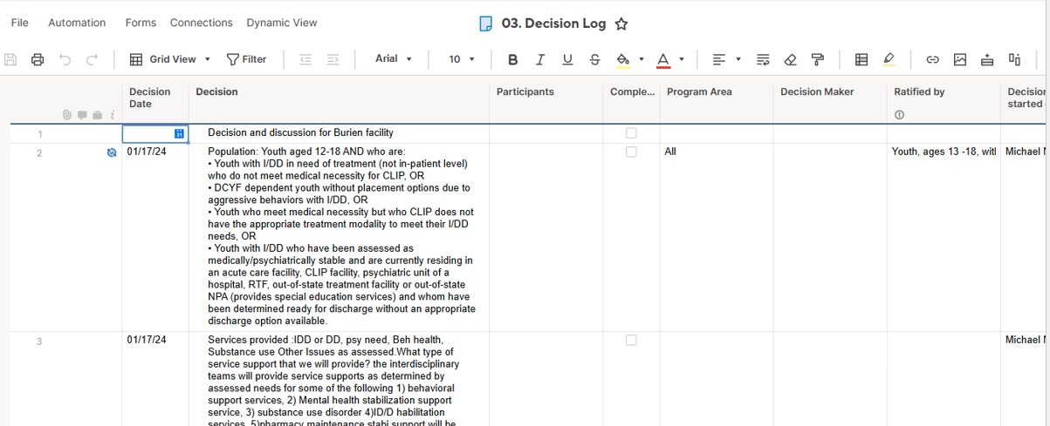

Decision Log

Slide 16
CRITICAL TOOLS
Let’s not forget the basic
Basic Project Management
New tools
Some fun DSDM tools
Progress/Planning Status
Report Card
Communication
RAID Log
Team Roaster
Project Status
Decision Log
Staff Log

Slide 17
RAID Log

Slide 18
CRITICAL TOOLS
Let’s not forget the basic
Basic Project Management
New tools
Some fun DSDM tools
Progress/Planning Status
Report Card
Communication
RAID Log
Team Roaster
Project Status
Decision Log
Staff Log

Slide 19
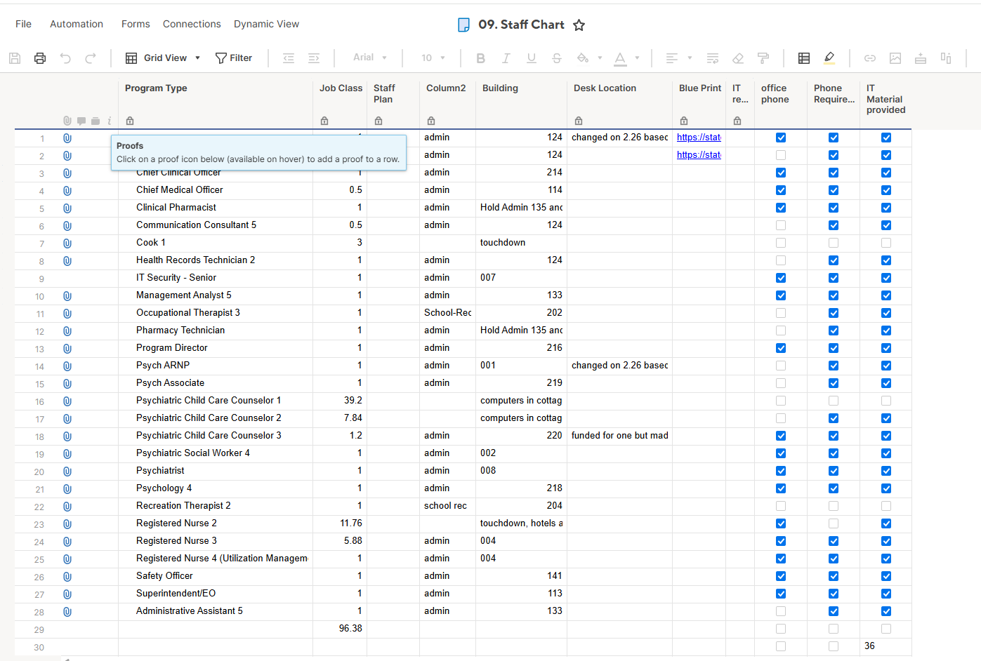
Staff Chart

Slide 20
CRITICAL TOOLS
Let’s not forget the basic
Basic Project Management
New tools
Some fun DSDM tools
Progress/Planning Status
Report Card
Communication
RAID Log
Team Roaster
Project Status
Decision Log
Staff Log

Slide 21
Team Roster

Slide 22
CRITICAL TOOLS
Let’s not forget the basic
Basic Project Management
New tools
Some fun DSDM tools
Progress/Planning Status
Report Card
Communication
RAID Log
Team Roaster
Project Status
Decision Log
Staff Log

Slide 23
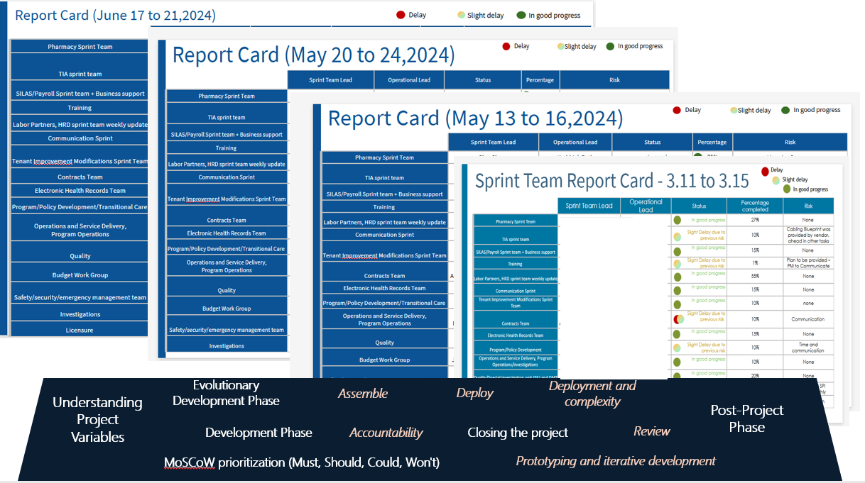
Report Card

Slide 24
CRITICAL TOOLS
Let’s not forget the basic
Basic Project Management
New tools
Some fun DSDM tools
Progress/Planning Status
Report Card
Communication
RAID Log
Team Roaster
Project Status
Decision Log
Staff Log

Slide 25
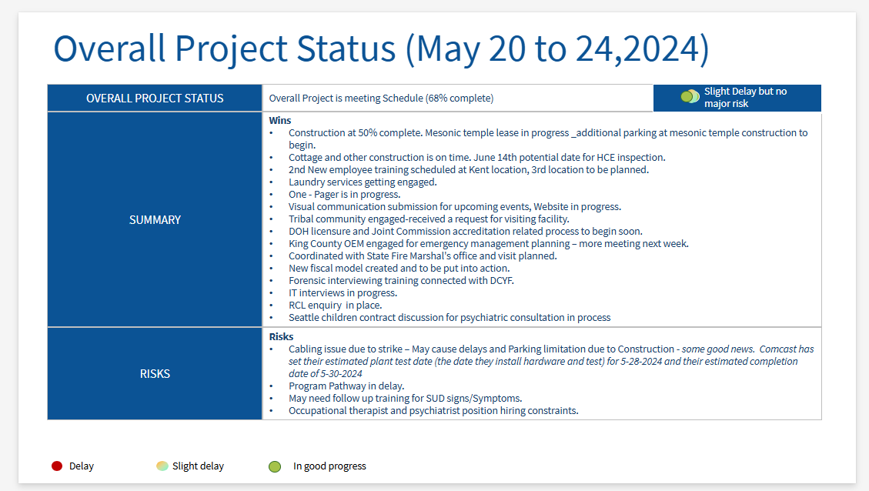
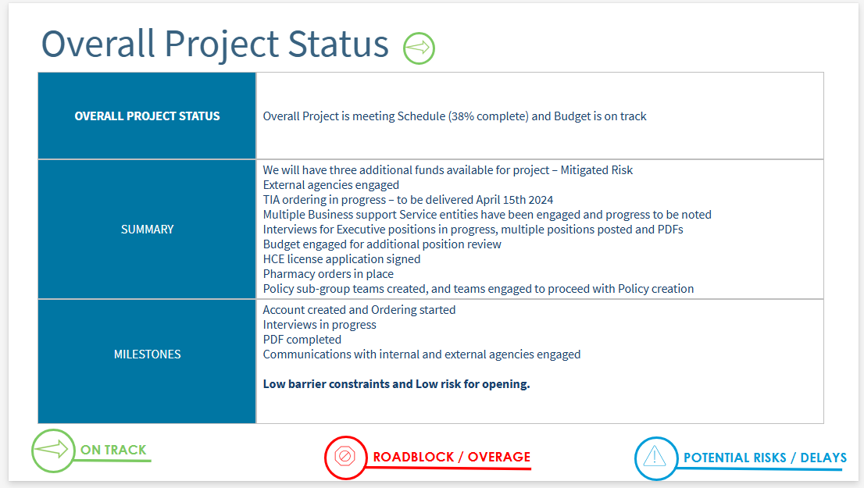
Project Status report
Evolutionary Development Phase
Assemble
Deploy
Deployment and complexity
Understanding Project Variables
Post-Project Phase
Development Phase
Accountability
Closing the project
Review
MoSCoW prioritization (Must, Should, Could, Won't)
Prototyping and iterative development

Slide 26
CRITICAL TOOLS
Let’s not forget the basic
Basic Project Management
New tools
Some fun DSDM tools
Progress/Planning Status
Report Card
Communication
RAID Log
Team Roaster
Project Status
Decision Log
Staff Log

Slide 27
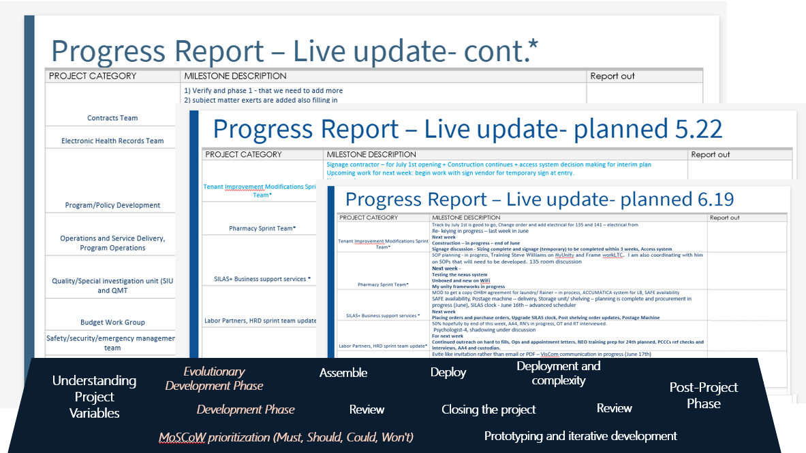
Progress Report

Slide 28
WHAT WORKED WITH LBTCF?
Tasks
80% complete on time
85% met.
Management Objectives
Project Objectives
Implementation Plan
Schedules
One week delay.
100% met.
Customer Objectives
100% met
80% met.
Resources
Needed external help

Slide 29
PROJECT PROGRESS TO COMPLETION
90-DAY TIMELINE
Time
Growth
Total cost
Exceeded by 10 days
Growth rate 5-25%
$12 Million
Burn up chart were used to assess growth
OFM managed funding
Cost model were created
No BAC or CAC created
Cabling strike

Slide 30
TOOLS USED
Dynamic report out
Dynamic planning .
Staff planning/ staff charts
External Documents/Road Maps/ Policy and Procedure
RAID log /Decision log/ Project plan
Communication plan/sprint communication log.

Slide 31
Thank You

