Slide 1
Arizona Management System:
Influencing Culture

Slide 2
People-Centered Government
People are at the center of everything we do
Each agency’s mission statement is a reflection of the ways State Government works to improve people’s lives. Collectively, with focus, we can make a big difference.
Our staff are the most crucial aspect of our work. Building our capacity for good starts with building the capacity of our public servants.
Our systems must be designed with people in mind
Our measures of success should continuously push us to increase the impact our work has on people’s lives.
Our technology and our processes need to be human-centered and meet people where they are.
Notes:
Say: This is the Governor's administration message around the vision for state government. It is the WHAT, at a high level, we are trying to accomplish as a statewide system. We will discuss the more specific priority areas and how AMS fits into this in just a moment. People Centered Government is the what and AMS is the HOW.
Ask: (more of a say) It is important that we all think about how our Agency accomplishes this overarching goal. If you would like to ask the participants how their agency reflects this you may, add 5 min to your slide time for answers
Key points: This slide is intended to introduce the concept of people centered government.

Slide 3
Arizona’s Management System
An intentional, outcomes-driven approach for doing the work of state government so that every employee, at every level, is empowered to improve the lives of the people we serve through measurable improvement and sustainable progress.
Notes:
AMS is the HOW we implement a People Centered Government
Say: This is how we define a Management System. (Break down each section of this long statement and discuss what it means to the agency:)
Intentional, outcomes-driven approach: we focus on strategic planning development and deployment to ensure the most important priorities are achieved. We use driver metrics and results metrics to track our progress, understand how our critical process are operating and adjust as necessary to achieve success.
Every employee, at every level, is empowered to improve lives of the people we serve. We use our foundational elements and their associated behaviors and tools achieve this.
Problem solving and waste elimination are embedded in everything we do. We seek continuous improvement and ensure that employees have the skills and experience to do better for themselves and others everyday.
Ask: Are there any question about this definition?
Key points: For fy 24: you will notice a renewed focus on the people aspect of AMS
Slide time: 1 min

Slide 4
04
01
Improving Education
Why is AMS needed?
02
Housing and
Human Services
The Arizona Management System connects and aligns the long-term goals set for Arizona to the work state employees are doing today.
It gives us a way to focus our collective efforts across the state on making Arizona better for the people we serve.
It's up to us to think about the challenges of TOMORROW and start to address them TODAY through innovation and collaboration.
03
Health Care and
Reproductive Freedom
Resilience, Water
and the Environment
05
Public Safety, Border Security, and Corrections Reform
06
Affordable and
Thriving Economy
07
Infrastructure
Notes:
Say: AMS has historically been focused on helping agencies be efficient and effective in achieving their mission and we have had tremendous success. Over the years we have seen 10s of thousands of agency improvements celebrated across our cabinet and continuous improvement will continue to be foundational to the work we do.
But what I am really excited about is how the approach and work we are talking about today, this improvement engine, is aligned to directly support statewide priorities,outcomes, and long-term goals established for Arizona. So we are going to start with the Governor’s 7 key priority areas.
These goals really drive the Why.

Slide 5
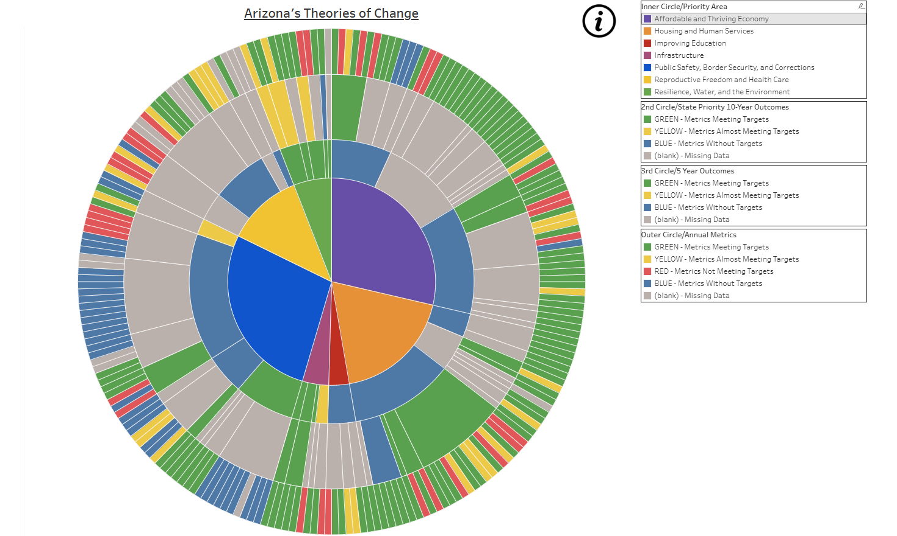
Notes:
Discuss how the Statewide priorities are broken down via Strategic Planning into aligned 10, 5 and 1 year outcomes

Slide 6



Supporting agency success
Examples of how Arizona Management System practices have transformed government services.
Child Services
Transportation
Environmental Quality
99%
Reduction in backlogs, from 16,200 to 178
1.3M
Hours saved annually; average MVD visits under 30 minutes
97%
Faster issue recognition; 25% of services online
Notes:
The effects of practicing continuous improvement in Arizona government have been enormously successful. These are just a few examples from across state agencies of improvements in service:
DCS reduced inactive case backlog from 16,200 to 178 – resulting in improved quality and care for Arizona's children most in need
ADOT reduced MVD customer experience times to under 30 minutes – saving Arizona customers ~1.3 million hours a year
DEQ moved 25% of services online – reducing issue identification timelines from 2 months to 2 days
How was this accomplished? Through agency leadership sponsorship, structured problem solving, coaching, research, trial and error and a lot of hard work from passionate public servants who believe in their agencies’ missions.

Slide 7


Behavior Change & Business Impact
Since implementing AMS
The number of
people who feel they receive recognition for their work has risen by
Agency teams track and use metrics related to their core processes and customers
Agency teams know who their main customers are and what they value
33%
62%
63%
Recognition
Metrics
Customers
Notes:
AMS and continuous improvement has been maturing in the state for over a decade, but it contributes to better culture, better retention, transparent and accountable outcomes and better and more accessible service for Arizonans.
Employee Engagement Survey - we will dive into that a bit more later.

Slide 8
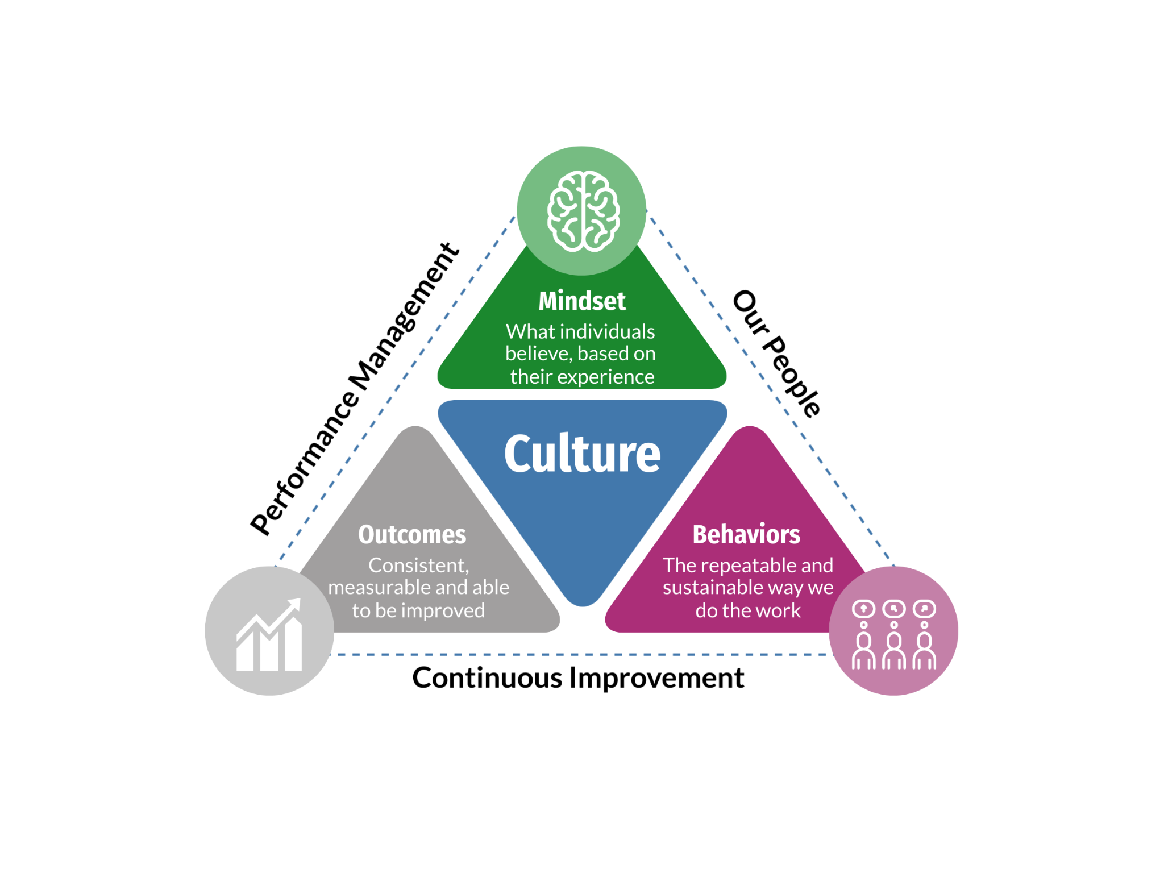



An Arizona for everyone: The culture we want
“Culture eats policy.”
~ Jennifer Pahlka,
Recoding America
Notes:
Say: Read the quote then say: This means that no matter how well-designed your strategic plan is, it will fall flat unless your team shares the appropriate culture. At the end of the day, the people who implement the plan matter.
Refer to the graphic and say: Beginning with the blue Culture Triangle in center:
Every agency has a culture, and it exists whether we want it to or not.
Culture is the shared beliefs, values and practices that both define and distinguish an organization.
3 supporting triangles: Mindset, Behaviors & Outcomes are the components of the system.
Culture embodies the default mindsets and habitual behaviors that combine to deliver consistent outcomes. These outcomes can be good and bad, too, but either way, they result directly from the way people think about and how they do their work.
Unplanned and left to evolve freely over time, organizational culture can become an odd mix of both good and bad habitual behaviors, the tangible evidence of culture.
Approach Elements triangle that surrounds :
But we can also create an intentional culture – one we can be proud of, which is exactly what we’re doing by deploying a Management System in our agencies. It’s an intentional culture built upon a focus around the three foundational elements - Our People, Performance Management and Continuous Improvement
Positive outcomes result as we apply the methods and tools of the system to visually manage performance, solve problems, and commit to excellence at all levels to drive continuous improvement and deliver ever-increasing results for our ever-expanding mission.
Ask: Facilitators choice - no recommendation
Key points: Introduce the 3 components of the system and how they relate to the 3 foundational elements that all work together to build the culture.
Slide time: 2 min

Slide 9
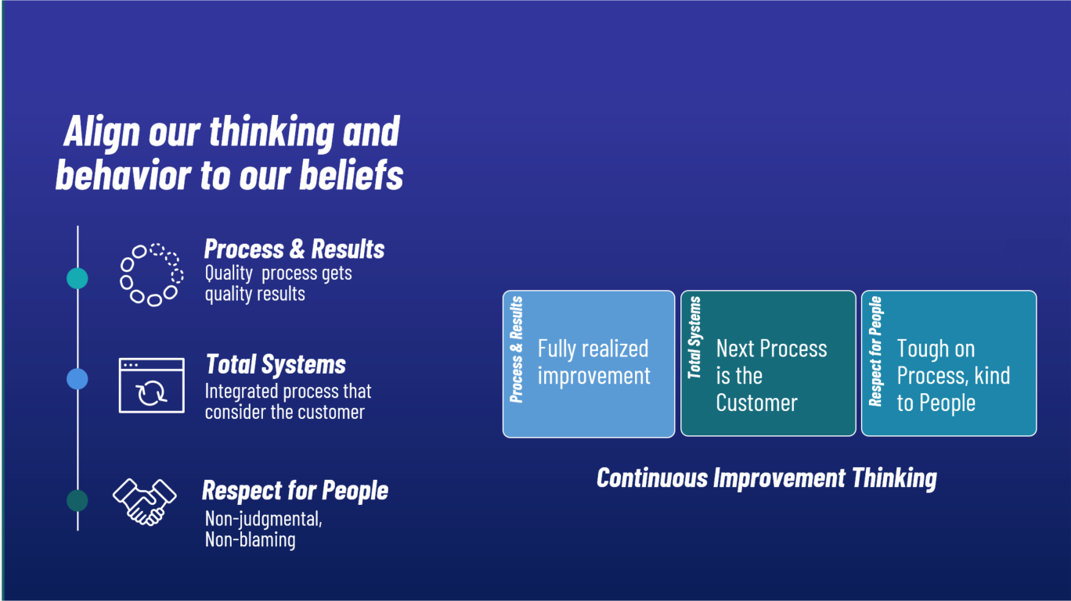
CI Thinking & Principles
Notes:
A cornerstone of AMS is Continuous Improvement - known widely in many industries as Lean management
Our management system creates the culture of continuous improvement
It starts with asking Why? Why do we do our work this way? Why are we having problems? Why are we behind?
4. By creating this culture of continuous improvement, we have improved safety, improved time, flow, value quality, satisfaction and cost.
To achieve that success, we have to begin with thinking & mindset.
Explain these 3 principles are the thinking needed to help us implement and practice CI.
Use this slide to reinforce that this session is about how we think and relate thinking to how we behave; based upon our beliefs.
The purpose of CI or Lean is to tie together our tools, skills, and strategy towards a single focused improvement effort. The principles and practices, or the thinking provide the ‘foundation’ for these tools and skills. Lean tools support/drive the system.
Key Point: Foundation of Continuous Improvement - AMS - IS the Thinking.

Slide 10
Change Mindset
"An organization is a living organism; it has to continue to shed its skin. Methods have to change. Focus has to change. Values have to change. The sum total of those changes is transformation."
- Andrew Grove
Results
Actions
Beliefs
Experiences
Notes:
Use this slide introduce the process of how people change. Connect to BEHAVIORS - reconnect back to slide 9
To use Continuous Improvement thinking and adopt AMS, we have to change our thinking and behaviors.
Explain that everyone has a set of beliefs that drive their actions. These beliefs come from life experiences. Give some examples (e.g. Mom rewarded you for A’s in school, so you believe that A’s matter, so your actions today are: work hard to be the best. Or the opposite: you experienced bad effects if you didn’t please your teachers, so now you make sure that your actions please your managers because your belief is that you will experience bad effects if you don’t.)
Connect that concept to beliefs about problems solving: if your team had a manager who believed that problems should not ever get to the next level up manager, what did that team experience? What are their beliefs about showing problems based on those experiences?
Ask how can we influence the problem solving mindset of our team? (As leaders: CREATE new experiences for them about finding problems, finding ways to see problems earlier, showing problems visually, accept red as useful information, etc. As team Members: be willing to accept red as an opportunity, don’t take it personally, embrace trying the process, be willing to gather data, etc.)
Facilitator additional information:
Use a personal story to illustrate the personal change process if possible. Example: “losing weight” to help clarify the steps involved in creating will, desire, and behaviors to change.
This is a framework – it illustrates how we see things. Changing the framework will cause us to see things differently.
Talk about how Changing our systems (how we operate – rules, processes) will be the most difficult, and is often where organizations turn back and give up, but no gains can be sustained without challenging the systems. Systems change will also require changes in Leadership thinking, because leaders are in charge of systems. Our systems will change if we take the waste out of our core processes.
Key Point: Our challenge is to focus to the daily practice of CI – following CI practices will be the way we change our systems and our culture.
Quote - third CEO of Intel Corporation

Slide 11
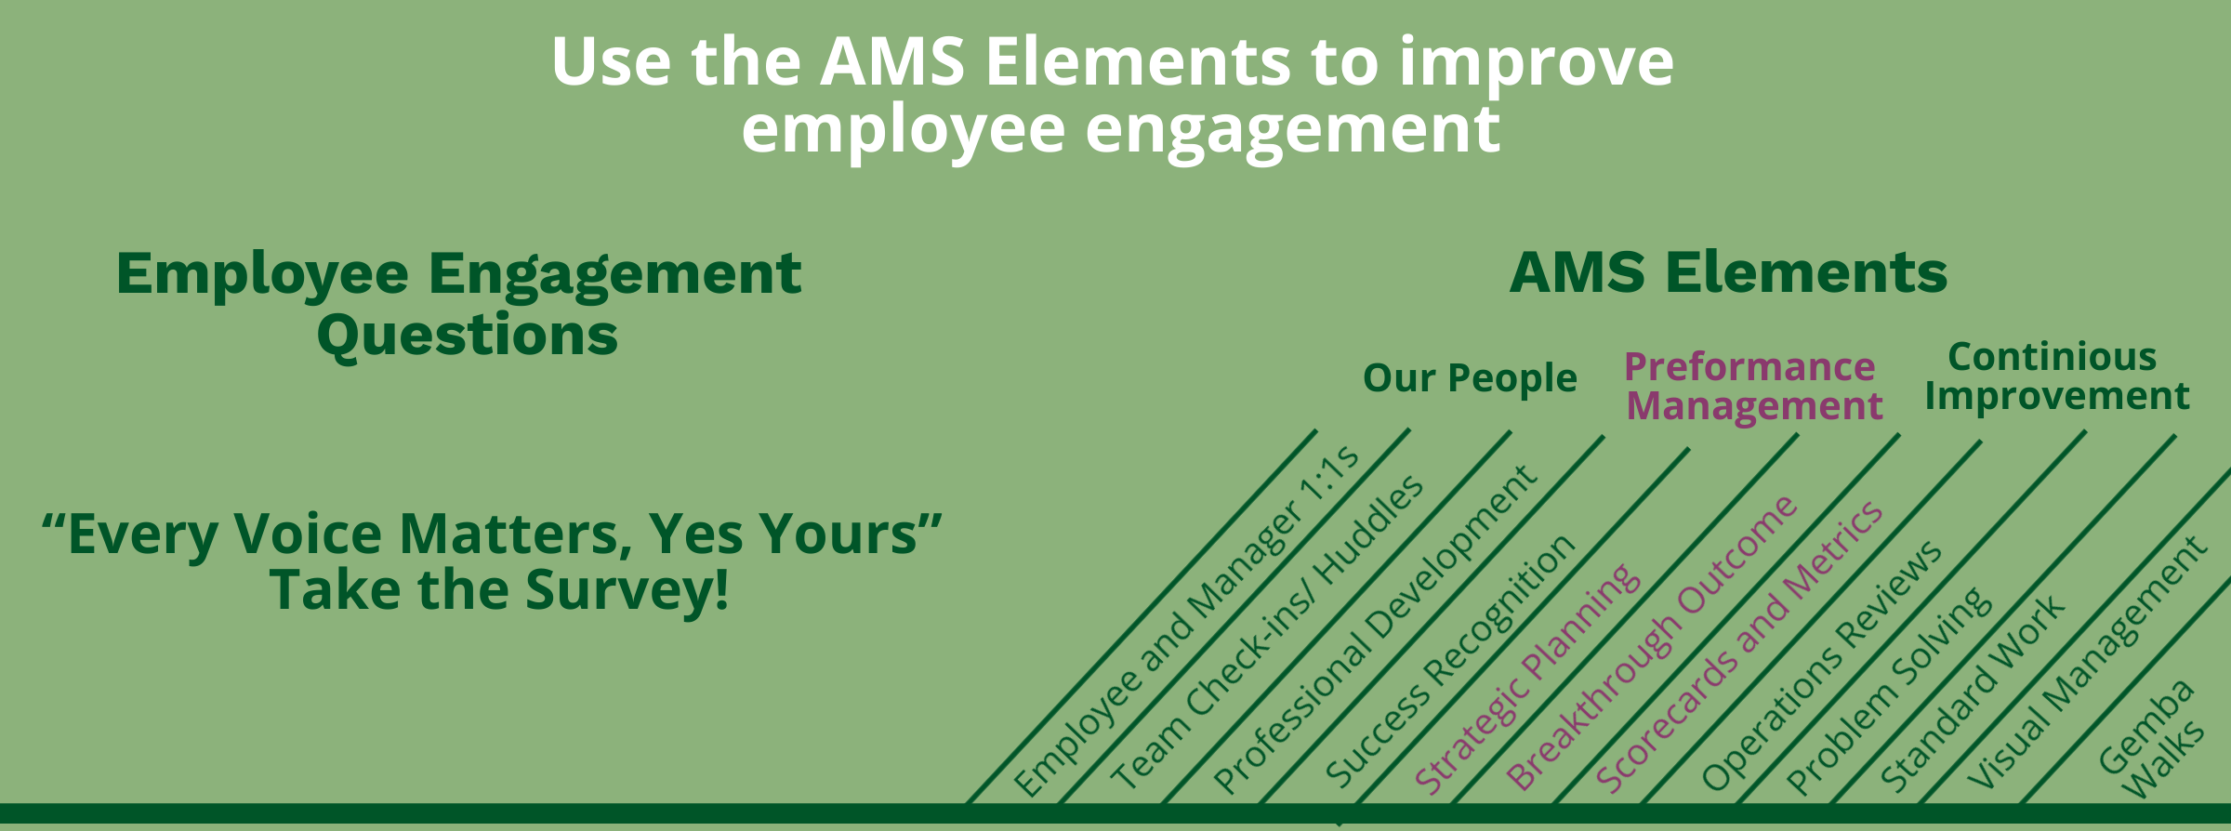
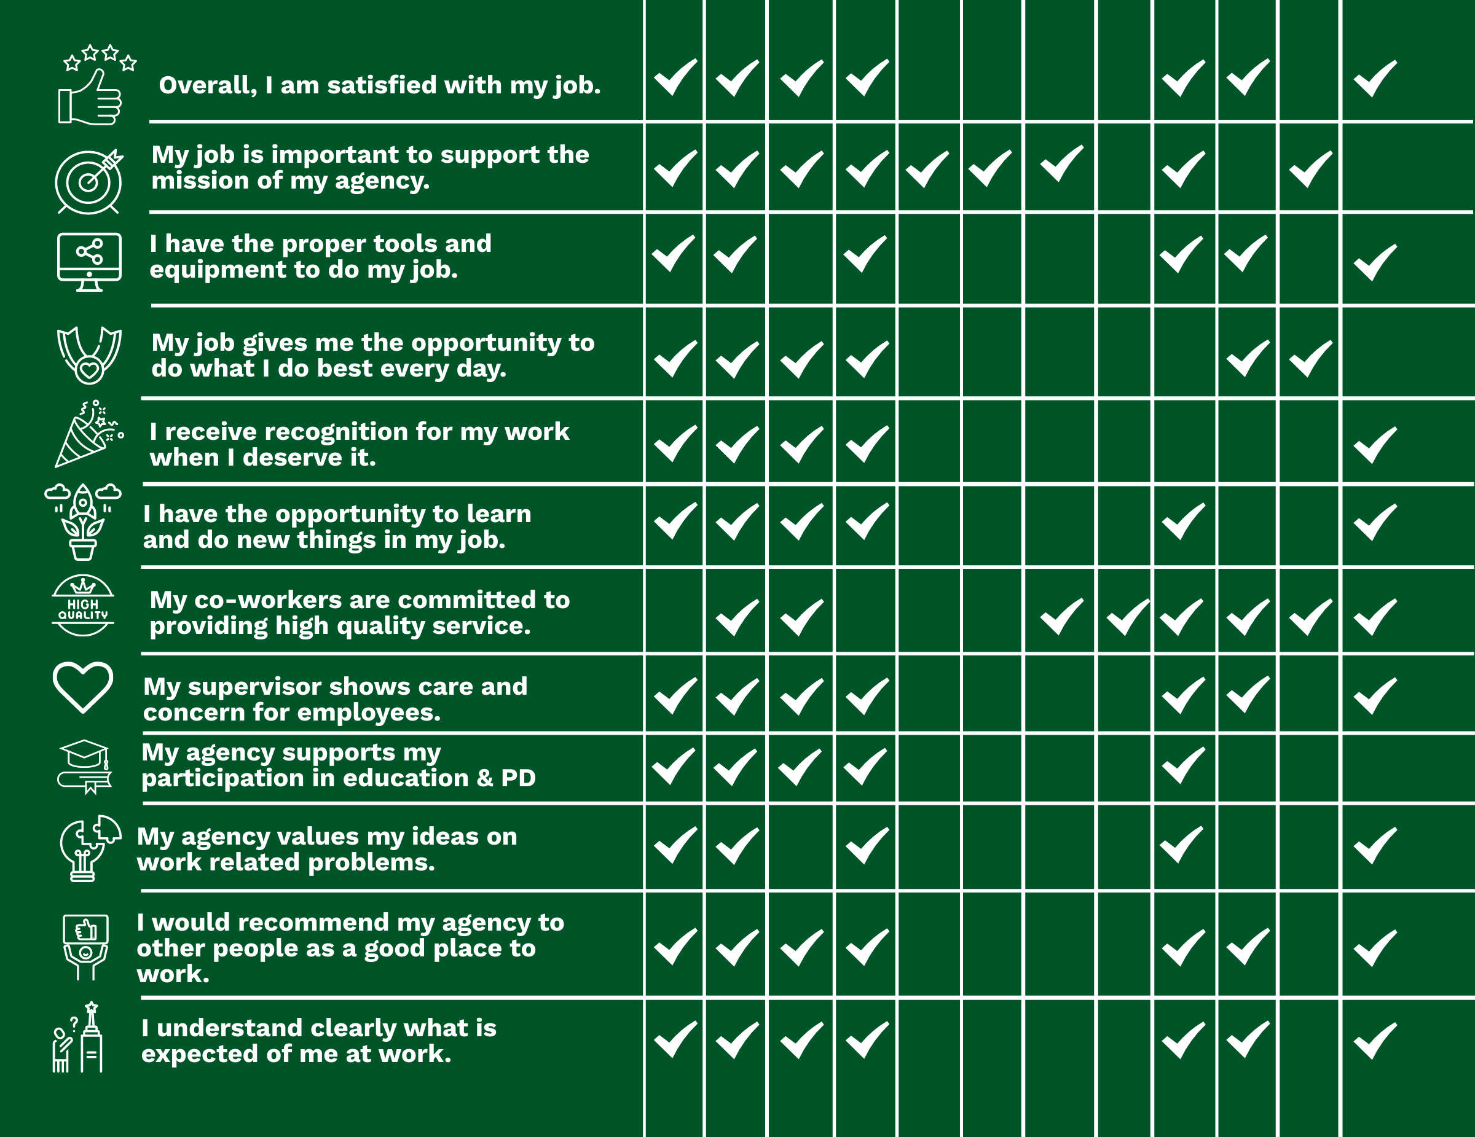
Notes:
AMS helps you achieve high employee engagement!
This graphic shows how the different elements of AMS connect to the questions on the employee engagement survey. This reminds us that AMS isn't just a set of tools or processes, it's a framework for creating a positive and engaging work environment.
Share PDF: https://drive.google.com/file/d/1tMdASPFiRfn6_CcmuUJA4Gk_3svCTzG1/view?usp=drive_link

Slide 12
Actionable Leadership Strategies for AMS
Communicate expectations clearly and frequently
Model the behaviors you want to see
Empower employees to solve
problems & make decisions
Recognize and reward success
Provide regular feedback and coaching
Support employee development and growth
Encourage innovation and creativity
Notes:
HOW? Use the tools!
This is a high level list - In our next section we are going to break down where in the management system you are going to put these strategies in place. Let’s look at each element and it’s associated behaviors

Slide 13



Foundational elements
Our People
Performance Management
Continuous Improvement
Employee and Manager 1:1s
Team Check-ins
Professional Development
Success Recognition
Strategic Planning
Breakthrough Outcomes
Scorecards and Metrics
Operations Review
Problem Solving and Experimentation
Standard Work
Visual Management
Gemba Walks

Slide 14
Measuring AMS Health
The AMS Assessment

Slide 15
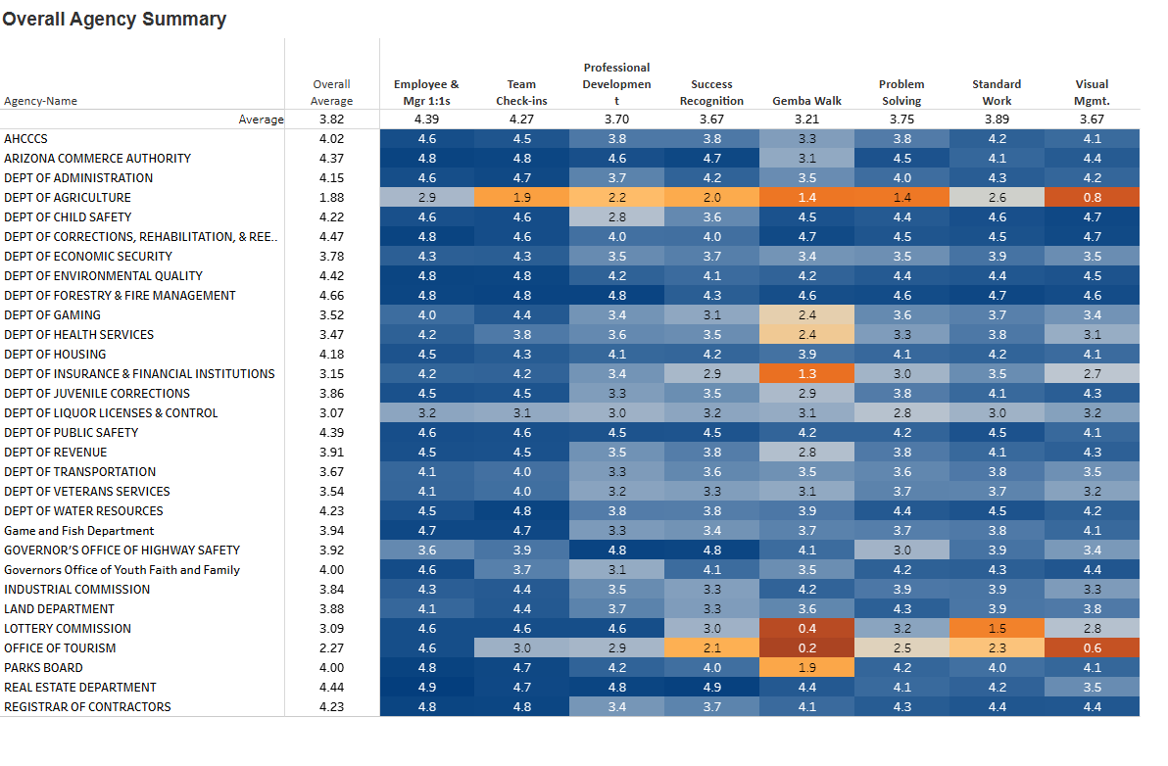
Measuring AMS Health - The AMS Assessment
For each Element the Assessment asks:
Do you have Standard Work for this element? Answered as a single “Yes/No” question.
What level of Awareness and Understanding exists for this element? Answered in 5 levels
Is the team Consistent in its application of standard work for this Element? Answered as % of time applied.
Does the team exhibit the Behaviors of this Element and achieve positive Results by doing so? Answered as a series of “Yes/No” questions.
Notes:
Each Element has a maximum score of 5 points. The bar chart to the right shows the breakdown of the 5 points available for each Element.
For each Element the Assessment asks:
Do you have Standard Work for this element? Answered as a single “Yes/No” question.
What level of Awareness and Understanding exists for this element? Answered in 5 levels (see Table 1).
Is the team Consistent in its application of standard work for this Element? Answered as % of time applied.
Does the team exhibit the Behaviors of this Element and achieve positive Results by doing so? Answered as a series of “Yes/No” questions.
Table 1: Awareness & Understanding Question - Scoring and Description
Score in AMS Assessment
Score for Calculation
Description
1 - Little / None
0.2
Team has not been introduced to or has minimal awareness of the element.
2 - Understanding
0.4
Team understands and can describe the element.
3 - Applying
0.6
Team has an understanding of how the element is applied and can evaluate the value to the work/activity.
4 - Managing
0.8
Additionally, at least 10-20% of the team have a detailed understanding of how the element is applied, and can critically evaluate and manage the work/activity.
5 - Coaching
1.0
Additionally, at least 5-10% of the team have a detailed understanding of how the element is applied within complex situations/activities and can coach others as required.

Slide 16
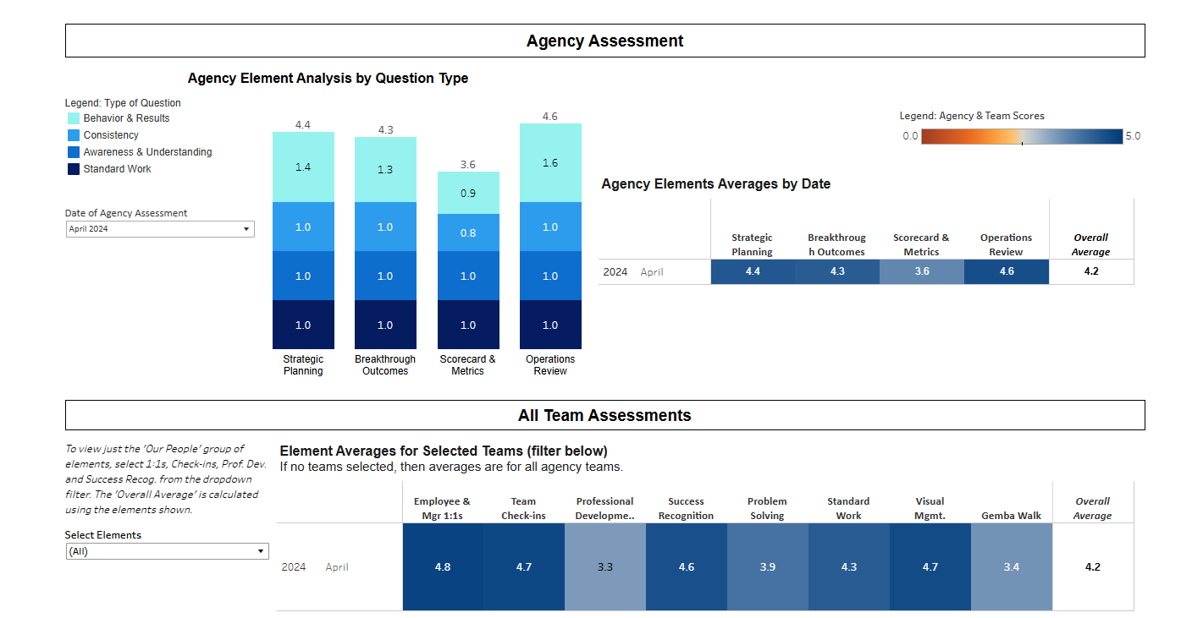
Notes:
Break down the visual

Slide 17
Celebrating Success
Excellence in Government Awards

Slide 18


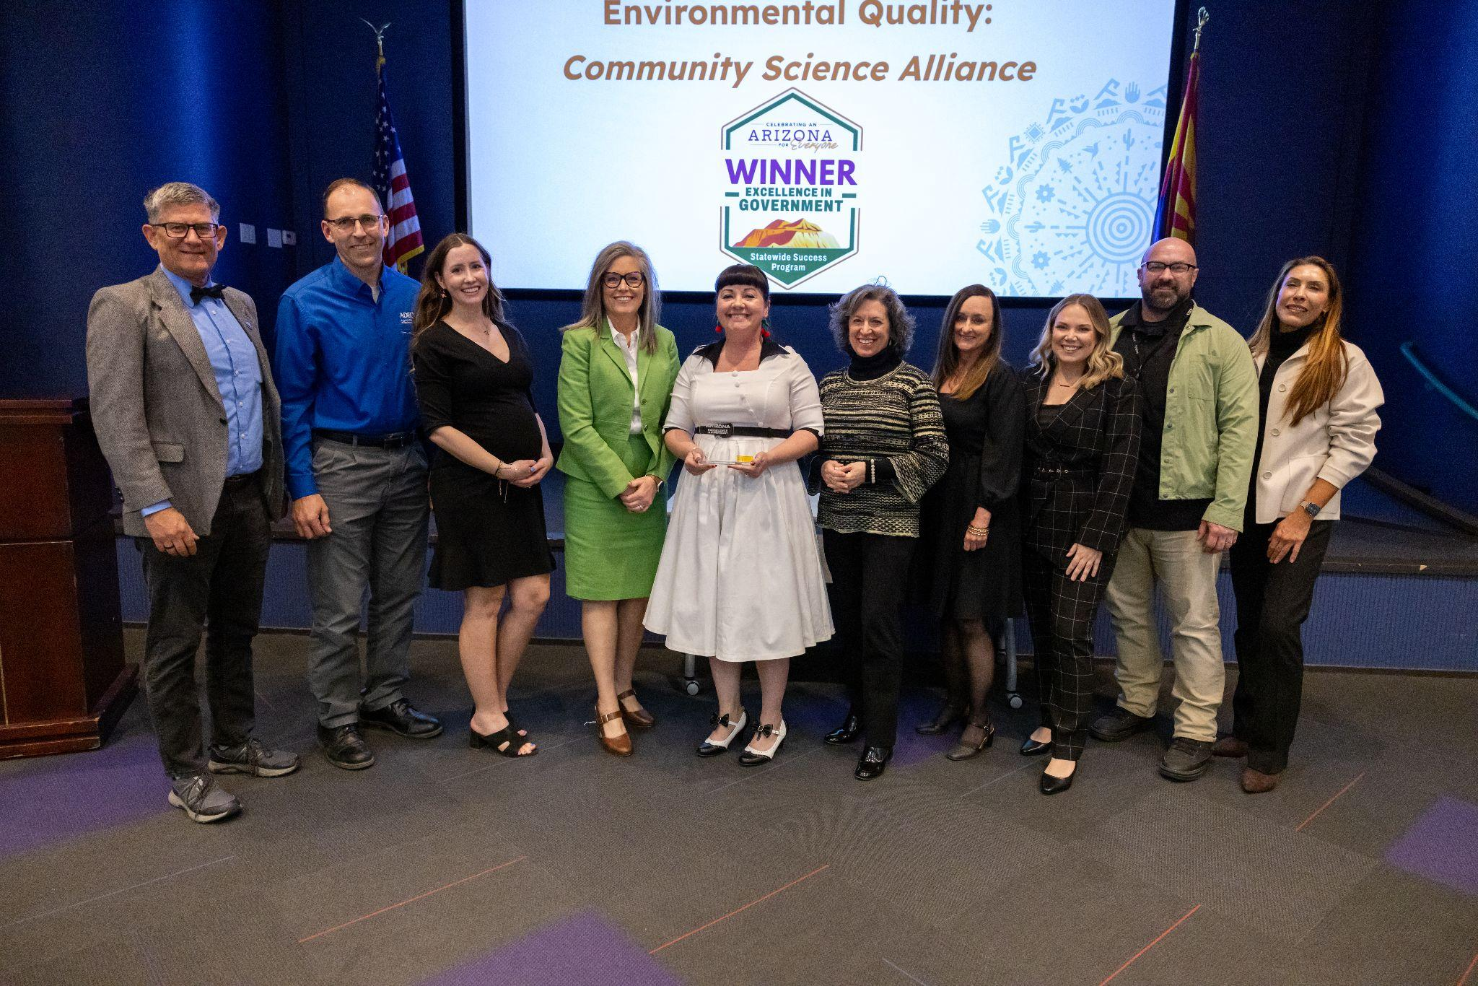
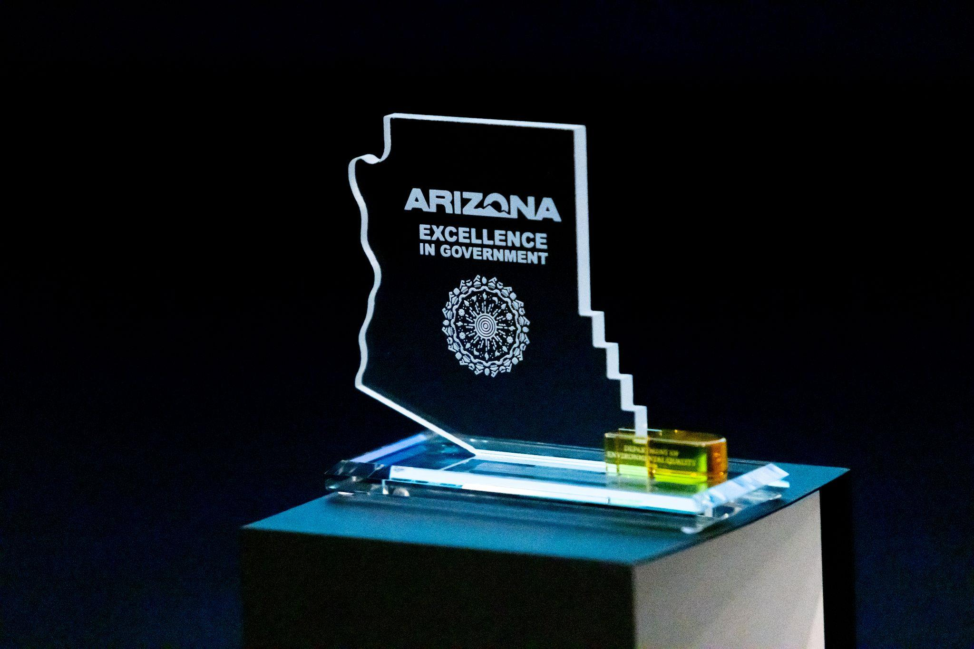
First of its kind Agency Recognition Program
Notes:
Discuss Award program

Slide 19
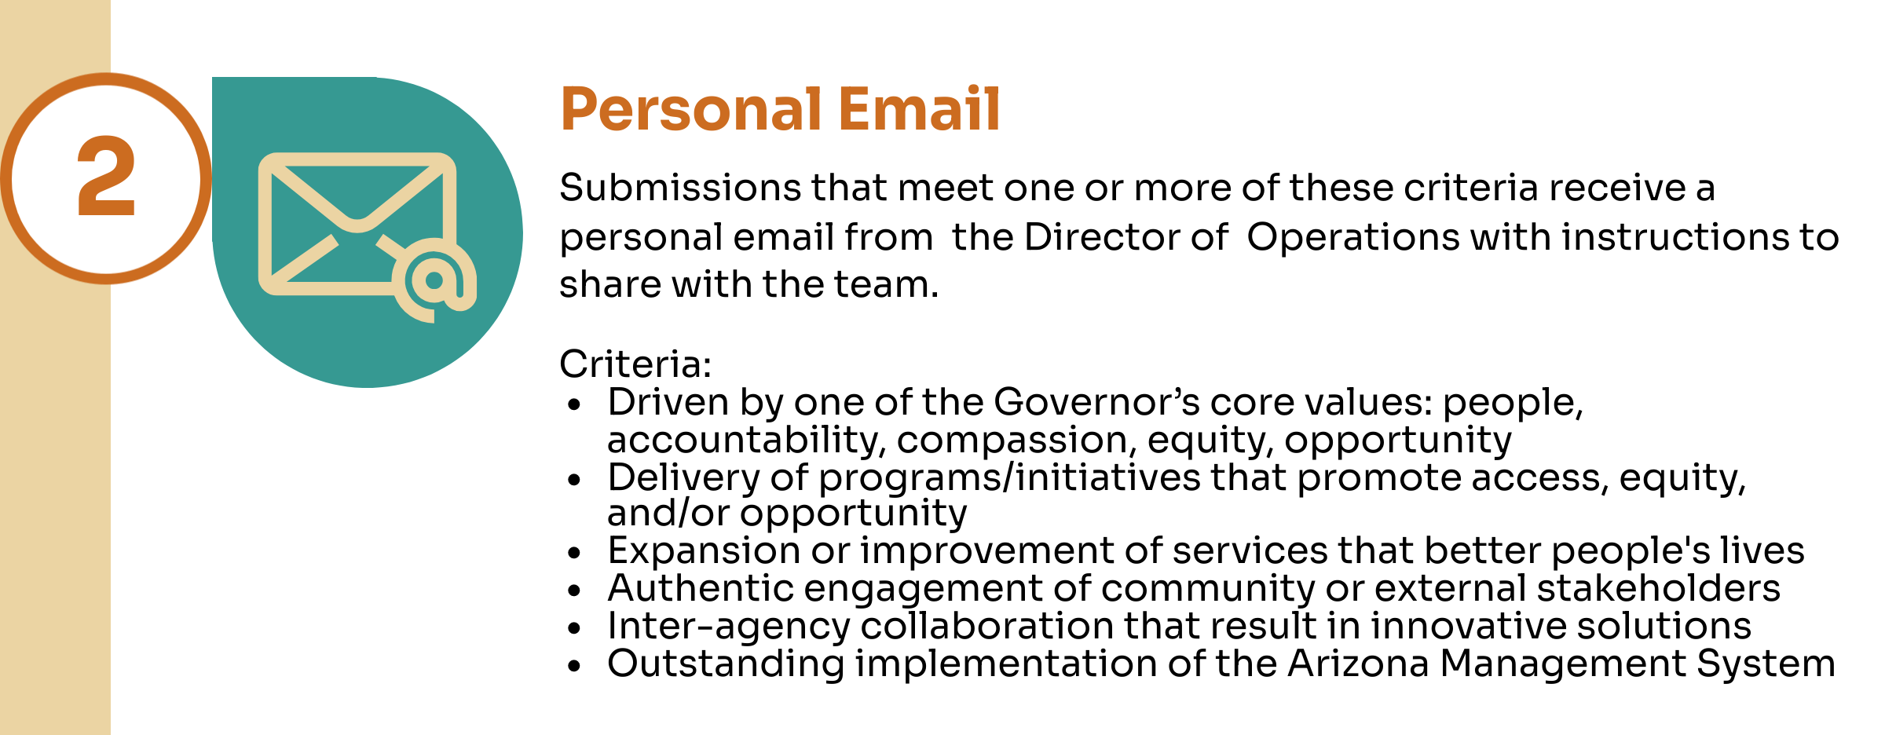
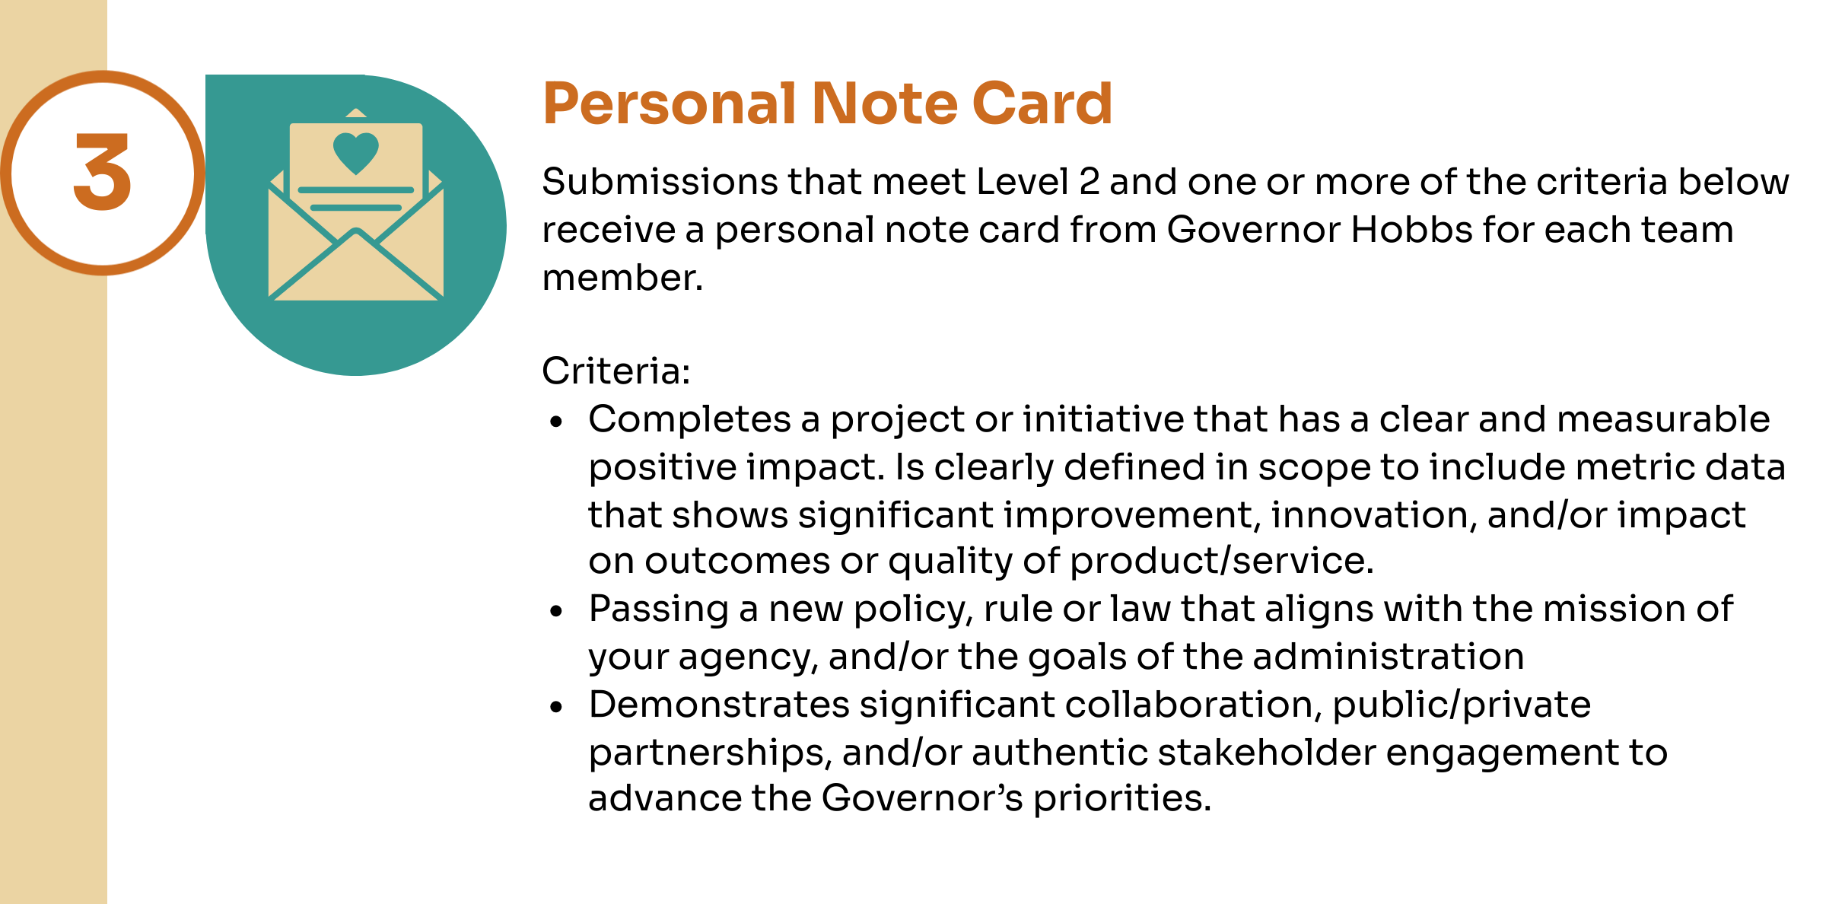
Notes:
Program criteria

Slide 20
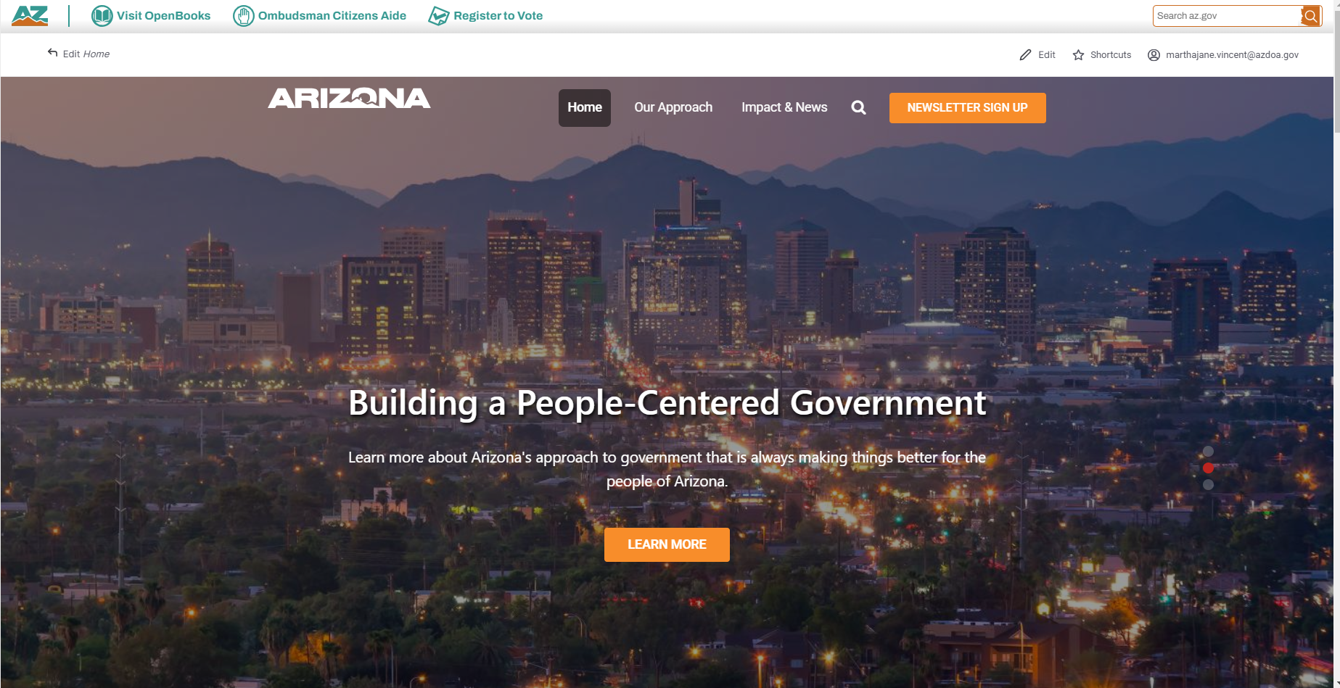
Resources & Questions
https://results.az.gov/

