Slide 1

Lighting Up Insights: The Power of Heat Maps in Process Data Visualization
Notes:
Photo by Ray Hennessy on Unsplash

Slide 2


Before we start…
What do you expect
to take away from this session?
Notes:
Photo by Nagara Oyodo on Unsplash

Slide 3

Agenda
The Problem with Prioritizing
What Makes the Difference
The Heat Maps
The Questionnaire
Where to Start
Q&A
Notes:
Photo by Marissa Grootes on Unsplash

Slide 4
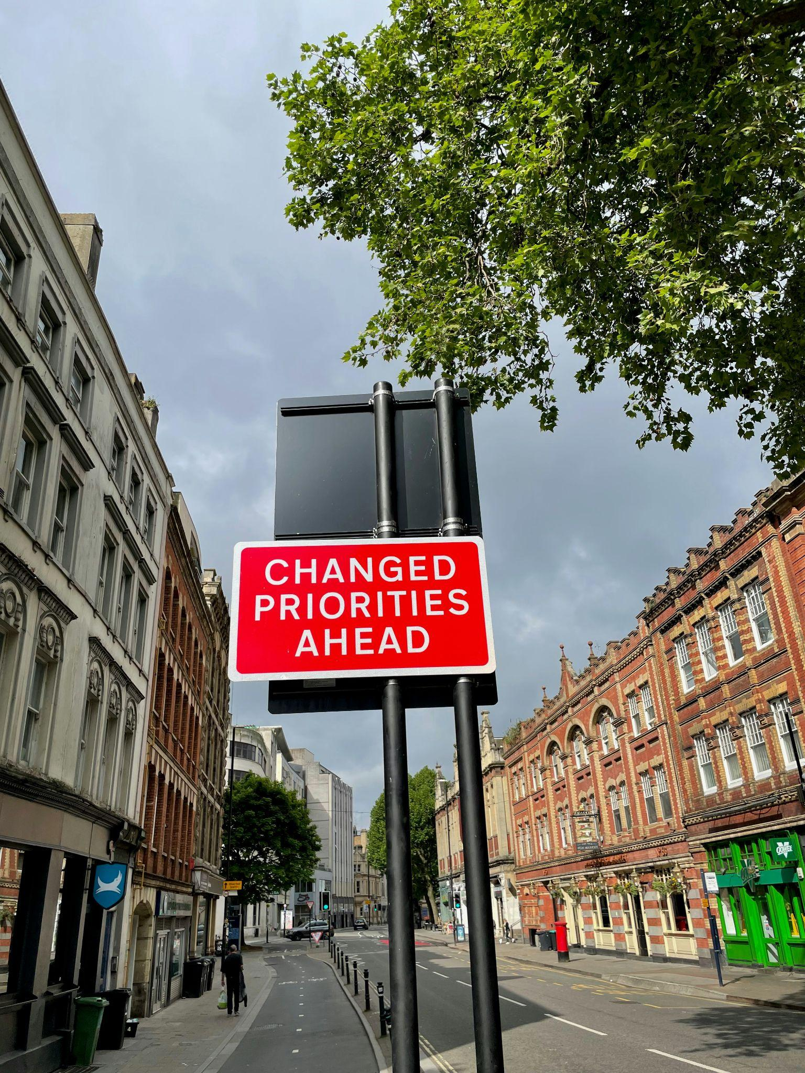
What is prioritization? Why do we need it?
Effective resource allocation
Improved decision-making
Alignment with goals
Signals impact and urgency
Notes:
Photo by Ch_pski on Unsplash

Slide 5
The problem with prioritization
Skipping prioritization
Overextending focus
Misaligned focus
Lack of strategic perspective
Distraction by minor details
Weak alignment with business goals
Narrow criteria for prioritization
Lack of stakeholder input

Slide 6

What makes the difference
The stories we tell
The images we illustrate them with
Notes:
Photo by Jonas Jacobsson on Unsplash

Slide 7
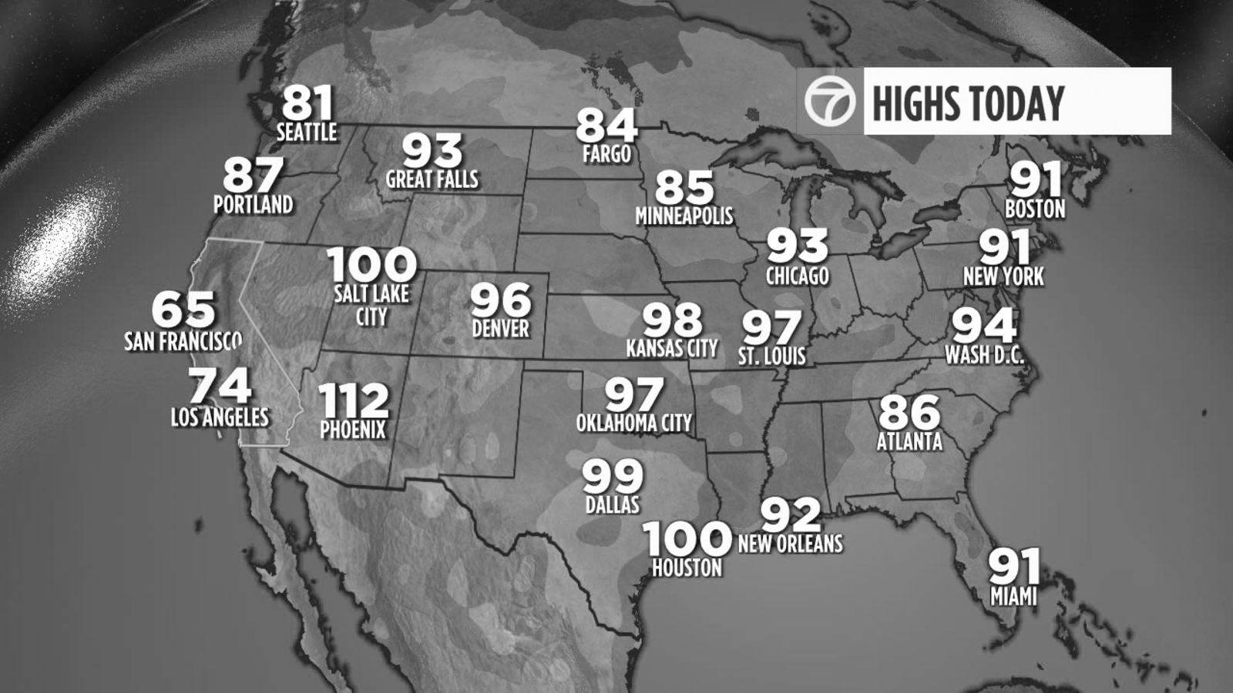
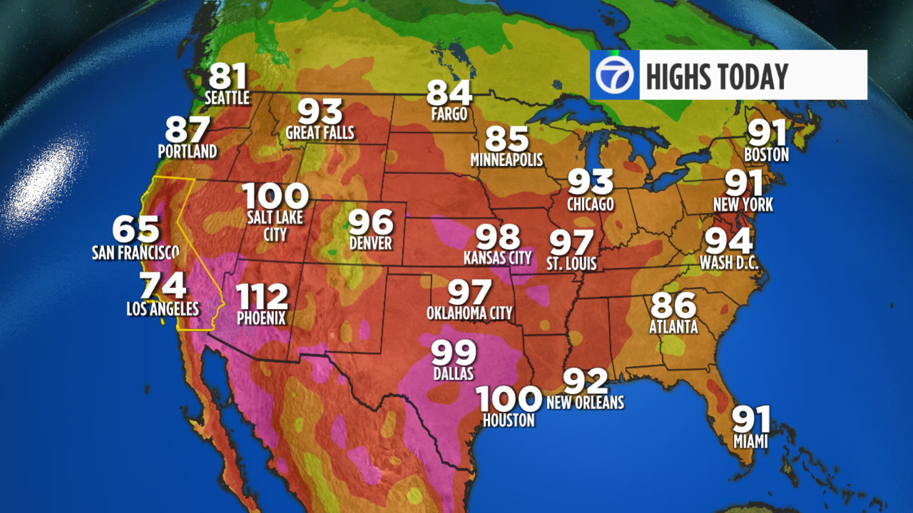
Why Heat Maps?
Pictures by ABC7 from July 2022

Slide 8

How to use this prioritization exercise
(and keep going)
5 - Create roadmap of opportunities
1- Catalog the processes
4 - Generate heatmap
2 - Assess each process on the scale
3 - Validate assessments
Notes:
Photo by Braden Collum on Unsplash

Slide 9

The Questionnaire
Process Basics
Information about the process:
category, population impacted, frequency, SMEs, stakeholders
Process Assessment
Process maturity
Process documentation
Automation level
Customer experience
Fulfiller experience
Notes:
Photo by Celpax on Unsplash

Slide 10
Definitions
Process Maturity
Ad-hoc – the process is reactive and not consistent.
(Often described with ”on a case-by-case basis”, “it depends”)
Standardized – the process is stabilized and consistent across the organization (won’t differ significantly if the operator changes, often means that the process is standardized geographically)
Optimized – the process had gone through some type of transformation or improvement and is considered “in good shape”
(Think metrics, dashboards and advanced analytics)
Process automation
Manual - 0-15% automated
Assisted 16-30% automated
Supported 31-49% automated
Managed 50-65% automated
Advanced 66-80% automated
Digitized 81-95% automated
Automated 96-100% automated
Process Documentation
Nonexistent – no available documentation about the process
Insufficient – to little documentation (can also be outdated, have significant gap)
Sufficient – just enough high-level documentation for general process understanding or audit
Comprehensive – all required information about the process can be found in the process documents (policies, process maps, FAQs, etc.)
Experience (customer / fulfiller)
Unsatisfactory – experience is not acceptable
Satisfactory – represents acceptable level of satisfaction with the process
Good – represents “good enough” level of satisfaction with the process
Excellent – represents highest level of satisfaction with the process
Not available – information is not available or is not statistically significant

Slide 11
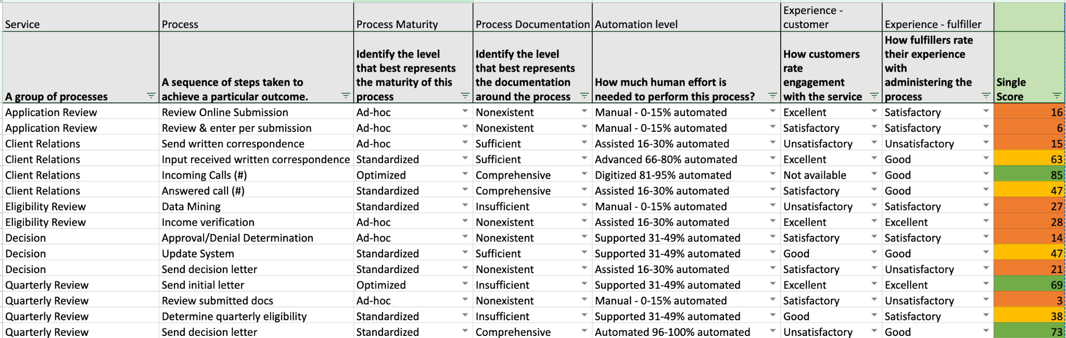
Questionnaire Sample

Slide 12
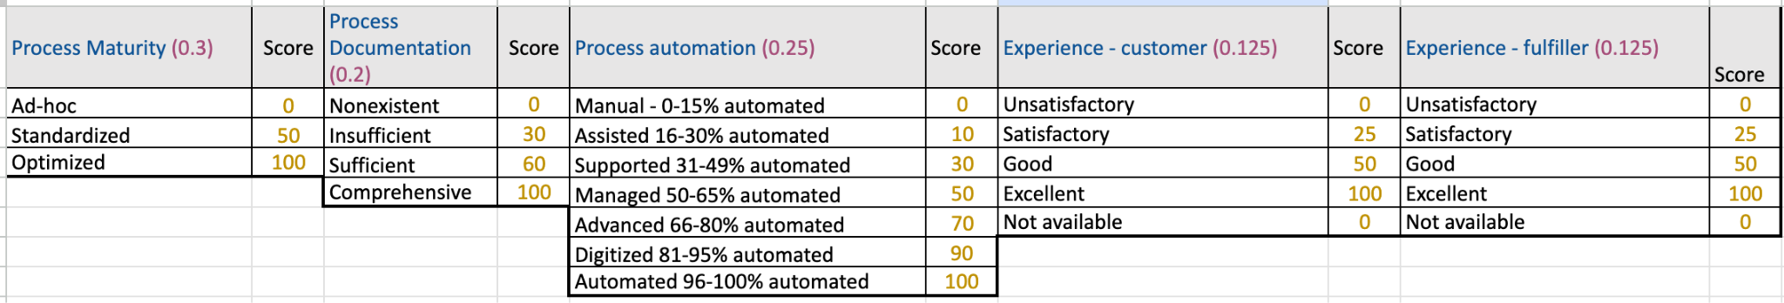
The Questionnaire
Weight
Criteria
Score

Slide 13

Add a pop of color!
Notes:
Photo by engin akyurt on Unsplash

Slide 14
The Heat Map – “Medicaid process”
Application Review | Client Relations | Eligibility Review | Decision | Quarterly Review
Review Online Submission | Send written correspondence | Data Mining | Approval/Denial Determination | Send initial letter
Review & enter per submission | Input received written correspondence | Income verification | Update System | Review submitted docs
 | Incoming Calls (#) |  | Send decision letter | Determine quarterly eligibility
 | Answered call (#) |  |  | Send decision letter
16
15
27
14
69
6
63
28
47
3
85
21
38
Legend
 | 67-100 | Low
 | 34-66 | Medium
 | 0-33 | High
 | n/a | n/a
47
73
Not real data. For training purposes only.

Slide 15

Heat maps - what do we get out of it?
Highlight strategic overview
Show trends
Compare on the same scale
Help orient faster
Facilitate collaboration
Support transparency
Drive prioritization
Notes:
Photo by Şahin Sezer Dinçer on Unsplash

Slide 16

Tips for successful implementation
Secure executive support
Start small and iterate
Be consistent
Stay flexible
Maintain focus
Communicate early and often
Measure and showcase results
Notes:
Photo by Frederik Löwer on Unsplash

Slide 17

Instead of conclusion
It’s a marathon not a sprint
Tools don’t change behaviors, conversations do
Build a network of allies
Notes:
Photo by x ) on Unsplash

Slide 18

Have a question? Contact me!
LinkedIn:
https://www.linkedin.com/in/ozhuravel/
Email:
olga.zhuravel@snowflake.com

