Slide 1



BEYOND RESOLUTIONS:
The Science of Building Lasting Habits
Presented by Jeannie Bowen – Results Washington
1/21/2025
Based on the book Atomic Habits by James Clear

Slide 2

What is something that feels productive to you in the moment..
..but usually ends up wasting time and energy?
Put your answers in the chat!

Slide 3

Make big plans.
Build small habits.
Start small, but never dream small!
James Clear Atomic Habits

Slide 4

Visioning
Having clarity of purpose and vision is the first step in goal setting.

Slide 5

“Imagine a world in which every single person is given free access to the sum of all human knowledge”

Slide 6
“To create a better everyday life for many people”

Slide 7
“Bring inspiration and innovation to every athlete in the world”

Slide 8

Action Planning
Creating your vision

Slide 9
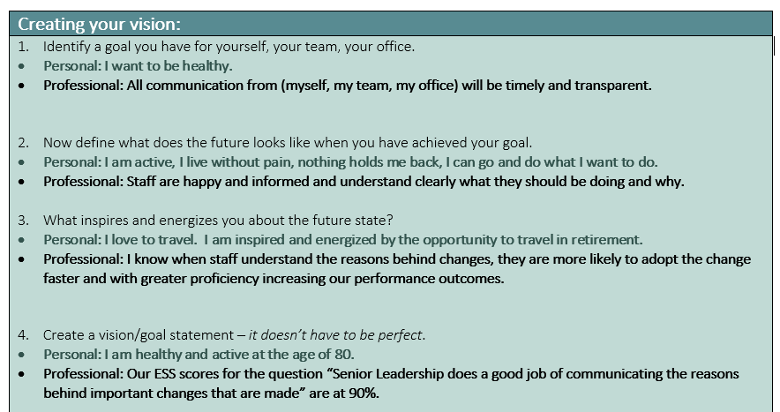
Creating Your Vision Template Screenshot

Slide 10

Willing to Share?

Slide 11

Keep Your Vision In Mind…
Fast forward 6 months and assume that you have not made any progress towards your goal.
Why have you failed?
Put your responses in the chat!

Slide 12
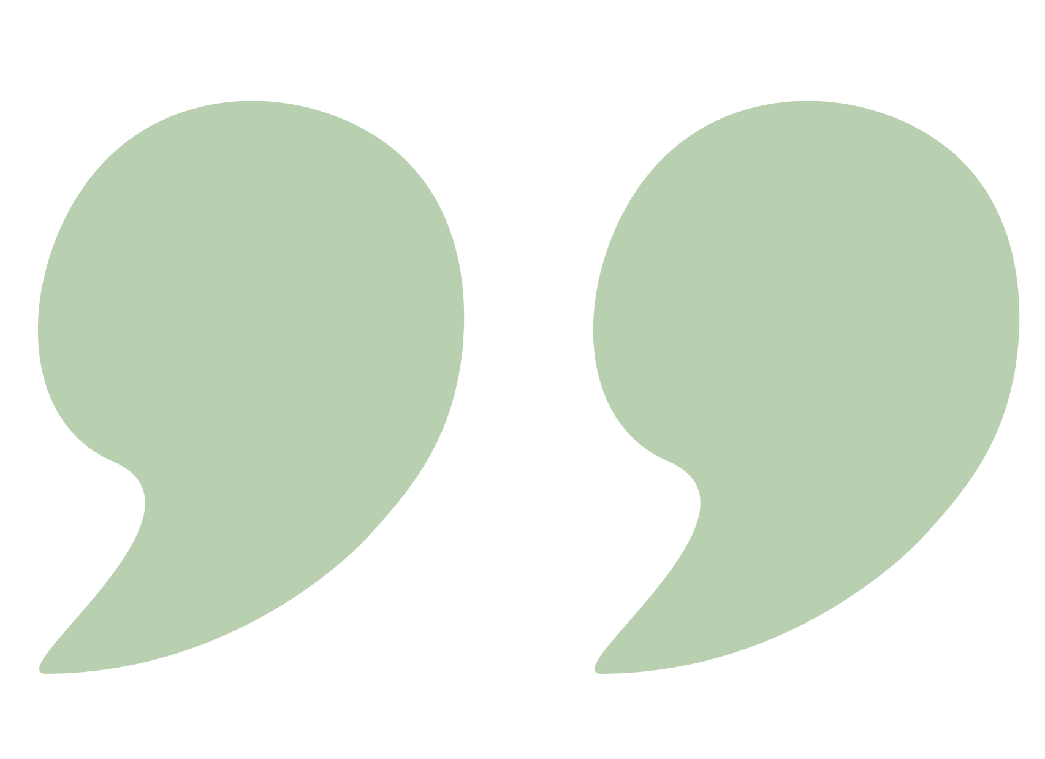
Don’t let your previous choices set your future ceiling.

Slide 13


Tactical Success is a Two Step Process
IDENTITY
SMALL WINS
Culture eats strategy for breakfast
Slow and steady wins the race

Slide 14

Identity
True behavior change is identity change.

Slide 15
Action Planning
Action Planning: Creating Your Identity
Creating your identity

Slide 16
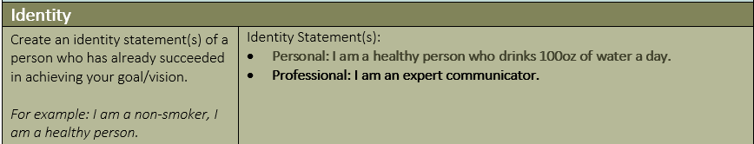
Creating your identity screenshot

Slide 17
Willing to Share?
Willing to Share Your Identity

Slide 18

Small Wins
Each new habit you sustain in contribution to your vision/goal is a small win.

Slide 19
Action Planning
Action Planning: One 2-minute action you can take
One 2-minute action you can take

Slide 20
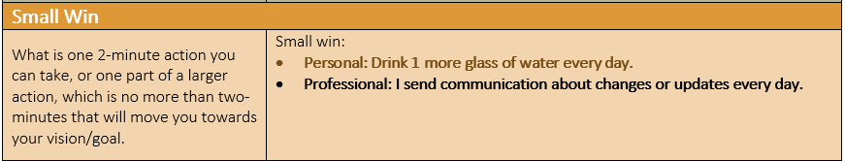
Identifying small wins

Slide 21
Willing to Share?

Slide 22
Every action you take is a vote for the type of person you wish to become.

Slide 23




4
Four Laws of Behavior Change
Make it obvious
Make it attractive
Make it easy
Make it satisfying

Slide 24
You only need to know the direction, not the destination. The direction is enough to make the next choice.

Slide 25
1) Make it Obvious
Create an intention
Stack your habit

Slide 26
Action Planning
Action Planning: Create your implementation intention and habit stack
Create your implementation intention and habit stack.

Slide 27
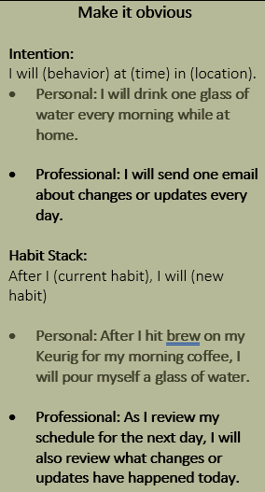
Making it obvious screenshot

Slide 28
Willing to Share?

Slide 29
The purpose of setting goals is to win the game. The purpose of developing systems is to continue playing the game.

Slide 30
2) Make it Attractive
Temptation Bundling

Slide 31
Action Planning
Action Planning: Create a temptation bundle
Create a temptation bundle

Slide 32
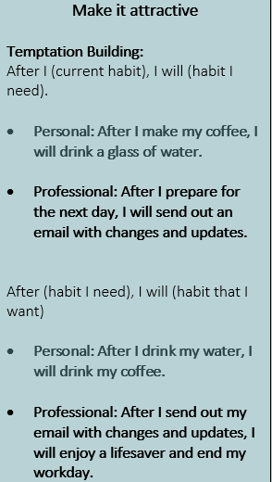
Making it attractive screenshot

Slide 33
Willing to Share?

Slide 34
You should be far more concerned with your current trajectory, than with your current results.

Slide 35
3) Make it Easy
Law of least effort

Slide 36
Action Planning
Action Planning: Prime your environment
Prime your environment

Slide 37
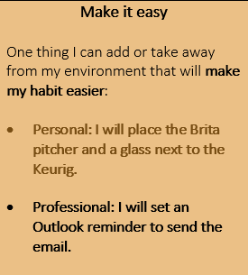
Make it easy screenshot

Slide 38
Willing to Share?

Slide 39
If you can get 1% better each day for a year, you will end up 37 times better by the time you are done.

Slide 40
Tie your habit to an immediate reward
4) Make it Satisfying

Slide 41
Action Planning
Action Planning: Identify your reward
Identify your reward

Slide 42
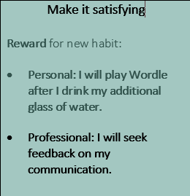
Make it satisfying screenshot

Slide 43
Willing to Share?

Slide 44
You don’t rise to the level of your goals, you fall to the level of your systems.

Slide 45

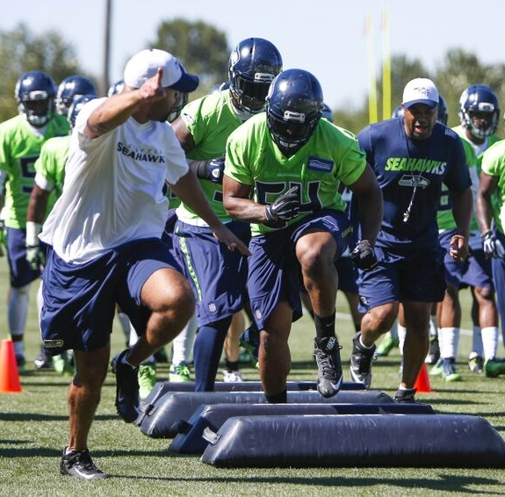

Dream Big
Build Small Habits
Success!

